Slide 1

Company Logo
AI Strategy Review
Concierge Service

Slide 2
Purpose of the Document
Intent
The purpose of this document is to provide an external review of your current AI strategy.
Approach and Methodology
This document contains the results of Info-Tech’s AI Strategy Review Concierge Service. The review leverages Info-Tech’s best-practice methodology and research as well as industry expertise to derive insights around the recommendations. The approach taken to score and analyze the results is broken into two distinct categories that are characteristic of leading practices when designing an IT strategy:
  Must-haves: Characteristics that must be present (at minimum) for the strategy to be considered viable to meet its intended AI goals and align to business objectives. These are indicated in purple on the scorecard.
  Nice-to-haves: Characteristics that are not mandatory but provide incremental value to the AI strategy to have a clear diagnosis of the problem, clarity in the scope and objectives, and a coherent articulation of the approach that is action-oriented and comfortable with debate and ambiguity. These are indicated in light blue on the scorecard.
Inherent Limitations
This document has been prepared on a confidential basis for the internal use of _________________ (Member Name). Info-Tech Research Group (ITRG) neither warrants nor represents that the information contained in this research report is accurate, complete, sufficient, or appropriate for use by any person or entity other than __________ (the Member) for the purposes of reviewing the AI strategy.

Slide 3
Interpretation of Results
Info-Tech’s approach to IT strategy assessment focuses on 5 key dimensions
Definition of Dimensions
AI Strategy Foundations: Provide context on AI vision, goals, strategic principles, foundational (responsible) principles.
AI Maturity: Measure the AI readiness based on five maturity dimensions; AI governance, data management, people and talent, AI processes and technology.
AI Use Case Discovery: Focuses on candidate AI use case list and their prioritization based on feasibility and value.
Use Case Details: Clear descriptions of AI use cases appropriately aligned to enable and drive business value.
AI Roadmap: Identifies explicit timelines for each of AI initiatives.

Slide 4
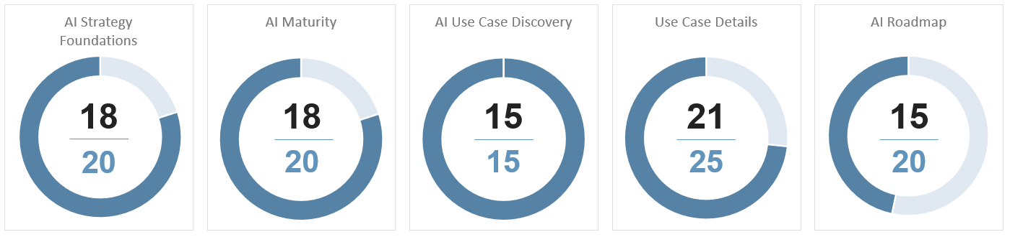
Executive Summary
Top Insights Here
86.7
Overall Score

Slide 5
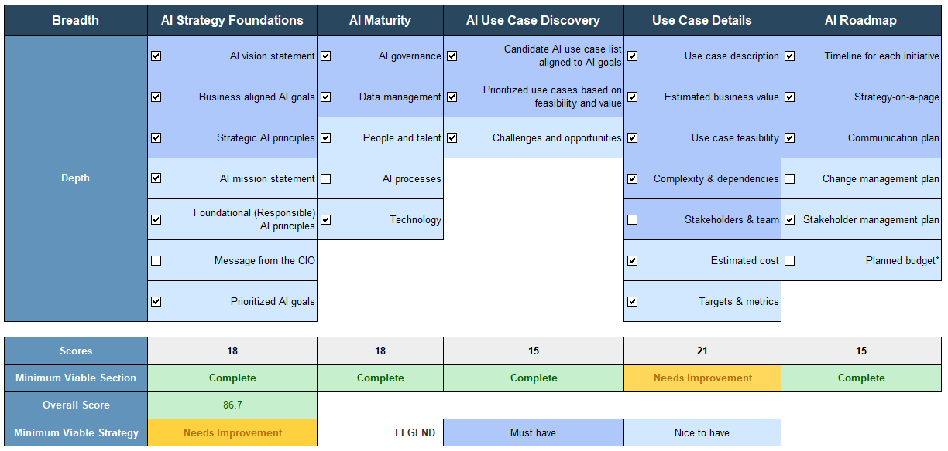
Complete Scorecard Results
Top Insights Here
Write more details about overall breadth and depth of findings.

Slide 6
Recommendations to Achieve a Minimum Viable Strategy
Delete whichever red arrows you do NOT need and then delete this box.
Build out the required depth for each of these criteria.
AI Strategy Foundations | AI Maturity | AI Use Case Discovery | Use Case Details | AI Roadmap
Recommendations on what to build
AI Strategy Foundations
AI vision statement
Business aligned AI goals
Strategic AI principles
AI Maturity
AI governance
Data management
AI Use Case Discovery
Candidate AI use case list aligned to AI goals
Prioritized use cases based on feasibility and value
Use Case Details
Use case descriptions
Estimated business value
Use case feasibility
Complexity & dependencies
Stakeholder & team
AI Roadmap
Timeline for each initiative
Strategy on a page
Communication plan

Slide 7
Recommendations to Improve Upon the Depth of Your Strategy
Delete whichever red arrows you do NOT need and then delete this box.
Build out the required depth for each of these criteria.
AI Strategy Foundations | AI Maturity | AI Use Case Discovery | Use Case Details | AI Roadmap
Recommendations on what to build
AI Strategy Foundations
AI mission statement
Foundational (responsible) AI principles
Message from the CIO
Prioritized AI goals
AI Maturity
People and talent
AI processes
Technology
AI Use Case Discovery
Challenges and opportunities
Use Case Details
Estimated cost
Target and metrics
AI Roadmap
Change management plan
Stakeholder management plan
Planned budget

Slide 8
Change the boxes to have either green or yellow on top. Make sure the green and yellow are selected from THEME COLORS in “Shape Fill.” Delete whichever boxes are not needed.
Strategy Foundations – Assessment
Write a sentence that contains the most important takeaway for the slide here but no more than two lines of text.
Write a sentence that contains the most important takeaway for the slide here but no more than two lines of text.
Must-have
Assessment
AI’s foundational information
If not present, describe what it should include. If present, provide any suggestions for improvement.
AI vision statement
Business aligned AI goals
Strategic AI principles
Nice to have
AI mission statement
Foundational AI principles
Message from the CIO (nice to have)
Prioritized AI goals
Section Score = x/20
Complete/Needs Improvement

Slide 9
Change the boxes to have either green or yellow on top. Make sure the green and yellow are selected from THEME COLORS in “Shape Fill.” Delete whichever boxes are not needed.
AI Maturity - Assessment
Write a sentence that contains the most important takeaway for the slide here but no more than two lines of text.
Write a sentence that contains the most important takeaway for the slide here but no more than two lines of text.
Must-have
Assessment
Progress of AI maturity
If not present, describe what it should include. If present, provide any suggestions for improvement.
AI governance
Data management
Nice to have
People and talent
AI process
Technology
Section Score = x/10
Complete/Needs Improvement

Slide 10
Change the boxes to have either green or yellow on top. Make sure the green and yellow are selected from THEME COLORS in “Shape Fill.” Delete whichever boxes are not needed.
AI Use Case Discovery – Assessment
Write a sentence that contains the most important takeaway for the slide here but no more than two lines of text.
Write a sentence that contains the most important takeaway for the slide here but no more than two lines of text.
Must-have
Assessment
AI use cases and business alignment
If not present, describe what it should include. If present, provide any suggestions for improvement.
Candidate AI use case list aligned to AI goals
Prioritized use cases based on feasibility and value
Nice to have
Challenges and opportunities
Section Score = x/15
Complete/Needs Improvement

Slide 11
Change the boxes to have either green or yellow on top. Make sure the green and yellow are selected from THEME COLORS in “Shape Fill.” Delete whichever boxes are not needed.
Use Case Details – Assessment
Write a sentence that contains the most important takeaway for the slide here but no more than two lines of text.
Write a sentence that contains the most important takeaway for the slide here but no more than two lines of text.
Must-have
Assessment
Details of AI use cases
If not present, describe what it should include. If present, provide any suggestions for improvement.
Use case description
Estimated business value
Use case feasibility
Complexity and dependencies
Stakeholders and teams
Nice to have
Estimated cost
Targets and metrics
Section Score = x/20
Complete/Needs Improvement

Slide 12
Change the boxes to have either green or yellow on top. Make sure the green and yellow are selected from THEME COLORS in “Shape Fill.” Delete whichever boxes are not needed.
AI Roadmap – Assessment
Write a sentence that contains the most important takeaway for the slide here but no more than two lines of text.
Write a sentence that contains the most important takeaway for the slide here but no more than two lines of text.
Must-have
Assessment
A roadmap of the AI goals and initiatives
If not present, describe what it should include. If present, provide any suggestions for improvement.
Timeline for each initiative
Strategy on a page
Communication plan
Nice to have
Change management plan
Stakeholder management plan
Planned budget
Section Score = x/10
Complete/Needs Improvement

Slide 13
Next Steps
Take a look at the following offerings from Info-Tech for help with completing the survey.
Info-Tech Resource | Strategy Need
AI Research Center | A starting point and a repository for your AI journey.
Build Your AI Business Case | Start building a business case for AI.
Build Your AI Strategy Roadmap | Complete AI strategy build effort.
Govern the Use of AI Responsibly With a Fit-for-Purpose Structure | Enable your organization to transparently deliver effective and human-centric AI.
Launch Your AI Proof of Concept | Accelerate your implementation by launching your AI proof of concept.
Build Your AI Risk Management Roadmap | Develop your AI risk management framework.
AI Marketplace | Identify the right AI vendor for your needs.
Develop Responsible AI Guiding Principles | Find your north star for responsible AI.
Develop an AI Compliance Strategy | Provide actionable steps for your teams to align with global AI standards.

Slide 14
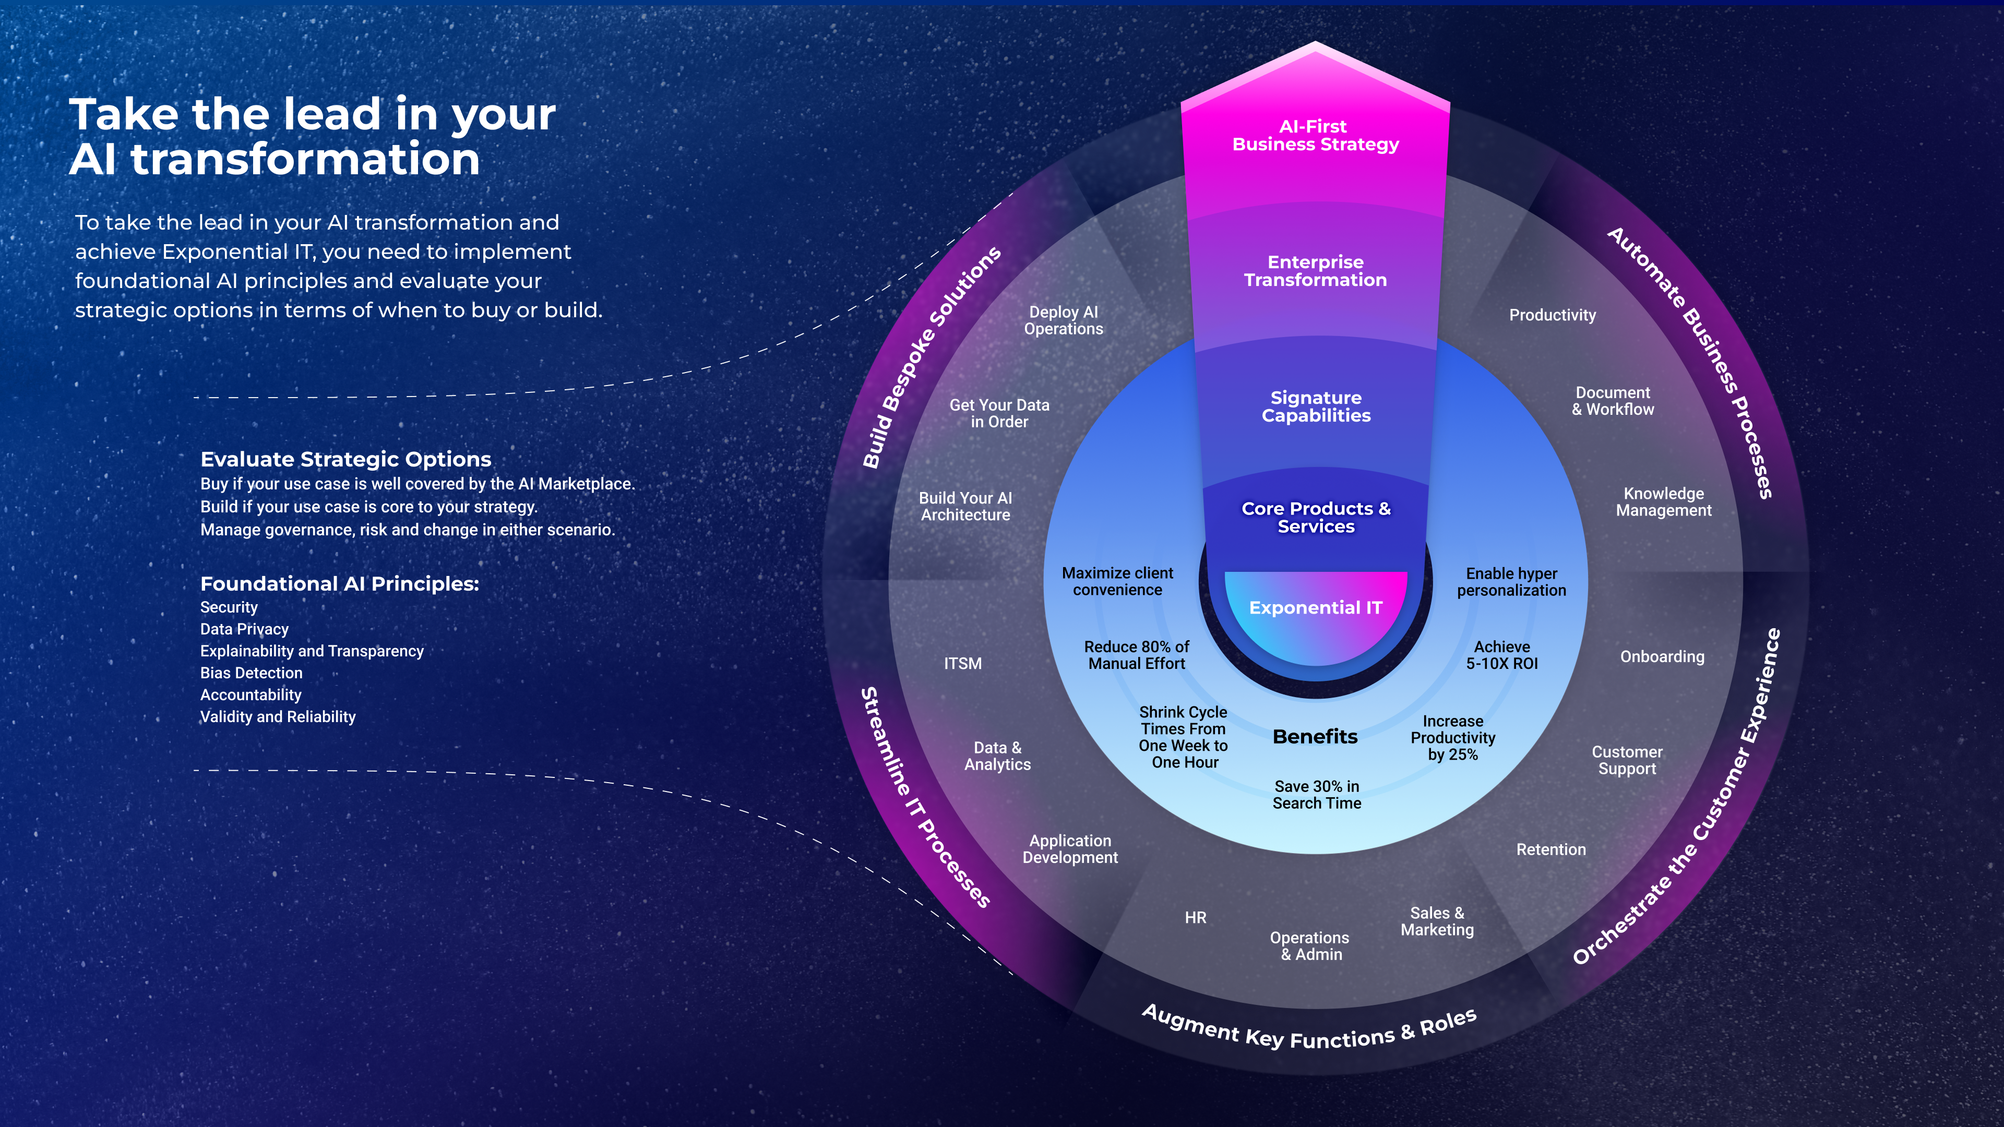

Slide 15
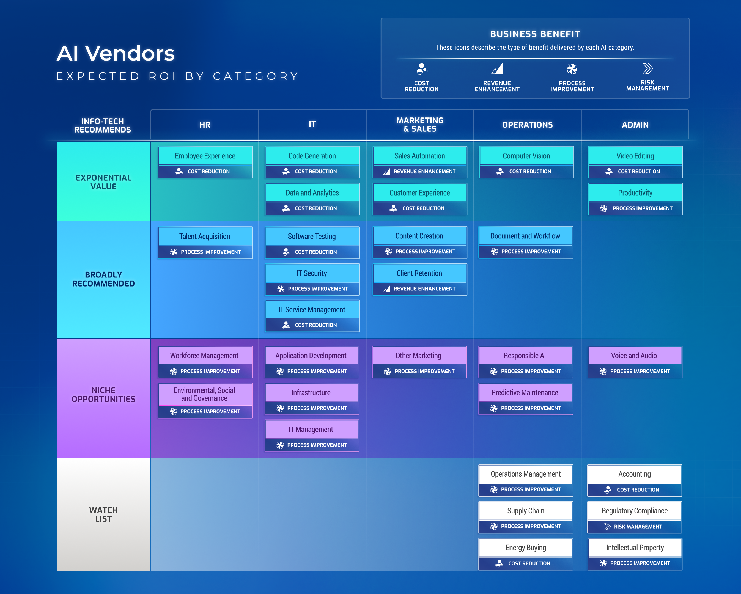
AI Marketplace
Unlock the potential of AI tailored to your needs and transform possibilities into reality with our dedicated support.
Info-Tech’s AI marketplace makes your AI vendor selection a breeze by leveraging an extensive catalogue of case studies and thought leader interviews.

