Slide 1
Prepare to Lead Product Delivery – Concierge Services
Strengthen product management in your organization through effective executive leadership by focusing on product teams, core capabilities, and proper alignment.

Slide 2
Agenda
Start | End | Agenda
9:00 AM | 9:30 AM | Introduction
9:30 AM | 11:00 AM | Discuss your top challenges
 |  | Exercise: What is driving your organization to become product focused?
10:30 AM | 10:45 AM | BREAK
11:00 AM | 12:00 PM | Compare project and product delivery
 |  | Exercise: What is a product?
 |  | Exercise: Define differences between project and product delivery
12:00 PM | 1:00 PM | LUNCH BREAK
1:00 PM | 2:00 PM | Understand product management capabilities and scaling
 |  | Exercise: Identify enablers and blockers
2:00 PM | 3:15 PM | Lead, manage, and govern product teams
 |  | Exercise: Understanding your product and corporate culture
2:30 PM | 2:45 PM | BREAK
3:15 PM | 3:45 PM | Commit to product delivery
 |  | Exercise: Personal stop, start, and continue
 |  | Exercise: Now, next, later roadmap (optional)
3:45 PM | 4:00 PM | Wrap-up and retrospective
 |  | Exercise: Update expectations and parking lot
4:00 PM |  | END
Notes:
Update if you want to include the detailed agenda in the presentation.

Slide 3
Executive Workshop Agenda and Table of Contents
Section | Title
1 | Understanding Your Top Challenges
 | Define the drivers for your transition to product-centric delivery.
2 | Transitioning From Projects to Product-Centric Delivery
 | Identify the cultural, behavioral, and leadership changes needed for a successful transformation.
3 | Enterprise Agility and the Value of Change
 | Leverage smaller iterations to reduce time to value and accumulated risk core operations.
4 | Defining Your Products and Product Management in Your Context
 | Tailer product management to meet the needs and vision for your organization.
5 | Connecting Product Management to Agile Practices
 | Optimize product management to prioritize the right changes for the right people at the right time.
6 | Commit to Empowering Agile Product Teams
 | Embrace leadership and cultural changes needed to empower and support teams.
7 | Wrap-Up and Retrospective
 | Define the next steps for continuing your product transformation.
8 | Appendices
 | Supporting Research Understanding Agile Scrum Practices and Ceremonies Improving Product Management | How Funding Changes When Applying Product Thinking SDLC Transformation Steps About Info-Tech

Slide 4
Executive Summary
Your Challenge
Common Obstacles
Info-Tech’s Approach
Products are the lifeblood of an organization. They deliver the capabilities needed to deliver value to customers, internal users, and stakeholders.
The shift to becoming a product organization is intended to continually increase the value you provide to the broader organization as you grow
and evolve.
You need to clearly convey the direction and strategy of your product portfolio to gain alignment, support, and funding from your organization.
IT organizations are traditionally organized to deliver initiatives in specific periods of time. This conflicts with product delivery, which continuously delivers value over the lifetime of a product.
Delivering multiple products together creates additional challenges because each product has its own pedigree, history, and goals.
Product owners struggle to prioritize changes to deliver product value. This creates a gap and conflict between product and enterprise goals.
Info-Tech’s approach will guide you through:
Understanding your top challenges driving your product initiative.
Improving your transition from projects to product-centric delivery.
Enhancing enterprise agility and the value of change.
Defining products and product management in your context.
Connecting product management to Agile practices.
Committing to empowering Agile product teams.

Slide 5

Objective of this Session
To develop a common understanding and foundation for product management, so as leaders
we better understand how to lead product owners, product managers, and their teams.

Slide 6
Understanding Your
Top Challenges
Transitioning From Projects to Product-Centric Delivery
Enterprise Agility and the Value of Change
Defining Your Products and Product Management
Connecting Product Management to Agile Practices
Wrap-Up and Retrospective
Commit to Empowering Agile Product Teams
Understanding Your
Top Challenges

Slide 7
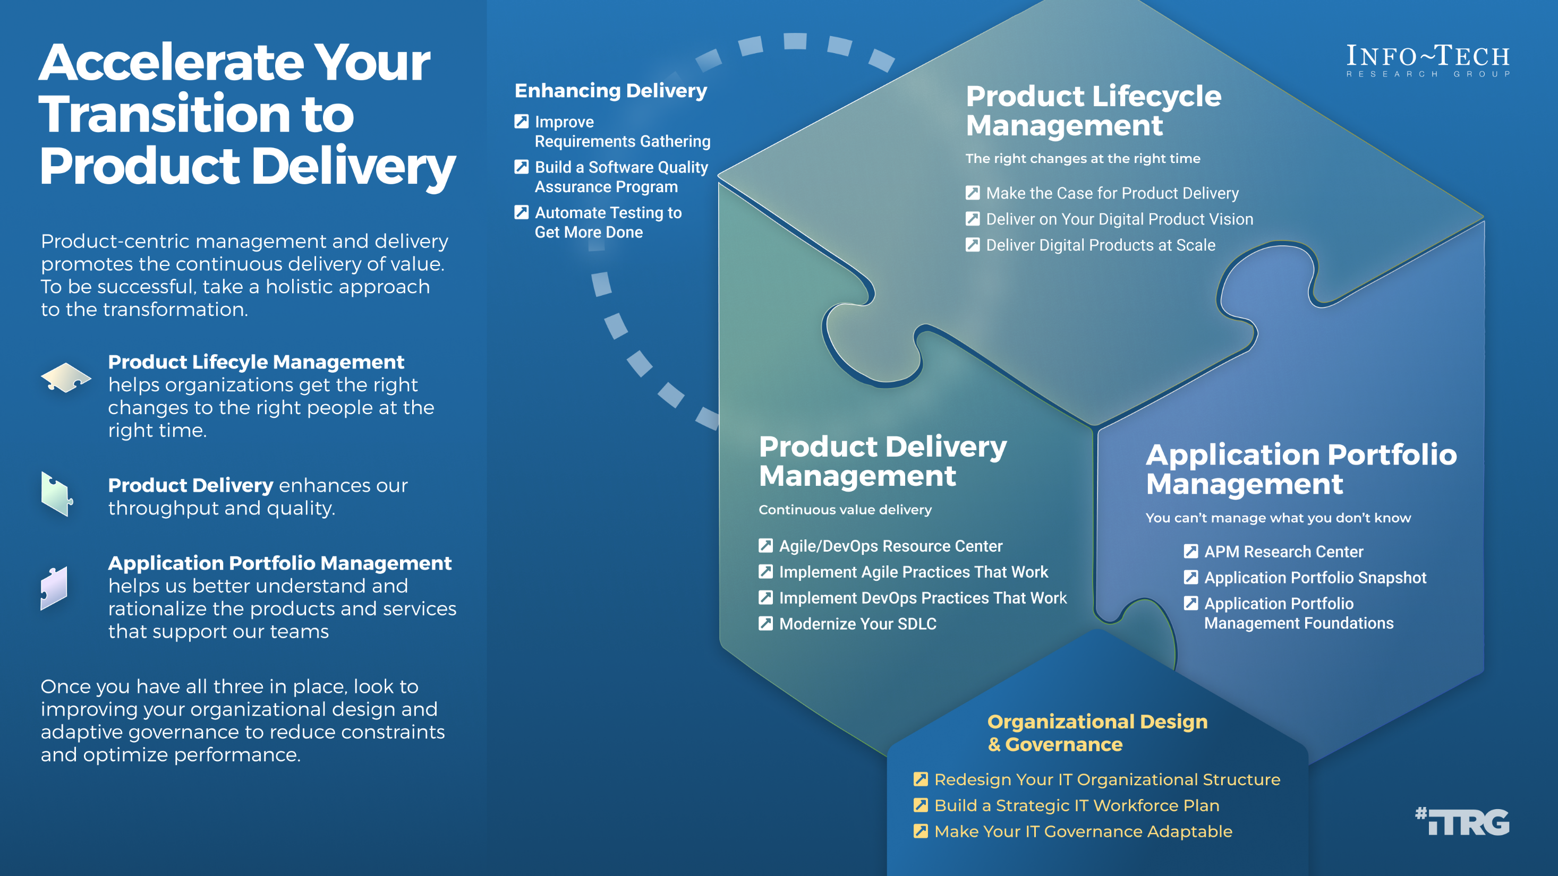

Slide 8
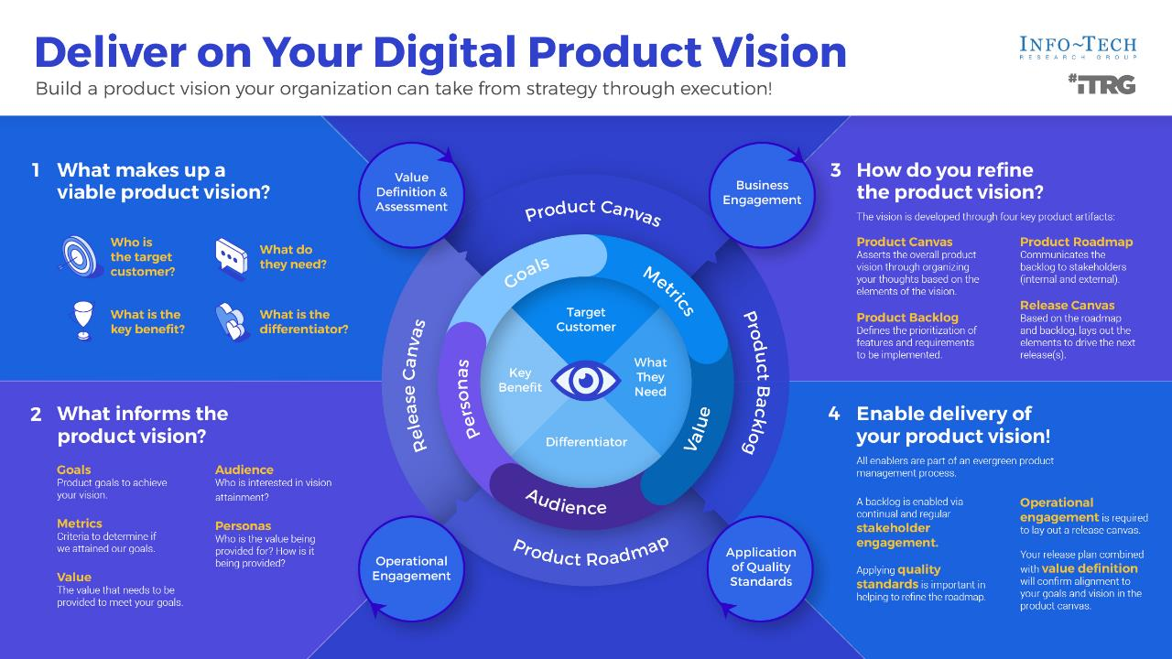

Slide 9
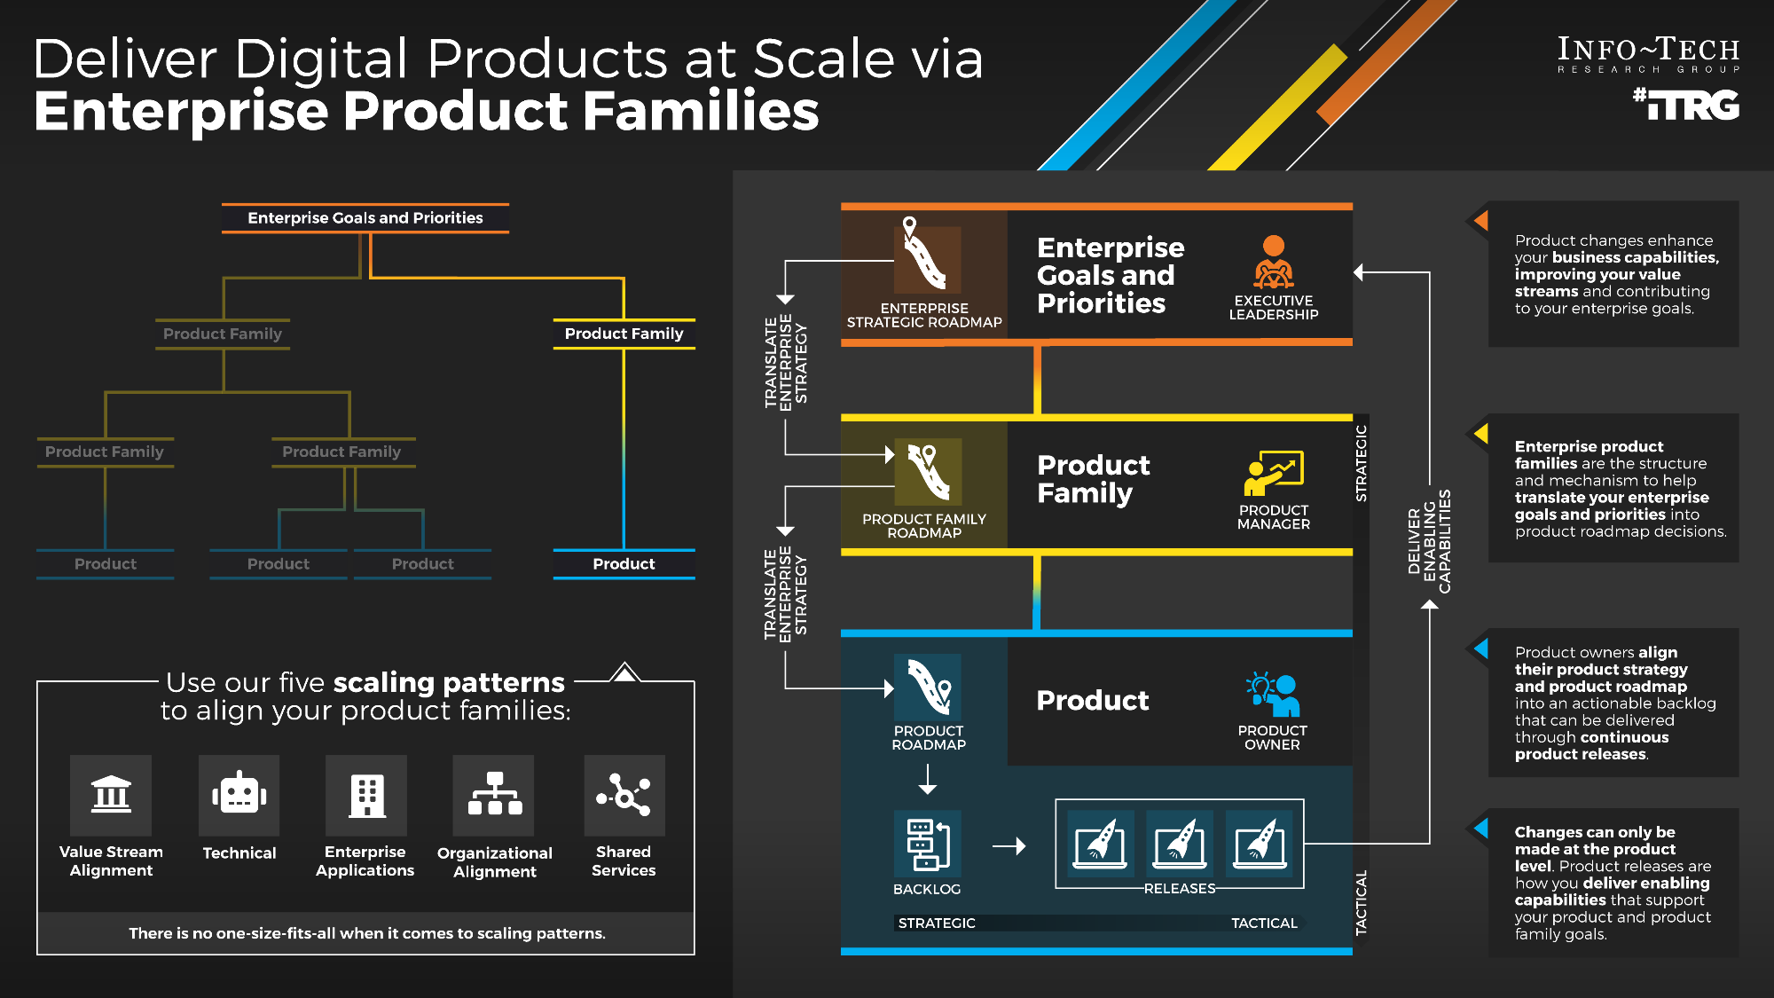
Deliver Digital Products at Scale via Enterprise Product Families – Thought Model

Slide 10
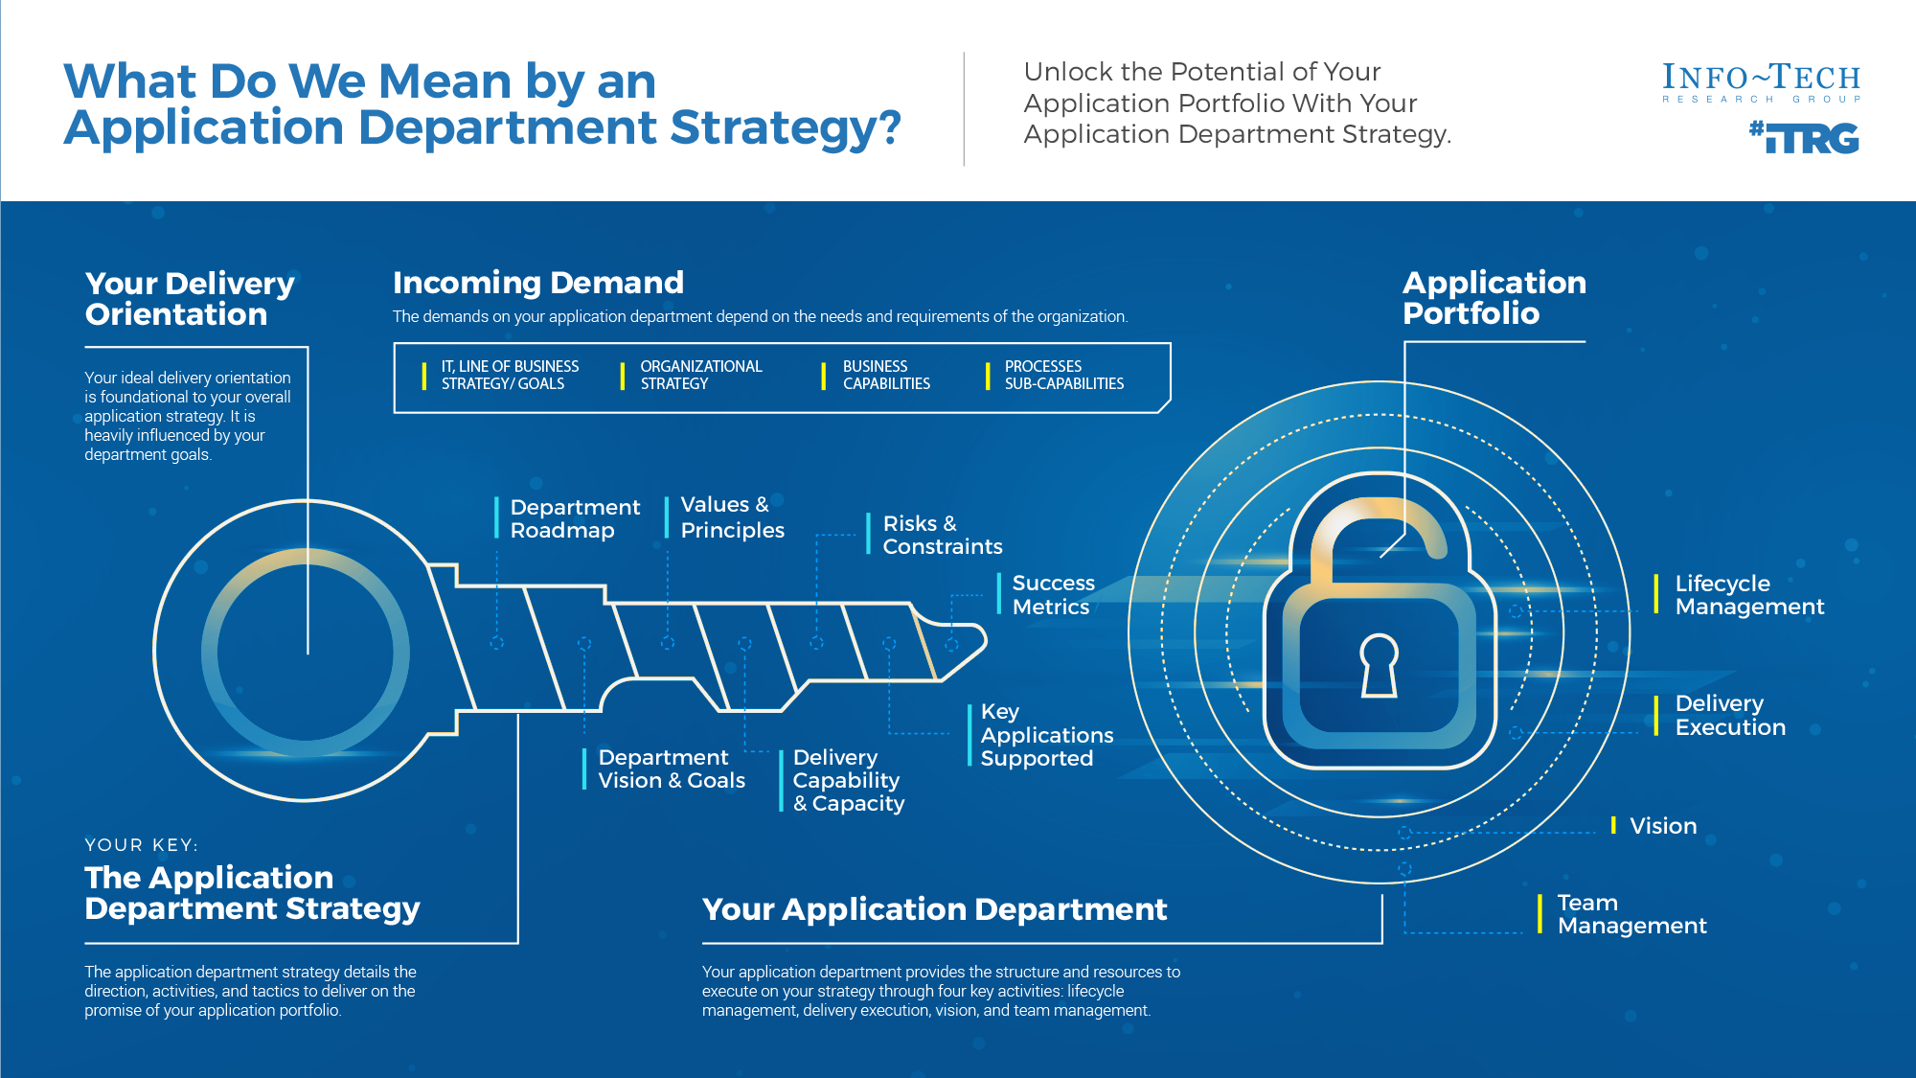
Start by understanding your application landscape and performance. Use APM Foundations to connect and update your application department orientation.
For more information, download Build an Application Department Strategy

Slide 11

What is driving your organization to become product focused?
Input
Organizational knowledge Goals and challenges
Output
List of key challenges List of session expectations Parking lot items
30 minutes
  Team introductions:
    Share your name and role.
    What are the key challenges we are looking to solve concerning product management?
    What blockers or challenges will we need to overcome?
Info-Tech Research Group | 11
Notes:
Facilitator notes:
Write a summary of the stories on a flip chart or whiteboard that you will leave up throughout the session.
Identify which stories you will be addressing.
Park stories that are out of scope for the session and should be dealt with in an advisory call, a future four-day session, or by the company’s transformation team.
For very large groups you should send the story cards in advance and get them returned at least one week prior to the session to review, analyze, and map to the covered topics.

Slide 12
Understanding Your
Top Challenges
Transitioning From Projects to Product-Centric Delivery
Enterprise Agility and the Value of Change
Defining Your Products and Product Management
Connecting Product Management to Agile Practices
Wrap-Up and Retrospective
Commit to Empowering Agile Product Teams
Transitioning from Projects to Product-Centric Delivery

Slide 13

Define the differences between project delivery and product delivery
Input
Organizational knowledge Internal terms and definitions
Output
List of differences between projects and product delivery
30 minutes
Consider project delivery and product delivery.
Discussion:
  What are some differences between the two?
Info-Tech Research Group | 13
Notes:
Facilitate a discussion on the differences between project and product delivery. Try to draw out the cultural, process, governance, and leadership items which might need to change for product management to work. This exercise sets the foundation for defining your product practices and cultural changes needed to be successful. The root of product ownership is empowerment of product owners to own the product and make decisions. This is counter to most command-and-control cultures. Also try to draw out instances where product owners are acting as proxies for stakeholders, rather than making decisions. These are very common in scrum, where the PO gathers and manages a tactical backlog but does not own the vision or roadmap.

Slide 14
Identify the differences between a project-centric and a product-centric organization
Project-centric
Product-centric
Info-Tech Insight
Product delivery requires significant shifts in the way you complete development work and deliver value to your users. Make the changes that support improving end-user value and enterprise alignment.
Funds projects
Funding
Funds products or teams
Has a line of business sponsor
Prioritization
Has a product owner
Makes specific changes
to a product
Product management
Improves product maturity
and support
Assigns people to work
Work allocation
Assigns work
to product teams
Is run by project manager
Capacity management
A managed by teams
Notes:
Note the change in tone. We are not talking about the project or the assignment as the end-goal, but the outcome for the customer. Highlight these five key areas that need to change for product management to work. If you omitted the exercise, use this slide to facilitate the same discussion.
Facilitate a discussion on the differences between project and product delivery. Try to draw out the cultural, process, governance, and leadership items which might need to change for product management to work. This exercise sets the foundation for defining your product practices and cultural changes needed to be successful. The root of product ownership is empowerment of product owners to own the product and make decisions. This is counter to most command-and-control cultures. Also try to draw out instances where product owners are acting as proxies for stakeholders, rather than making decisions. These are very common in scrum, where the PO gathers and manages a tactical backlog but does not own the vision or roadmap.

Slide 15
Define the differences between project delivery and product delivery
Input
Organizational knowledge Internal terms and definitions
Output
List of differences between projects and product delivery
15 minutes
VS.
Project delivery | Product delivery
Point in time | What is changed
Method of funding changes | Needs an owner
Info-Tech Research Group | 15
Notes:
Capture the differences here.

Slide 16
Projects can be a mechanism for funding product changes and improvements
Projects within products
Regardless of whether you recognize yourself as a product-based or project-based shop, the same basic principles apply.
You go through a period or periods of project-like development to build a version of an application or product.
You also have parallel services along with your project development, which encompass the more product-based view. These may range from basic support and maintenance to full-fledged strategy teams, or services like sales and marketing.
Continuous delivery of value
Product release
Product release
Product releases
Product releases
Hybrid lifecycle
Product lifecycle
Product release
Product release
Product roadmap
Project lifecycle
Product backlog
Project
Project
Project
Project
Project
Project
  Features
  Services
  Features
  Services
  Features
  Services
  Features
  Services
CI/CD delivery cycles
Notes:
Projects do not have to go away because you have products. Product owners shift focus to product maturity.
Shifting to a product focus is a change in perspective. Teams need to view the product or service as a long-term entity which will be managed, enhanced, and adapted to meet the organization's changing needs.
Projects can still be the source for funding. The project-release milestones or phases are tied to the product releases. Project is simply the team funding method for the product lifecycle.
In a hybrid model, product owners now use their roadmaps and backlogs to generate and manage release scope. This aligns to your continuous delivery of product value and longer-term alignment to enterprise goals.
Teams still need to focus on key milestones and releases, especially when other teams are impacted. Project managers continue to manage milestones and PMO governance gates, but not long-manage tasks and work assignments (Agile uses self-managing teams). If the team does not use PMs, then the product owner or scrum master takes over these responsibilities.
As you improve product delivery maturity, product releases can follow your CI/CD delivery pipeline and coordinate timed releases when end users are impacted or require training/communication.

Slide 17
While Agile and product are intertwined, they are not the same!
Delivering products does not necessarily require an Agile mindset. However, Agile methods help facilitate the journey because product thinking is baked into them.
Product delivery maturity
Continuous integration
and delivery
DevOps
Agile
Throughput
Efficiency
Iterative
ROI
Stakeholder value
Waterfall/
Ad hoc
Stability
Notes:
Discuss the company’s level of maturity in terms of Agile methods.

Slide 18
Product roadmaps guide delivery and communicate your strategy
In Deliver on Your Digital Product Vision, we demonstrate how the product roadmap is core to value realization. The product roadmap is your communicated path, and as a product owner you use it to align teams and changes to your defined goals while aligning your product to enterprise goals and strategy.
Vision and leadership
Info-Tech Insight
The quality of your product backlog – and your ability to realize business value from your delivery pipeline – is directly related to the input, content, and prioritization of items in your product roadmap.
Guides
Is constrained by
Strategy and market research
Justifies
Product roadmap
Delivery capacity and throughput
Business value
realization
Product lifecycle management
Manages
Product delivery pipeline
Sprint backlog
Business alignment and financials
Validates
Tiered product backlog
Adapted from: romanpichler, 2016.
Notes:
When we are talking product delivery, roadmapping is a key communication tool. The roadmap aligns stakeholders and delivery teams around common and clear goals.
Your product vision is the North Star aligning the value the product provides to its users.
Your product strategy and end-user analysis help determine what capabilities are needed and in what priority.
Your PLM provides the structure and approach to organizing your releases based on the throughput and capacity of your delivery team.
Your product must be aligned within your budgetary constraints and prioritize the highest ROI items that can be delivered quickly.

Slide 19

Product delivery realizes value for your product family
While planning and analysis are done at the family level, work and delivery are done at the individual product level.
Defined at the
family level?
Defined at the
product level?
What are the artifacts?
What are you saying?
Product strategy
Vision
I want to...
Goals
To get there we need to...
Roadmap
To achieve our goals, we’ll deliver...
Strategic focus
Backlog
The work will be done in this order...
Release plan
We will deliver in the following ways...
Delivery focus

Slide 20
Understanding Your
Top Challenges
Transitioning From Projects to Product-Centric Delivery
Enterprise Agility and the Value of Change
Defining Your Products and Product Management
Connecting Product Management to Agile Practices
Wrap-Up and Retrospective
Commit to Empowering Agile Product Teams
Enterprise Agility and the Value of Change

Slide 21


What is business agility?
Business agility enables you to:
Deliver value quickly.
Rapidly respond to change.
Delivering the right value
at the right time to the right stakeholders

Slide 22















Leveraging the minimum viable products (MVPs)
Delivering in Waterfall
Delivering via Agile/Iterative
Notes:
What is a minimum viable product? Ask three people and you might get seven examples. One of the challenges with MVPs is deciding at which point the product is viable. Is it the first prototype that we can react to? Is it the first product your customer can use? Maybe the problem comes from trying to define the product and not the goal.
If we were building a car, we’d start with wheels and build a frame around them. Then we’d add a chassis. At some point, we’d have a completed car. After all this work, we’d finally have the first MVP we could test or sell.
Instead, what if we define the goal as a transportation solution? Now our first MVP might be a skateboard that increases our mobility. Once we see how the skateboard solves the transportation need, we can see what the next critical steps are to produce a scooter. From the scooter, we add more value by creating the bicycle. The bicycle MVP now allows us to add an engine and build the motorcycle. After the motorcycle, we finally know what the car should be.
There are two important differences when we take the skateboard approach. First, we have viable products we can test internally or sell externally while we are working toward the car. This means we are gaining value at an earlier date and for a much lower investment. Second, before we produce the car we have a whole history of learning and refinement. This also means that our car is going to be far better than the ones produced all at once.

Slide 23

Iterations maximize value delivery
Percentage value earned
Maximum value to effort line
Value delivered via:
Waterfall
Percentage effort expended
Agile
Notes:
In an ideal world, we could maximize our effort expending to value received, which is represented as the green dotted line. The steeper the line, the higher value to effort ratio.
When we look at traditional project/product delivery, we expend most of our effort with very little value earned (red line). As we start development and testing, we begin earning value through lessons learned or reusable work, but still don’t have anything ready to ship. It isn’t till the end of delivery that we attain the desired value.
Since this curve is standard for almost all efforts, our best choice is to shorten the cycle and find more releases where we deliver earned value. In this case, each cycle can be represented as our skateboard path, with each MVP cycle delivering earned value.
The gap between the blue line cycles and the red line cycle is waste in our traditional delivery model.

Slide 24
Iterations reduce accumulated risk
Risk
Accumulated risk when using:
Waterfall
Time
Agile
Notes:
We can look at the same cycles as they apply to our project/product risk. In our traditional delivery, we continue to accumulate risk as we expend more effort without delivering value. Once you get into development and testing, you quickly start reducing risk as you validate the solution and viability.
Instead, if we apply our skateboard model and use smaller delivery cycles and MVPs, we dramatically reduce the risk accumulated before we can validate the solution. Again, the gap between the blue line cycle and our red line is the additional accumulated risk in our traditional delivery cycle.
This can go beyond the car and enable you to focus on continuous improvement of the product and your product delivery practices.

Slide 25
Understanding Your
Top Challenges
Transitioning From Projects to Product-Centric Delivery
Enterprise Agility and the Value of Change
Defining Your Products and Product Management
Connecting Product Management to Agile Practices
Wrap-Up and Retrospective
Commit to Empowering Agile Product Teams
Defining Your Products and Product Management in Your Context

Slide 26

What is a product?
Who are your consumers?
Input
Organizational knowledge Internal terms and definitions
Output
Our definition of products and services Our definition of product and service consumers/customers
30 minutes
Discussion:
  How do you define a product, service, or application?
  Who are the consumers that receive value from the product?
Info-Tech Research Group | 26
Notes:
Lead a discussion on how the organization defines products and services. Try to draw out a common working definition the participants can use throughout the session.

Slide 27
What is a product?
Our definition of a product:
A tangible solution, tool, or service (physical or digital), which enables the long-term and evolving delivery of value to customers and stakeholders based on business and user requirements.
Info-Tech Insight
A proper definition of a product recognizes three key facts.
A clear recognition that products are long-term endeavors that don’t end after the project finishes.
Products are not just apps but can be software or services that drive value.
There is more than one stakeholder group that derives value from the product or service.

Slide 28
Exercise:
What is a product?
15 minutes
Includes any solution that is produced
to help
Can be internal to the group or external
Is tangible/has value
Meets a defined need
Was developed through a process to provide value to stakeholders and the organization
Provides a service
Evolves with the needs of the group/stakeholders/client
Provides service, function, and value to the stakeholder group
Notes:
Record key definitions here.

Slide 29
Products and services share the same foundation and best practices
“Product” and “service” are terms that each organization needs to define to fit its culture and customers (internal and external). The most important aspect is consistent use and understanding of:
External products
Internal products
External services
Internal services
Products as a service (PaaS)
Productizing services (SaaS)
The term “product” is used for consistency but would apply to services as well.
Product
Service
=
Notes:
The foundation and capabilities for product management and service management are functionally the same. Typically, services describe process or people support, whereas products tend to be applications, platforms, or physical items.

Slide 30

Recognize the different product owner perspectives
“A product owner in its most beneficial form acts like an entrepreneur, like a mini CEO. The product owner is someone who really ‘owns’ the product.”
– Robbin Schuurman,
Scrum, 2017
Business
Operations
Customer facing, revenue generating
IT systems
and tools
Keep the lights on processes
Technical
Product owners must translate needs and constraints from their perspective into the language of their audience. Kathy Borneman, Digital Product Owner at SunTrust Bank, noted the challenges of finding a common language between lines of business and IT (e.g. what is a unit?).

Slide 31

Define product management to match your culture and customers
Characteristics of a discrete product:
What does not need product ownership?
Has end users or consumers
Delivers quantifiable value
Evolves or changes over time
Has predictable delivery
Has definable boundaries
Has a cost to produce and operate
Individual features
Transactions
Unstructured data
One-time solutions
Non-repeatable processes
Solutions that have no users or consumers
People or teams
Need help defining your products or services? Download our blueprint
Make the Case for Product Delivery.
Notes:
Use these items to help refine the product definition from the previous exercise. If the last exercise was removed, use this slide to aid in the discussion.

Slide 32
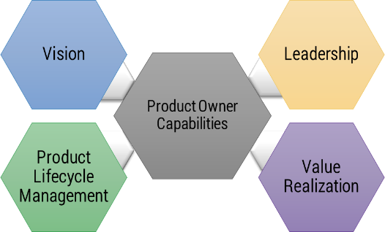
Implement the Info-Tech product owner capability model
Vision
Leadership
  Market analysis
  Business alignment
  Product roadmap
  Soft skills
  Collaboration
  Decision making
Product Lifecycle Management
Value Realization
  Plan
  Build
  Run
  KPIs
  Financial management
  Business model
Unfortunately, most product owners operate with an incomplete knowledge of the skills and capabilities needed to perform the role. Common gaps include focusing only on product backlogs, acting as a proxy for product decisions, and ignoring the need for key performance indicators (KPIs) and analytics in both planning and value realization.

Slide 33
Scale products to improve alignment
The Info-Tech difference:
Operationally align product delivery to enterprise goals.
Start by piloting product families to determine which approaches work best for your organization.
Create a common definition of what a product is and identify products in your inventory.
Use scaling patterns to build operationally aligned product families.
Develop a roadmap strategy to align families and products to enterprise goals and priorities.
Use products and families to evaluate delivery and organizational design improvements.
Goals & strategy
Enterprise goals and strategy
Product family
Product family
Product family
Product
Product
Product
Product
Enabling capabilities
Goals & strategy
Goals & strategy
Changes can only be made at the product level.
Notes:
Emphasize the importance of aligning enterprise goals and strategy with product delivery. Make sure to build out a roadmap to accomplish it.

Slide 34
Deliver Digital Products at Scale via Enterprise Product Families – Thought Model

Slide 35
Select the right models for scaling product management
Pyramid
Logical hierarchy of products rolling into a single service area
Service grouping
Organization of related services into service family
Technical grouping
Logical grouping of IT infrastructure, platforms, or applications
Market alignment
Organizational alignment
Used at higher levels of the organization where products are aligned under divisions
Grouping of products by customer segments or market strategy
Aligns product to end users and consumers
Example: Customer banking products and services
Provides full lifecycle management when hierarchies do not exist
Example: Workflow and collaboration tools
Direct hierarchy does not necessarily exist within the family
Example: End user support and ticketing
Lower levels of the pyramid focus on more discrete services
Example: Human resources mapping down to supporting applications
Separation of product management from organizational structure no longer distinct

Slide 36

Identify shared service products
Align to demand from other product managers.
Shared Service Product Owner
Consuming Product Owner
Consuming Poduct Owner
Consuming Product Owner
Consuming Product Owner
Shared products and services provide enabling capabilities for other products. A shared service technical product manager needs to understand all the sources of demand from other technical product managers, define clear criteria for prioritizing changes, and coordinate releases to align with other technical product manager roadmaps.
Info-Tech Research Group | 36

Slide 37
Product delivery realizes value for your product family
While planning and analysis are done at the family level, work and delivery are done at the individual product level.
Defined at the
family level?
Defined at the
product level?
What are the artifacts?
What are you saying?
Product strategy
Vision
I want to...
Goals
To get there we need to...
Roadmap
To achieve our goals, we’ll deliver...
Strategic focus
Backlog
The work will be done in this order...
Release plan
We will deliver in the following ways...
Delivery focus

Slide 38
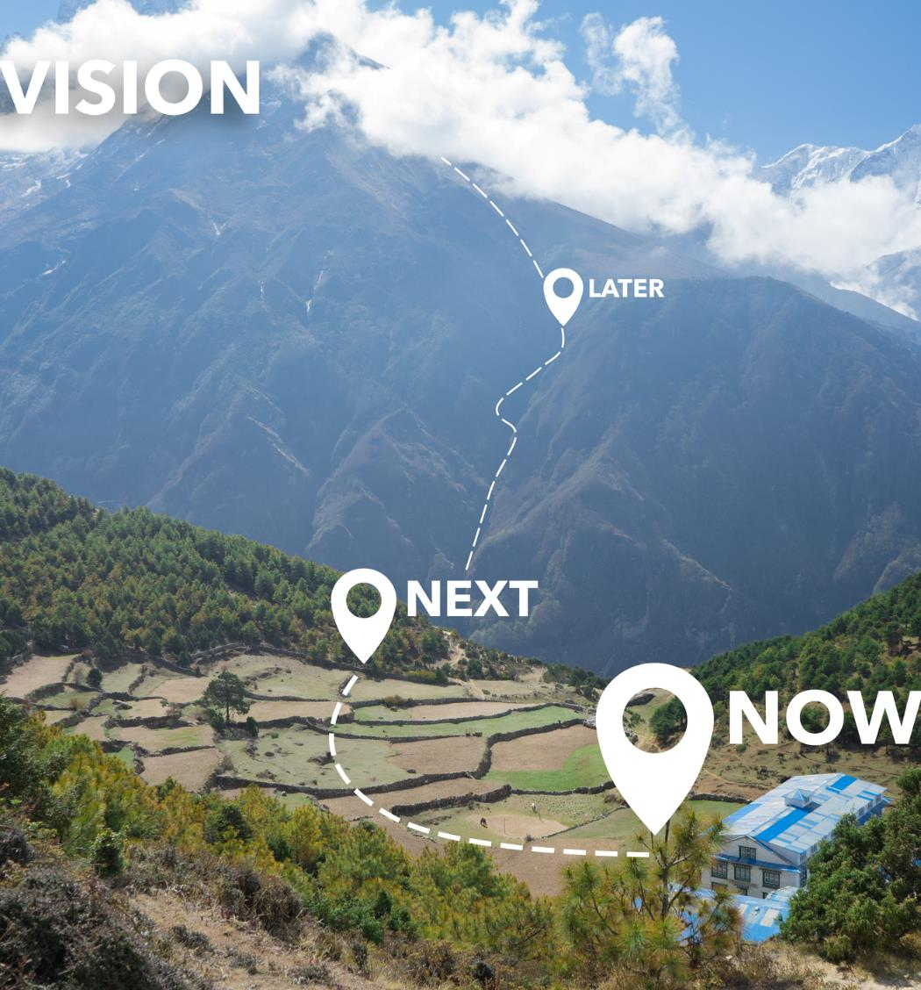
Leverage the product family roadmap for alignment
It’s more than a set of colorful boxes. It’s the map to align everyone to where you are going.
Your product family roadmap:
  Lays out a strategy for your product family.
  Is a statement of intent for your family of products.
  Communicates direction for the entire product family and product teams.
  Directly connects to the organization’s goals.
However, it is not:
  Representative of a hard commitment.
  A simple combination of your current product roadmaps.

Slide 39
Your ideal roadmap approach is a spectrum, not a choice
Match your roadmap and backlog to the needs of the product.
Tactical
A roadmap that is technical, committed, and detailed.
An internal, non-critical app is being retired.
An ERP expects some feature additions over the next few years.
A group of apps linked by one LoB needs the latest technological advancements.
An associated portfolio of products that has a constantly evolving customer journey.
Strategic
A roadmap that is strategic, goal-based, high-level, flexible
Stories and Tasks Features Epics and Capabilities
“Product Managers do not have to choose between being tactical or strategic.”
– Aha!, 2015
Notes:
Different products and different audiences will require potentially different roadmaps.

Slide 40

Multiple roadmap views can communicate differently yet tell the same truth
Audience
Business/
IT leaders
Users/Customers
Delivery teams
Roadmap
View
Portfolio
Product Family
Technology
To provide a snapshot
of the portfolio and
priority products
To visualize and validate product strategy
To coordinate broad technology and architecture decisions
Objectives
Line items or sections of the roadmap are made up of individual products; an artifact represents a disposition at its highest level.
Artifacts are generally grouped by product teams and consist of strategic goals and the features that realize
those goals.
Artifacts are grouped by
the teams who deliver
that work and consist of technical capabilities that support the broader delivery of value for the product family.
Artifacts

Slide 41
Before connecting your family roadmap to products, think about what each roadmap typically presents
Enterprise Goals
Vision
Vision
Epics/ Goals
Goals
Capabilities
Value Stream
Features
Capabilities
Your product family
Products
User Stories/Tasks
Info-Tech Insight
Your product family roadmap and product roadmap tell different stories. The product family roadmap represents the overall connection of products to the enterprise strategy, while the product roadmap focuses on the fulfillment of the product’s vision.

Slide 42
Typical elements of a product family roadmap
Time Horizon
This shows sseparate periods within the projected timeline, covered by the roadmap.
While there are others, these represent what will commonly appear across most family-based roadmaps.
Group/Category
Groups are collections of artifacts. In a product family context, these are usually product family goals, value streams, or products.
Q3 XXXX
Q4 XXXX
1H XXXY
2H XXXY
Artifact
An artifact is one of many kinds of tangible byproducts produced during the delivery of products. For a product family, the artifacts represented are capabilities or value streams.
Milestone
These are points in the timeline when established sets of artifacts are complete. This is a critical tool in the alignment of products in each family.

Slide 43
Connecting your product family roadmaps to product roadmaps
Your product and product family roadmaps should be connected at an artifact level that is common between both. Typically this is done with capabilities, but it can be done at a more granular level if an understanding of capabilities isn’t available.
Product Family Roadmap
Product Roadmaps
Q1
Q2
Goal 1
Family Capability
Theme
Q1
Q2
Theme
Family Capability
Capability 1
Product A Feature
Epic
Family Capability
Product B Feature
Product D Feature
Goal 2
Family Capability
Epic
Epic
Epic
Family Capability
Capability 2
Product B Feature
Product A Stories
Goal 3
Family Capability
Product C Feature
Family Capability
Family Capability
Capability 3
Level of Hierarchy
Artifact

Slide 44












Your communication objectives are linked to your audience; ensure you know your audience and speak their language
I want to...
I need to talk to...
Because they
are focused on...
ALIGN
PRODUCT
TEAMS
  Get my delivery teams on the same page.
  A product that delivers value against a common set of goals and objectives.
PRODUCTS
Architects
Product Owners
  Inform users and customers of product strategy.
SHOWCASE
CHANGES
  A group of functionality that business customers see as a single unit.
FUNCTIONALITY
Bus. Process
Owners
End Users
ARTICULATE
RESOURCE
REQUIREMENTS
  Inform the business of product development requirements.
  An initiative that those with the money see as a single budget.
FUNDING
IT
Management
Business
Stakeholders
Adapted from: Martin Fowler

Slide 45
Product roadmaps guide delivery and communicate your strategy
In Deliver on Your Digital Product Vision, we demonstrate how the product roadmap is core to value realization. The product roadmap is your communicated path, and as a product owner, you use it to align teams and changes to your defined goals while aligning your product to enterprise goals and strategy.
Vision and leadership
Info-Tech Insight
The quality of your product backlog – and your ability to realize business value from your delivery pipeline – is directly related to the input, content, and prioritization of items in your product roadmap.
Guides
Is constrained by
Strategy and market research
Justifies
Product roadmap
Delivery capacity and throughput
Business value
realization
Product lifecycle management
Manages
Product delivery pipeline
Sprint backlog
Business alignment and financials
Validates
Tiered product backlog
Adapted from: romanpichler, 2016.
Notes:
When we are talking product delivery, roadmapping is a key communication tool.

Slide 46

Business value is a key component to drive better decision making
Other criteria
Other criteria
Other criteria
Better
decisions
Balanced
business
value
Other criteria
Other criteria

Slide 47
Get a clear picture of how your products and services drive customer and business value
Business value definitions must come from the business, not IT. They are the keepers of the organization’s mission, vision, or mandates. Make the business the authority on value, then form a partnership that defines that value in the context of your products. Outline the business value sources that define the success criteria of your products and services. Note that these drivers should tie back to your holistic business strategy. Business value is divided into four categories.
Business value matrix
Our value drivers
Outward
Financial benefits vs. improved capabilities
  Financial benefits refer to the degree to which the value source can be measured through monetary metrics and is often quite tangible.
  Human benefits refers to how a product or service can deliver value through a user’s experience.
Inward vs. outward orientation
  Inward refers to value sources that have an internal impact and improve your organization’s effectiveness and efficiency in performing its operations.
  Outward refers to value sources that come from your interaction with external factors, such as the market or your customers.
Outward
Reach customers
Increase revenue
?
?
Human benefit
Financial benefit
Human benefit
Financial benefit
Enhance services
Reduce
costs
?
?
Inward
Inward
Increase revenue
Product or service functions that are specifically related to the impact on your organization’s ability to generate revenue.
Reduce costs
Reduction of overhead. The ways in which your product limits the operational costs of business functions.
Enhance services
Functions that enable business capabilities that improve the organization’s ability to perform its internal operations.
Reach customers
Application functions that enable and improve the interaction with customers or produce market information and insights.

Slide 48
Get a clear picture of how your products and services drive customer and business value
Value cannot always be represented by revenue or reduced expenses. However, the full spectrum of sources of values is not always apparent or obvious. See the many ways in which a product or service can bring value to your organization.
Business value matrix
Financial benefits vs. improved capabilities
  Improved capabilities refers to the enhancement of business capabilities and skill sets.
  Financial benefits refers to the degree in which the value source can be measured through monetary metrics and is often highly tangible.
Inward vs. outward orientation
  Inward refers to value sources that have an internal impact an organization’s effectiveness and efficiency in performing its operations.
  Outward refers to value sources that come from interactions with external factors, such as the market or your customers.
Our value matrix
Improved capabilities
Improved capabilities
Enhance Services
Reach Customers
Value
Value
Inward
Outward
Inward
Outward
Reduce Costs
Demonstrate Value
Value
Value
Financial benefits
Financial benefits
Demonstrate value
(Return on investment)
Products and services that are specifically related to the impact on an organization’s ability to create a return on investment.
Reduce costs
Products and services that reduce overhead. They typically are less related to broad strategic vision or goals and more simply limit expenses that would occur had the product or service not been put in place.
Enhance services
Products and services that enable business capabilities and improve an organization’s ability to perform its internal operations.
Reach customers
Products and services that enable and improve the interaction with customers or produce practical market information and insights.

Slide 49

What is a value score?
Importance of the
value driver
X
Impact of value source
= Value score
Key drivers to your key management goals
Ability to affect the Value Driver

Slide 50

What is a balanced value score?
Build your balanced business value score using four key value drivers
+
Importance of value driver
x
Impact of value source
+
Importance of value driver
x
Impact of value source
+
Importance of value driver
x
Impact of value source
+
Importance of value driver
x
Impact of value source
=
Balanced business value score

Slide 51
Identify enablers and blockers of product ownership
Input
Understanding of current products
Output
List of factors that can improve business agility
15 minutes
Brainstorm and discuss the key enablers that can help promote and ease your implementation of product ownership.
Brainstorm and discuss the key blockers (or risks) that may interrupt or derail your efforts.
Brainstorm mitigation activities for each blocker.
Enablers | Blockers | Mitigation
High business engagement and buy-in | Significant time is required to implement and train resources | Limit the scope for pilot project to allow time to learn
Organizational acceptance for change | Geographically distributed resources | Temporarily collocate all resources and acquire virtual communication technology
Existing tools can be customized for BRM | Difficulty injecting customers in demos | Educate customer groups on the importance of attendance and what's in it for them
Info-Tech Research Group | 51

Slide 52

Guiding principles
Guiding principles provide your teams with rules, goals, or themes to help frame and direct decisions.

Slide 53


Articulate how product management will support the strategic priorities of the business with a set of product management principles
How to determine your product management principles:
1
Review your product strategy, organization’s goals, and the organization’s target state maturity level.
2
Describe your target state for product management.
What are the goals and constraints that will help you achieve your target state? These are your product management guiding principles.
3

Slide 54
Define a set of guiding principles for product management
Input
Stakeholder and team expectations Understanding of organization culture Enterprise strategy and priorities
Output
Guiding principles for product management
30 minutes
Create a statement describing your target state or destination postcard. Discuss the guiding principles of product management. Your guiding principles are constraints, goals, and checkpoints for product management.
Principle | Rationale
Prioritize opportunities to improve customer value and retention | The organization prioritizes customer needs and opportunities above all else.
Info-Tech Research Group | 54

Slide 55
Understanding Your
Top Challenges
Transitioning From Projects to Product-Centric Delivery
Enterprise Agility and the Value of Change
Defining Your Products and Product Management
Connecting Product Management to Agile Practices
Wrap-Up and Retrospective
Commit to Empowering Agile Product Teams
Connecting Product Management to
Agile Practices

Slide 56
Introduction: Traditional solution delivery (Waterfall)
Intake
Analyze
Step are done sequentially.
The next step cannot start until the previous step is 100% complete.
It is very difficult to go backward.
This process feels like construction.
Design
Build + Test
Deploy
(Deliver)
Operate

Slide 57


What did Royce really say about Waterfall?
Agile isn’t as radical or new as you might think.
Royce’s 5 principles for success
01
Complete program design first.
Dr. Winston W. Royce first introduced the Waterfall process back in 1970.
However, he noted:
Keep documentation current and complete.
02
03
Iterate within each phase, repeatedly.
Plan, control, and monitor testing throughout.
04
“I believe in this concept, but the implementation described above is risky and invites failure.”
05
Involve the customer formally, in depth, and continually.
Source: Royce, “Managing the Development of Large Software Systems,” 1970.

Slide 58

Waterfall vs. Agile – How are they different?
Waterfall
Agile
Intake
Analyze
Design
Build
Test
DEMO
Intake
Sprint 1
(1-4 Weeks)
Analyze
Design
Sprint 2
Analyze
Design
Build
Test
DEMO
Build + Test
…
Deploy (Deliver)
Sprint “n”
Analyze
Design
Build
Test
DEPLOY
Operate
TIME (months)
TIME (months)
A one-and-done approach (planning- and documentation-based);
elapsed time to deliver any value: months to years
An iterative approach (empirical and evidence-based);
elapsed time to deliver any value: weeks

Slide 59

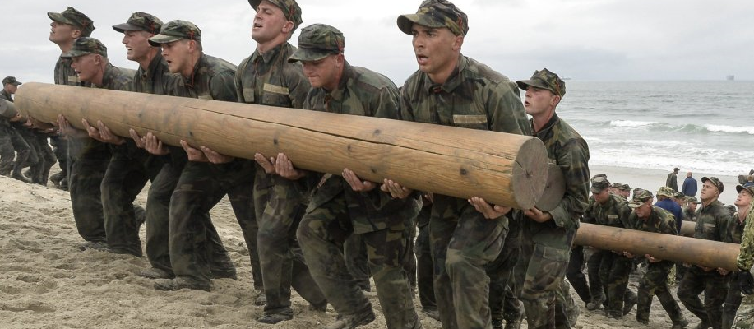
Agile is NOT just lots of mini-Waterfalls!
Going from Waterfall to Agile is like…
Business
analyst (BA)
Architect (Arch)
…going from running a relay race to doing a Navy Seal log carry.
The skills required are very different.
The transition can be difficult.
You will have to start slow and learn as you go.
It’s about empowering and protecting the health of the team.
The power of Agile comes from harnessing the power of the team.
But a new team is never at peak efficiency at the start.
You will have to learn to be more Agile as you go.
Trust the process
(Assign tasks to individuals)
Requirements
BA
Arch
Dev
Dev
Ops
Dev
Test
Test
Deploy
Design
Code
Requirements
Trust the team
(Assign ownership to the team)
Source: DVIDS Hub
Notes:
Adopting Agile is really about change.
Change is always hard!
If you are going from Waterfall to Agile -> Its going to be hard!
Because Agile is really different from Waterfall <- Your tendency will be to backslide!
Frosh Week: N+1 Legged Race – How we won
Practice!
Slow (incremental) improvement
We all had to work together – at the same pace!
Exercise:
Compare and contrast skills?
How would you “train” an N+1 legged team?

Slide 60
Agile’s four core values
We value. . .
Individuals and interactions
Processes and tools
“…while there is value in the items on the right, we value the items on the left more.”
– “The Agile Manifesto”
Comprehensive documentation
Working software
Customer collaboration
Over
Contract negotiation
Responding to change
Following a plan
Source: Agile Alliance, 2022.
Being Agile
Being Prescriptive
Notes:
Facilitator’s notes:
Review the balance.
Comment that if you find yourself on the right as opposed to the left you might be doing Agile, but you won’t see the benefits of being agile.

Slide 61



Be aware of common myths about Agile
Agile does not…
1
“Although Agile methods are increasingly being adopted in globally distributed settings, there is no panacea for success.”
– “Negotiating Common Ground in Distributed Agile Development: A Case Study Perspective.” IEE Explore.
…solve development and communication issues.
2
“Without proper planning, organizations can start throwing more resources at the work which spirals into the classic Waterfall issues of managing by schedule.”
– Kristen Morton, Associate Implementation Architect,
OneShield Inc., Info-Tech Interview
…ensure you will finish requirements faster.
3
…mean you don’t need planning and documentation.

Slide 62
Projects can be a mechanism for funding product releases
Projects within products
Regardless of whether you recognize yourself as a product-based or project-based shop, the same basic principles apply.
You go through a period or periods of project-like development to build a version of an application or product.
You also have parallel services along with your project development, which encompass the more product-based view. These may range from basic support and maintenance to full-fledged strategy teams or services like sales and marketing.
Continuous delivery of value
Product release
Product release
Product releases
Product releases
Hybrid lifecycle
Product lifecycle
Product release
Product release
Product roadmap
Project lifecycle
Product backlog
Project
Project
Project
Project
  Features
  Services
  Features
  Services
  Features
  Services
  Features
  Services
CI/CD delivery cycles
Notes:
Projects do not have to go away because you have products. Technical product managers shift focus to product maturity.
Shifting to a product focus is a change in perspective. Teams need to view the product or service as a long-term entity which will be managed, enhanced, and adapted to meet the organization's changing needs.
Projects can still be the source for funding. The project-release milestones or phases are tied to the product releases. Project is simply the team funding method for the product lifecycle.
In a hybrid model, technical product managers now use their roadmaps and backlogs to generate and manage release scope. This aligns to your continuous delivery of product value and longer-term alignment to enterprise goals.
Teams still need to focus on key milestones and releases, especially when other teams are impacted. Project managers continue to manage milestones and PMO governance gates, but not long-manage tasks and work assignments (Agile uses self-managing teams). If the team does not use PMs, then the product owner or scrum master takes over these responsibilities.
As you improve product delivery maturity, product releases can follow your CI/CD delivery pipeline and coordinate timed releases when end users are impacted or require training/communication.

Slide 63

A backlog stores and organizes PBIs at various stages of readiness
A well-formed backlog can be thought of as a DEEP backlog:
Detailed appropriately: PBIs are broken down and refined, as necessary.
Emergent: The backlog grows and evolves over time as PBIs are added and removed.
Estimated: The effort a PBI requires is estimated at each tier.
Prioritized: The PBI’s value and priority are determined at each tier.
New idea
3 – Ideas
Composed of raw, vague, and potentially large ideas that have yet to go through any formal valuation
Low-priority PBIs
Ideas
Product
backlog
2 – Qualified
Qualified
Researched and qualified PBIs awaiting refinement
1 – Ready
Ready
Discrete, refined PBIs that are ready to be placed in your development team’s sprint plans
High-priority PBIs
(Perforce, 2018)
Sprint backlog
Sprint
Adapted from “Essential Scrum,” Agile Alliance

Slide 64




Backlog tiers facilitate product planning
Ranging from the intake of an idea to a PBI ready for development; to enter the backlog, each PBI must pass through a given quality filter.
Each activity is a variation of measuring value and estimating effort in order to validate and prioritize a PBI.
A PBI successfully completes an activity and passes through to the next backlog tier when it meets the appropriate criteria. Quality filters should exist between each tier.
Activity participants
Backlog
activity
Quality filter
Product
manager
Product
owner
Dev team
Scrum
master
Business
Architects
Intake
Ideas
Backlogged
Qualified
Analysis
Qualified
Refine
Ready
Ready
Sprint
planning
Sprint
Accepted

Slide 65


Use quality filters to ensure focus on the most important PBIs
Expand the concepts of ready and done to include the other stages of a PBI’s journey through product planning.
Product
backlog
Sprint backlog
SPRINT
Enter the backlog
Intake
Analysis
Refine
Sprint planning
Not started
In progress
Completed
Quality filter
Backlogged
Qualified
Ready
Accepted
Understood by the product team
Aligns to the product vision
Has defined benefits, acceptance criteria, and KPIs
Has undergone timeline, complexity, and effort estimations
Decomposed into user stories, with all related requirements containing clear descriptions of what is expected of a given functionality
Acceptance criteria, effort, value, and priority are re-established at a more granular level
The PBI is…
Considered valuable, useable, and feasible
Able to fit within the capacity of a sprint
To ….
Enter the backlog
Invest
Prioritize
Execute
And justify
the next step of…
… Initial research and design
Refinement and any other required business analysis
Development
Product demo
Sprint planning
Info-Tech Best Practice
A quality filter ensures quality is met and the appropriate teams are armed with the appropriate information to work more efficiently and improve throughput.
Notes:
Discuss the importance of knowledge management for improving backlog throughput and quality.

Slide 66
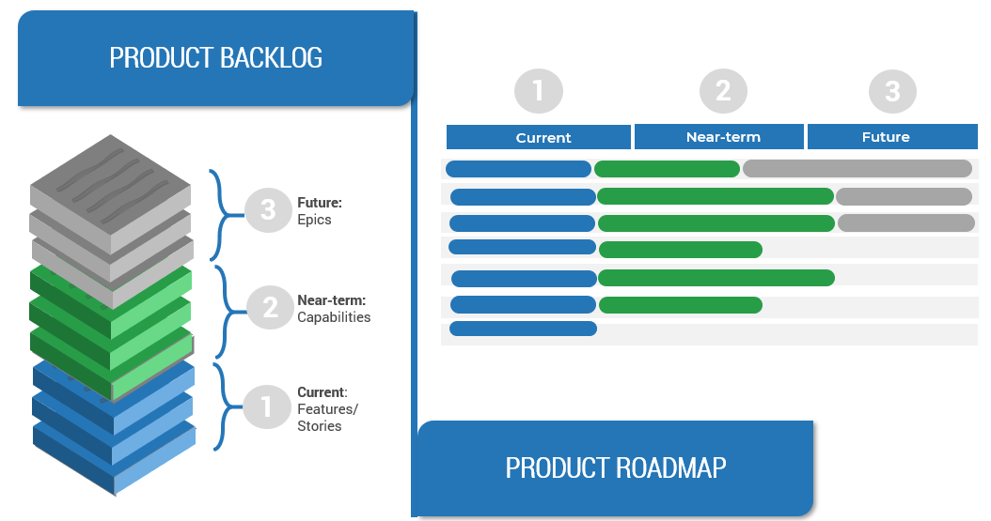
Define product value by aligning backlog delivery with roadmap goals
In each product plan, the backlogs show what you will deliver. Roadmaps identify when and in what order you will deliver value, capabilities, and goals.

Slide 67
Develop an adaptive governance process​
Adaptive
Traditional
Embedded/Automated governance
4
Governance that is entrenched and automated into organizational processes and product/service design. Empowered and fully delegated governance to maintain fit and drive organizational success and survival.
Agile governance
3
Governance that is flexible to support different needs and quick response in the organization. Driven by principles and is delegated throughout the company.
Controlled governance
2
Governance focused on compliance and hierarchy-based authority driven control of decisions. Levels of Authority are defined and often driven by regulatory requirements.
Ad hoc governance
1
Governance that is not well defined or understood within the organization.
It occurs out of necessity but often not by the right people or bodies.
Traditional

Slide 68
Five key principles for building an adaptive governance framework
Delegate and empower
Define outcomes
Make risk-informed decisions
Embed/ Automate
Establish standards and behavior
Decision making must be delegated down within the organization, and all resources must be empowered and supported to make effective decisions.
Outcomes and goals must be clearly articulated and understood across the organization to ensure decisions are in line and stay within reasonable boundaries.
Integrated risk information must be available with sufficient data to support decision making and design approaches at all levels of the organization.
Governance standards and activities need to be embedded in processes and practices. Optimal governance reduces its manual footprint while remaining viable. This also allows for more dynamic adaptation.
Standards and policies need to be defined as the foundation for embedding governance practices organizationally. These guardrails will create boundaries to reinforce delegated decision making.

Slide 69




Maturing governance is a journey
Organizations should look to progress in their governance stages. Ad hoc and controlled governance tends to be slow, expensive, and a poor fit for modern practices.
The goal as you progress in your stages is to delegate governance and empower teams to make optimal decisions in real-time, knowing that they are aligned with the understood best interests of the organization.
Automate governance for optimal velocity, while mitigating risks and driving value.
This puts your organization in the best position to be adaptive and able to react effectively to volatility and uncertainty.
Automated
Agile
High velocity, embedded, and flexible
Distributed and empowered
Process Integration
Controlled
Authoritarian, highly structured
Ad hoc
Inconsistent decision making
Trust and Empowerment

Slide 70
Understanding Your
Top Challenges
Transitioning From Projects to Product-Centric Delivery
Enterprise Agility and the Value of Change
Defining Your Products and Product Management
Connecting Product Management to Agile Practices
Wrap-Up and Retrospective
Commit to Empowering Agile Product Teams
Commit to Empowering Agile Product Teams

Slide 71
Your management culture
Input
Previous slides and activities Organizational knowledge
Output
An inventory of where you are supporting a product culture and where you are not
15 minutes
How would you describe your organization’s product and product delivery culture?
Add words or short phrases that describe your organization’s culture to the quadrant where it fits best.
Is the value more focused on company outcomes or people/staff outcomes?
Does your description refer more about what is happening right now (actual) or about what is possible or could be (possible)?
Add your item along each axis to the degree that access describes it.
Actual
People
Company
Possible
Info-Tech Research Group | 71

Slide 72




Your management culture
Input
Previous slides and activities Organizational knowledge
Output
An inventory of where you are supporting a product culture and where you are not
15 minutes
Actual
Collaboration
Success by working together
Control
Success by getting and maintaining control
People
Company
Cultivation
Success by growing people
Competence
Success by being the best
Possible
Info-Tech Research Group | 72

Slide 73
Reminder: Agile’s four core values
We value. . .
Individuals and interactions
Processes and tools
“…while there is value in the items on the right, we value the items on the left more.”
– “The Agile Manifesto,” Agile Alliance, 2022
Working software
Comprehensive documentation
Customer collaboration
Over
Contract negotiation
Responding to change
Following a plan
Being Agile
Being Prescriptive
Notes:
Facilitator’s notes:
Review the balance
Comment that If you find yourself on the right as opposed to the left you might be doing Agile, but you won’t see the benefits of being agile.

Slide 74
Give sufficient decision-making authority to your teams
“Push the decision making down as far as possible, down to the point where sprint teams completely coordinate all the integration, development, and design. What I push up the management chain is risk taking. [Management] decides what level of risk they are willing to take and [they] demonstrate that by the amount of decision making [they] push down.”
– Senior Manager, Canadian P&C
Insurance Company
Push the decisions down to your product owners and delivery teams.
Supporting teams on technical decisions will remove the need for approval processes, allowing teams to quickly adjust and implement changes.
Bring your business stakeholders and subject matter experts together to identify potential high-level risks.
Product owners need to incorporate stakeholder feedback into their decisions but should not be a proxy where the stakeholder holds authority.
Agree to the level of acceptable business risk.
Line of business stakeholders must trust their product owners to be able to make the appropriate decisions within the approved threshold.
The success of the project is a reflection on both the delivery team and stakeholders.
Product success is a balance between the needs and priorities of your product owner perspectives: business/technical/operational.

Slide 75
Ensure long-term product success with management support
Changing to Agile can be perceived by management as a loss of control. Help them understand the benefits of improved communication, responsiveness, and cost containment.
Provide constant support
Take a hands-off approach
Be a catalyst for change
  Rather than dictating timelines and scope, management will now support the team by helping to prioritize scope and resolving conflicting requirements among themselves.
  Once the scope is determined for a given iteration, management will not inject new requests until the current work is complete.
  Management should encourage the move toward product management as a means of increasing development transparency.

Slide 76


What is servant leadership?
Wrong:
Right:
“I’m ultimately responsible for delivering the project.”
“I’m responsible for supporting for the team who will achieve our goal.”
Instead of directing, you are facilitating.
What does our team need to be successful?
What obstacles need to be cleared?

Slide 77
Principles of servant leadership
Empower the team
Collaborate
Promote accountability
Trust team decisions
Support the team
Clear obstacles
Secure resources
Free the team from outside interference
Listen to understand
Don’t listen to respond
Problems are best solved closest to the problem
Consider whether the teams have all the information

Slide 78

Personal stop, start, and continue
Input
Organizational stop, start, and continue list Previous slides and activities Organizational knowledge
Output
List of personal factors needed to support product management
15 minutes
What do you need to stop, start, and continue to support product management and their authority to make product decisions?
  List behaviors, actions, or beliefs that the organization will need to stop.
  List behaviors, actions, or beliefs that the organization will need to start.
  List behaviors, actions, or beliefs that the organization will need to continue.
Homework:
  Update your stop/start/continue goals quarterly.
Info-Tech Research Group | 78

Slide 79
Personal stop, start, and continue
Stop | Start | Continue
Being territorial | Be more collaborative | Respecting each other

Slide 80

There is no such thing as painless change
Ensure focus
People must be able to focus on the new behaviors to make them patterns.
Understand expectations
People need to shape their own expectations to make the change.
Develop practice
Individuals must commit to and repeat practices that will make the change stick.

Slide 81
Use CLAIM to guide your journey
Value is best created by self-managing teams who deliver in frequent, short increments supported by leaders who coach them through challenges.
Product-centric delivery and Agile are a radical change in how people work and think. Structured, facilitated learning is required throughout the transformation to help leaders and practitioners make the shift.
Learning
Automation
Culture
Metrics and governance
Integrated teams
Successful implementations require the disciplined use of metrics that support developing better teams.
  Product Management, Agile, and DevOps have inspired SDLC tools that have become a key part of delivery practices and work management.
Self-organizing teams that cross business, delivery, and operations are essential to gain the full benefits of product-centric delivery.

Slide 82

Communicate reasons for changes and how they will be implemented
Five elements of communicating change
Leaders of successful change spend considerable time developing a powerful change message, a compelling narrative that articulates the desired end state and makes the change concrete and meaningful to staff.
The organizational change message should:
Explain why the change is needed.
Summarize what will stay the same.
Highlight what will be left behind.
Emphasize what is being changed.
Explain how change will be implemented.
Address how change will affect various roles in the organization.
Discuss the staff’s role in making the change successful.
What is the change?
What will the role be for each department, individual?
Why are we doing it?
COMMUNICATING THE CHANGE
How long will it take us to do it?
How are we going to go about it?
Source: Cornelius and Associates, 2010.

Slide 83
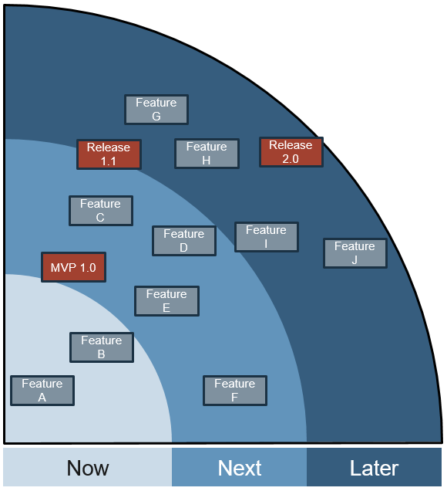

The now, next, later roadmap
Use this when deadlines and delivery dates are not strict. This is best suited for brainstorming a product plan when dependency mapping is not required.
Now
Next
Later
What are you going to do now?
(Very accurate)
What are you going to do very soon?
What are you going to do in the future?
(Vague and aspirational)
Source: Scrum.org, 2017

Slide 84
Now, next, later to support product owners
Input
Session materials and activities Previous slides and activities Organizational knowledge
Output
Now, next, later roadmap
30 minutes
Leveraging the personal start, stop, continue exercise, attempt to lay out the broad steps you want to take on as a management team to support your product owners.
Try to lay out in rough priority the items under each category:
  Now: Let’s do this ASAP, and quick wins
  Next: Sometime very soon, lets do these things
  Later: Much further down the road, let’s consider these things
For now, just write the items down; you can visualize the now, next, later roadmap later.
Info-Tech Research Group | 84

Slide 85
Now, next, later to support product owners
Input
Session materials and activities Previous slides and activities Organizational knowledge
Output
Now, next, later roadmap
30 minutes
Now | Next | Later
Being territorial | Be more collaborative | Respecting each other
Info-Tech Research Group | 85

Slide 86
Understanding Your
Top Challenges
Transitioning From Projects to Product-Centric Delivery
Enterprise Agility and the Value of Change
Defining Your Products and Product Management
Connecting Product Management to Agile Practices
Wrap-Up and Retrospective
Commit to Empowering Agile Product Teams
Wrap-Up and Retrospective

Slide 87
Aha moments!
Aha moment | Follow-up?

Slide 88
Thank you!

Slide 89
Supporting Research
Transformation topics and supporting Info-Tech research to make the journey easier, with less rework.

Slide 90
Supporting research and services
Improving IT alignment
Build a Business-Aligned IT Strategy
Success depends on IT initiatives clearly aligned to business goals, IT excellence, and driving technology innovation.
Make Your IT Governance Adaptable
Governance isn’t optional, so keep it simple and make it flexible.
Create an IT View of the Service Catalog
Unlock the full value of your service catalog with technical components.
Application Portfolio Management Foundations
Ensure your application portfolio delivers the best possible return on investment.

Slide 91
Supporting research and services
Shifting toward Agile DevOps
Agile/DevOps Resource Center
Find tools and advice you need to be successful with Agile.
Develop Your Agile Approach for a Successful Transformation
Understand Agile fundamentals, principles, and practices so you can apply them effectively in your organization.
Implement DevOps Practices That Work
Streamline business value delivery through the strategic adoption of DevOps practices.
Perform an Agile Skills Assessment
Being Agile isn’t about processes, it’s about people.
Define the Role of Project Management in Agile and Product-Centric Delivery
Projects and products are not mutually exclusive.

Slide 92
Supporting research and services
Shifting toward product management
Make the Case for Product Delivery
Align your organization on the practices to deliver what matters most.
Deliver on Your Digital Product Vision
Build a product vision your organization can take from strategy through execution.
Deliver Digital Products at Scale
Deliver value at the scale of your organization through defining enterprise product families.
Mature and Scale Product Ownership
Strengthen the product owner role in your organization by focusing on core capabilities and proper alignment.
Build a Value Measurement Framework
Focus product delivery on business value-driven outcomes.

Slide 93
Supporting research and services
Improving value and delivery metrics
Build a Value Measurement Framework
Focus product delivery on business value-driven outcomes.
Create a Holistic IT Dashboard
Mature your IT department by measuring what matters.
Select and Use SDLC Metrics Effectively
Be careful what you ask for because you will probably get it.
Reduce Time to Consensus with an Accelerated Business Case
Expand on the financial model to give your initiative momentum.

Slide 94
Supporting research and services
Improving governance, prioritization, and value
Make Your IT Governance Adaptable
Governance isn’t optional, so keep it simple and make it flexible.
Maximize Business Value from IT Through Benefits Realization
Embed benefits realization into your governance process to prioritize IT spending and confirm the value of IT.
Drive Digital Transformation with Platform Strategies
Innovate and transform your business models with digital platforms.
Succeed with Digital Strategy Execution
Building a digital strategy is only half the battle; create a systematic roadmap of technology initiatives to execute the strategy and drive digital transformation.
Build a Value Measurement Framework
Focus product delivery on business value-driven outcomes.
Create a Holistic IT Dashboard
Mature your IT department by measuring what matters.

Slide 95
Supporting research and services
Improving requirements management and quality assurance
Requirements Gathering for Small Enterprises
Right-size the guidelines of your requirements-gathering process.
Improve Requirements Gathering
Back to basics: great products are built on great requirements.
Build a Software Quality Assurance Program
Build quality into every step of your SDLC.
Automate Testing to Get More Done
Drive software delivery throughput and quality confidence by extending your automation test coverage.
Manage Your Technical Debt
Make the case to manage technical debt in terms of business impact.
Build a Winning Business Process Automation Playbook
Optimize and automate your business processes with a user-centric approach.
Create a Winning BPI Playbook
Don’t waste your time focusing on the “as is.” Focus on the improvements and the “to be.”

Slide 96
Supporting research and services
Improving release management
Optimize Applications Release Management
Build trust by right-sizing your process using appropriate governance.
Streamline Application Maintenance
Effective maintenance ensures the long-term value of your applications.
Streamline Application Management
Move beyond maintenance to ensure exceptional value from your apps.
Optimize IT Change Management
Right-size your change management process.
Manage Your Technical Debt
Make the case to manage technical debt in terms of business impact.
Improve Application Development Throughput
Drive down your delivery time by eliminating development inefficiencies and bottlenecks while maintaining high quality.

Slide 97
Supporting research and services
Improving Business Relationship Management
Embed Business Relationship Management in IT
Show that IT is worthy of Trusted Partner status.
Mature and Scale Product Ownership
Strengthen the product owner role in your organization by focusing on core capabilities and proper alignment.
Improving Security
Build an Information Security Strategy
Create value by aligning your strategy to business goals and business risks.
Develop and Deploy Security Policies
Enhance your overall security posture with a defensible and prescriptive policy suite.
Simplify Identity and Access Management
Leverage risk- and role-based access control to quantify and simplify the identity and access management (IAM) process.
Info-Tech Research Group | 97

Slide 98
Supporting research and services
Improving and Supporting Business Managed Applications
Embrace Business-Managed Applications
Empower the business to implement their own applications with a trusted business-IT relationship.
Enhance Your Solution Architecture Practices
Ensure your software systems solution is architected to reflect stakeholders’ short- and long-term needs.
Satisfy Digital End Users With Low- and No-Code
Extend IT, automation, and digital capabilities to the business with the right tools, good governance, and trusted organizational relationships.
Build Your First RPA Bot
Support RPA delivery with strong collaboration and management foundations.
Automate Work Faster and More Easily With Robotic Process Automation
Embrace the symbiotic relationship between the human and digital workforce.

Slide 99
Supporting research and services
Improving business intelligence, analytics, and reporting
Modernize Data Architecture for Measurable Business Results
Enable the business to achieve operational excellence, client intimacy, and product leadership with an innovative, agile, and fit-for-purpose data architecture practice.
Build a Reporting and Analytics Strategy
Deliver actionable business insights by creating a business-aligned reporting and analytics strategy.
Build Your Data Quality Program
Quality data drives quality business decisions.
Design Data-as-a-Service
Journey to the data marketplace ecosystems.
Build a Robust and Comprehensive Data Strategy
This is key to building and fostering a data-driven culture.
Build an Application Integration Strategy
Level the table before assembling the application integration puzzle or risk losing pieces.

Slide 100
Bibliography – Product Ownership
A, Karen. “20 Mental Models for Product Managers.” Medium, Product Management Insider, 2 Aug. 2018. Web.
Adams, Paul. “Product Teams: How to Build & Structure Product Teams for Growth.” Inside Intercom, 30 Oct. 2019. Web.
Agile Alliance. “Product Owner.” Agile Alliance, n.d. Web.
“Aligning IT Funding Models to the Pace of Technology Change.” EDUCAUSE. 14 Dec. 2015. Web.
Banfield, Richard, et al. “On-Demand Webinar: Strategies for Scaling Your (Growing) Enterprise Product Team.” Pluralsight, 31 Jan. 2018. Web.
Beck, Ken, et al. “What is the Agile Manifesto?” Agile Alliance, 2022. Web.
Blueprint. “10 Ways Requirements Can Sabotage Your Projects Right From the Start.” Blueprint, 2012. Web.
Breddels, Dajo, and Paul Kuijten. “Product Owner Value Game.” Agile2015 Conference, 2015. Web.
Cagan, Martin. “Behind Every Great Product.” Silicon Valley Product Group, 2005. Web.
Cohn, Mike “What is a product?” Mountain Goat Software, 16 Sept. 2016, Web
Cornelius and Associates. “The Qualities of Leadership: Leading Change, 2010.” Cornelius Associates, 2010.
Connellan, Thomas K. Inside the Magic Kingdom. Bard Press, 1997. Print.
Curphey, Mark, “Product Definition.” slideshare.net, 25 Feb. 2007. Web
Eringa, Ron. “Evolution of the Product Owner.” RonEringa.com, 12 June 2016. Web.
Fernandes, Thaisa. “Spotify Squad Framework - Part I.” Medium.com, 6 March 2017. Web.
Galen, Robert. “Measuring Product Ownership – What Does ‘Good’ Look Like?” RGalen Consulting, 5 Aug. 2015. Web.
Halisky, Merland, and Luke Lackrone. “The Product Owner’s Universe.” Agile Alliance, Agile2016, 2016. Web.
Kamer, Jurriaan. “How to Build Your Own ‘Spotify Model’.” Medium.com, 9 Feb. 2018. Web.
Kendis Team. “Exploring Key Elements of Spotify’s Agile Scaling Model.” Medium.com, 23 July 2018. Web.
Lindstrom, Lowell. “7 Skills You Need to Be a Great Product Owner.” Scrum Alliance, n.d. Web.

Slide 101
Bibliography – Product Ownership
Lukassen, Chris. “The Five Belts Of The Product Owner.” Xebia.com, 20 Sept. 2016. Web.
Management 3.0. “Delegation Poker Product Image.” Management 3.0, n.d. Web.
McCloskey, Heather. “Scaling Product Management: Secrets to Defeating Common Challenges.” ProductPlan, 12 July 2019. Web.
McCloskey, Heather. “When and How to Scale Your Product Team.” UserVoice, 21 Feb. 2017. Web.
Mironov, Rich. “Scaling Up Product Manager/Owner Teams: Rich Mironov's Product Bytes.” Rich Mironov's Product Bytes, Mironov Consulting, 12 April 2014 . Web.
Modi, Sunila, et al., “Negotiating Common Ground in Distributed Agile Development: A Case Study Perspective.” IEE Explore, 30 September 2013.
Overeem, Barry. “A Product Owner Self-Assessment.” Barry Overeem, 6 March 2017. Web.
Overeem, Barry. “Retrospective: Using the Team Radar.” Barry Overeem, 27 Feb. 2017. Web.
Pichler, Roman. “How to Scale the Scrum Product Owner.” Roman Pichler, 28 June 2016. Web.
Pichler, Roman. “Product Management Framework.” Pichler Consulting Limited, 2014. Web.
Pichler, Roman. “Sprint Planning Tips for Product Owners.” LinkedIn, 4 Sept. 2018. Web.
Pichler, Roman. “What Is Product Management?” Pichler Consulting Limited, 26 Nov. 2014. Web.
Radigan, Dan. “Putting the ‘Flow' Back in Workflow With WIP Limits.” Atlassian, n.d. Web.
Royce, W.W. “Managing the Development of Large Software Systems,” 1970.
Rubin, Ken. “Essential Scrum,” Agile Alliance, n.d. Web.
Schuurman, Robbin. “10 Tips for Product Owners on Agile Product Management.” Scrum.org, 28 Nov. 2017. Web.
Schuurman, Robbin. “10 Tips for Product Owners on (Business) Value.” Scrum.org, 30 Nov. 2017. Web.
Schuurman, Robbin. “10 Tips for Product Owners on Product Backlog Management.” Scrum.org, 5 Dec. 2017. Web.
Schuurman, Robbin. “10 Tips for Product Owners on the Product Vision.” Scrum.org, 29 Nov. 2017. Web.

Slide 102
Bibliography – Product Ownership
Schuurman, Robbin. “Tips for Starting Product Owners.” Scrum.org, 27 Nov. 2017. Web.
Sharma, Rohit. “Scaling Product Teams the Structured Way.” Monetary Musings, 28 Nov. 2016. Web.
Sharma, Rohit. “Scaling Product Teams the Structured Way.” Monetary Musings, 28 Nov. 2016. Web.
Steiner, Anne. “Start to Scale Your Product Management: Multiple Teams Working on Single Product.” Cprime, 6 Aug. 2019. Web.
Shirazi, Reza. “Betsy Stockdale of Seilevel: Product Managers Are Not Afraid To Be Wrong.” Austin VOP #50, 2 Oct. 2018. Web.
“The Standish Group 2015 Chaos Report.” The Standish Group, 2015. Web.
Theus, Andre. “When Should You Scale the Product Management Team?” ProductPlan, 7 May 2019. Web.
Tolonen, Arto. “Scaling Product Management in a Single Product Company.” Smartly.io, 26 Apr. 2018. Web.
Ulrich, Catherine. “The 6 Types of Product Managers. Which One Do You Need?” Medium.com, 19 Dec. 2017. Web.
VersionOne. “12th Annual State of Agile Report.” VersionOne, 9 April 2018. Web.
Verwijs, Christiaan. “Retrospective: Do The Team Radar.” Medium.com, 10 Feb. 2017. Web.
“How do you define a product?” Scrum.org, 4 April 2017, Web.
“Product Definition.” Techtarget, Sept. 2005. Web

Slide 103
Bibliography – Product Roadmap
Ambysoft. “2018 IT Project Success Rates Survey Results.” Ambysoft. 2018. Web.
Bastow, Janna. “Creating Agile Product roadmaps Everyone Understands.” ProdPad, 22 Mar. 2017. Accessed Sept. 2018.
Bastow, Janna. “The Product Tree Game: Our Favorite Way To Prioritize Features.” ProdPad, 21 Feb. 2016. Accessed Sept. 2018.
Chernak, Yuri. “Requirements Reuse: The State of the Practice.” 2012, Herzlia, Israel, 2012 IEEE International Conference on Software Science, Technology and Engineering, 12 June 2012. Web.
Fowler, Martin. “Application Boundary.” MartinFowler.com, 11 Sept. 2003. Accessed 20 Nov. 2017.
Harrin, Elizabeth. “Learn What a Project Milestone Is.” The Balance Careers, 10 May 2018. Accessed Sept. 2018.
“How to create a product roadmap.” Roadmunk, n.d. Accessed Sept. 2018.
Johnson, Steve. “How to Master the 3 Horizons of Product Strategy.” Aha!, 24 Sept. 2015. Accessed Sept. 2018.
Johnson, Steve. “The Product Roadmap vs. the Technology Roadmap.” Aha!, 23 June 2016. Accessed Sept. 2018
Juncal, Shaun. “How Should You Set Your Product Roadmap Timeframes?” ProductPlan, n.d. Accessed Sept. 2018.
Leffingwell, Dean. “SAFe 4.0.” Scaled Agile, Inc., 2017. Web.
Maurya, Ash. “What is a Minimum Viable Product (MVP)?” LEANSTACK, 12 June 2017. Accessed Sept. 2018.
Pichler, Roman. “10 Tips for Creating an Agile Product Roadmap.” Roman Pichler, 20 July 2016. Accessed Sept. 2018.
Pichler, Roman. Strategize: Product Strategy and Product Roadmap Practices for the Digital Age. Pichler Consulting, 2016.
“Product Roadmap Contents: What Should You Include?” ProductPlan, n.d. Accessed 20 Nov. 2017.
Saez, Andrea. “Why Your Roadmap Is Not a Release Plan.” ProdPad, 23 Oct. 2015. Accessed Sept. 2018.
Schuurman, Robbin. “Tips for Agile product roadmaps & product roadmap examples.” Scrum.org, 7 Dec. 2017. Accessed Sept. 2018
“Software Maintenance: Understanding and Estimating Costs.” LOOKFAR, 12 January 2022. Web

Slide 104


Emily Archer
David Berg
Lead Business Analyst,
Enterprise Consulting, authentic digital agency
Founder & CTO
Strainprint Technologies Inc.
Emily Archer is a consultant currently working with Fortune 500 clients to ensure the delivery of successful projects, products, and processes. She helps increase the business value returned for organizations’ investments in designing and implementing enterprise content hubs and content operations, custom web applications, digital marketing, and e-commerce platforms.
David Berg is a product commercialization expert that has spent the last 20 years of his career delivering product management and business development services across a broad range of industries. Early in his career, David worked with product management and engineering teams to build core network infrastructure products that secure and power the internet we benefit from today. David’s experience also includes working with clean technologies in the area of clean power generation, agritech, and Internet of Things infrastructure. Over the last five years David has been focused on his latest venture, Strainprint Technologies, a data and analytics company focused on the medical cannabis industry. Strainprint has built the largest longitudinal medical cannabis dataset in the world, with the goal to develop an understanding of treatment behavior, interactions, and chemical drivers to guide future product development.

Slide 105


Kathy Borneman
Charlie Campbell
Digital Product Owner, SunTrust Bank
Product Owner, Merchant e-Solutions
Kathy Borneman is a senior product owner who helps people enjoy their jobs again by engaging others in end-to-end decision making to deliver software and operational solutions that enhance the client experience and allow people to think and act strategically.
Charlie Campbell is an experienced problem solver with the ability to quickly dissect situations and recommend immediate actions to achieve resolution, liaise between technical and functional personnel to bridge the technology and communication gap, and work with diverse teams and resources to reach a common goal.

Slide 106


Yarrow Diamond
Cari J. Faanes-Blakey, CBAP, PMI-PBA
Sr. Director, Business Architecture
Financial Services
Enterprise Business Systems Analyst,
Vertex, Inc.
Yarrow Diamond is an experienced professional with expertise in enterprise strategy development, project portfolio management, and business process reengineering across financial services, healthcare and insurance, hospitality, and real estate environments. She has a master’s in Enterprise Architecture from Penn State University, LSSMBB, PMP, CSM, ITILv3.
Cari J. Faanes-Blakey has a history in software development and implementation as a Business Analyst and Project Manager for financial and taxation software vendors. Active in the International Institute of Business Analysis (IIBA), Cari participated on the writing team for the BA Body of Knowledge 3.0 and the certification exam.

Slide 107


Kieran Gobey
Rupert Kainzbauer
Senior Consultant Professional Services
Blueprint Software Systems
VP Product, Digital Wallets
Paysafe Group
Kieran Gobey is an IT professional with 24 years of experience, focused on business, technology, and systems analysis. He has split his career between external and internal customer-facing roles, and this has resulted in a true understanding of what is required to be a Professional Services Consultant. His problem-solving skills and ability to mentor others have resulted in successful software implementations.
Kieran’s specialties include deep system troubleshooting and analysis skills, facilitating communications to bring together participants effectively, mentoring, leadership, and organizational skills.
Rupert Kainzbauer is an experienced senior leader with a passion for defining and delivering products that deliver real customer and commercial benefit. Together with a team of highly experienced and motivated product managers, he has successfully led highly complex, multi-stakeholder payments initiatives, from proposition development and solution design through to market delivery. His domain experience is in building online payment products in high-risk and emerging markets, remittance, prepaid cards, and mobile applications.

Slide 108


Saeed Khan
Hoi Kun Lo
Founder,
Transformation Labs
Product Owner
Nielsen
Saeed Khan has been working in high tech for 30 years in both Canada and the US and has held several leadership roles in Product Management over that time. He speaks regularly at conferences and has been writing publicly about technology product management since 2005.
Through Transformation Labs, Saeed helps companies accelerate product success by working with product teams to improve their skills, practices, and processes. He is a cofounder of ProductCamp Toronto and currently runs a Meetup group and global Slack community called Product Leaders, the only global community of senior-level product executives.
Hoi Kun Lo is an experienced change agent who can be found actively participating within the IIBA and WITI groups in Tampa, FL, and a champion for Agile, architecture, diversity, and inclusion programs at Nielsen. She is currently a Product Owner in the Digital Strategy team within Nielsen Global Watch Technology.

Slide 109


Abhishek Mathur
Jeff Meister
Sr Director, Product Management
Kasisto, Inc.
Technology Advisor and Product Leader
Abhishek Mathur is a product management leader, an artificial intelligence practitioner, and an educator. He has led product management and engineering teams at Clarifai, IBM, and Kasisto to build a variety of artificial intelligence applications within computer vision, natural language processing, and recommendation systems. Abhishek enjoys having deep conversations about the future of technology and helping aspiring product managers enter and accelerate their careers.
Jeff Meister is a technology advisor and product leader. He has more than 20 years of experience building and operating software products and the teams that build them. He has built products across a wide range of industries and has built and led large engineering, design, and product organizations.
Jeff most recently served as Senior Director of Product Management at Avanade, where he built and led the product management practice. This involved hiring and leading product managers, defining product management processes, solution shaping and engagement execution, and evangelizing the discipline through pitches, presentations, and speaking engagements.
Jeff holds a Bachelor of Applied Science (Electrical Engineering) and a Bachelor of Arts from the University of Waterloo, an MBA from INSEAD (Strategy), and certifications in product management, project management, and design thinking.

Slide 110
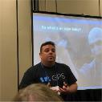

Vincent Mirabelli
Oz Nazili
Principal,
Global Project Synergy Group
VP, Product & Growth
TWG
With over 10 years of experience in both the private and public sectors, Vincent Mirabelli possesses an impressive track record of improving, informing, and transforming business strategy and operations through process improvement, design and re-engineering, and the application of quality to business analysis, project management, and process improvement standards.
Oz Nazili is a product leader with a decade of experience in both building products and product teams. Having spent time at funded startups and large enterprises, he thinks often about the most effective way to deliver value to users. His core areas of interest include Lean MVP development and data-driven product growth.

Slide 111


Mark Pearson
Brenda Peshak
Principal IT Architect
First Data Corporation
Product Owner,
Widget Industries, LLC
Mark Pearson is an executive business leader grounded in the process, data, technology, and operations of software-driven business. He knows the enterprise software landscape and is skilled in product, technology, and operations design and delivery within information technology organizations, outsourcing firms, and software product companies.
Brenda Peshak is skilled in business process, analytical skills, Microsoft Office Suite, communication, and customer relationship management (CRM). She is a strong product management professional with a Master’s focused in Business Leadership (MBL) from William Penn University.

Slide 112

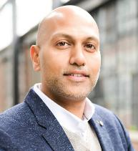
Mike Starkey
Anant Tailor
Director of Engineering
W.W. Grainger
Cofounder & Head of Product
Dream Payments Corp.
Mike Starkey is a Director of Engineering at W.W. Grainger, currently focusing on operating model development, digital architecture, and building enterprise software. Prior to joining W.W. Grainger, Mike held a variety of technology consulting roles throughout the system delivery lifecycle spanning multiple industries such as healthcare, retail, manufacturing, and utilities with Fortune 500 companies.
Anant Tailor is a cofounder at Dream Payments where he currently serves as the COO and Head of Product, having responsibility for Product Strategy & Development, Client Delivery, Compliance, and Operations. He has 20+ years of experience building and operating organizations that deliver software products and solutions for consumers and businesses of varying sizes.
Prior to founding Dream Payments, Anant was the COO and Director of Client Services at DonRiver Inc, a technology strategy and software consultancy that he helped to build and scale into a global company with 100+ employees operating in seven countries.
Anant is a Professional Engineer with a bachelor’s degree in Electrical Engineering from McMaster University and a certificate in Product Strategy & Management from the Kellogg School of Management at Northwestern University.

Slide 113

Angela Weller
Anonymous
Scrum Master, Businessolver
Senior Manager, Canadian P&C Insurance Company
Angela Weller is an experienced Agile business analyst who collaborates with key stakeholders to attain their goals and contributes to the achievement of the company’s strategic objectives to ensure a competitive advantage. She excels when mediating or facilitating teams.

Slide 114
Appendix:
Understanding Agile Scrum Practices and Ceremonies

Slide 115
The Agile key principles
Individuals and interactions
Working software
Customer collaboration
Responding to change
Doing Agile
Processes and tools
Comprehensive documentation
Contract negotiation
Following a plan
Being Agile
Notes:
Facilitator’s notes:
Review the balance
Comment that if you find yourself on the right as opposed to the left you might be doing Agile, but you won’t see the benefits of being agile.

Slide 116
Cultural advantages of Agile
Iterations
Continual improvement
Prioritization
Team members leverage all their experience working toward a common goal.
Collaboration
Cycles provide opportunities for more product feedback.
The most important needs are addressed in the current iteration.
Self-managing teams continually improve their approach for next iteration.

Slide 117
Beware of common Agile myths
Solves my development and communication issues
Does not require documentation
Will finish requirements faster

Slide 118
Basic scrum process
The scrum process coordinates multiple stakeholders to deliver on business priorities.
Prioritized backlog
Sprint backlog
Manage delivery
Sprint review
Product release
prioritizes
Ready
Commit
Done
Done
Product
owner
Sprint planning
Daily
scrum
Accepts
Burndown
Scrum
master
Team
members
Scrum
master
Team
members
Product
owner
1
2
3
4
The product owner prioritizes the backlog for the business.
The team determines effort to complete top priority tasks.
The team completes the tasks and updates daily scrum progress on a task board and burndown chart.
The product owner accepts work.

Slide 119
Understand the scrum process
The scrum process coordinates multiple stakeholders to deliver on business priorities.
gets
Task board
Product
points
Product
owner
UX
4
prioritizes
leads to
leads to
Product owner accepts work.
Product
owner
Sprint
planning
Sprint
backlog
Sprint
review
1
Product
backlog
Burndown
chart
accepts
product
participate
in
leads
to
Product owner prioritizes the backlog for the business.
through
Daily
scrum
updates
Scrum
master
Team
member
3
leads
Note: Functional requirements, which make up your product and sprint backlogs, are typically written as short user stories. Additional details are added to these user stories once they are ready and prioritized for immediate development.
Team
member
The team completes the tasks and updates daily scrum progress on a task board and burndown chart.
2
The team determines effort to complete top priority tasks.
PO and UX should come to standups to see if support is required
Scrum
master

Slide 120
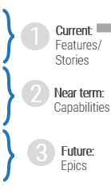


Understand the ceremonies part of the scrum process
Two- to four-week sprints:
Product backlog refinement
Scrum ceremonies that occur during a sprint
What have I done?
What will I do today?
Are there any roadblocks?
1
Current:
Features/
Stories
TASK
PBI
Sprint Backlog
TASK
TASK
TASK
TASK
TASK
2
Near term: Capabilities
Sprint planning: ~ two hours/sprint
Daily scrum/day
Demos with stakeholders might include a potentially releasable product increment
3
Future:
Epics
TASK
Blockers
Action Items
Sprint review: ~ two hours/sprint
Sprint retrospective: ~ two hours/sprint

Slide 121

Scrum vs. kanban – Key differences
Scrum:
Delivers related or grouped changes in fixed time intervals.
Kanban:
Delivers independent items as soon as each is ready.
Product backlog
Sprint backlog
Backlog item
Delivery cycles
Release
Product backlog (Alternative Model)
Backlog: Tickets, changes, requests, etc.
Sprint
Features
Tech debt
Deferred
Release

Slide 122
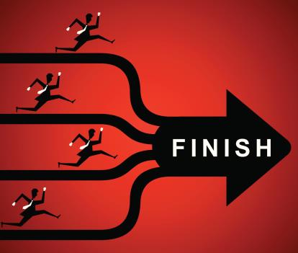

Scrum vs. kanban – When to use each
Scrum: Delivers related or grouped changes in fixed time intervals.
Coordinating the development or release of related items
Maturing a product or service
Interdependencies between work items
Kanban: Delivers independent items as soon as each is ready.
Work items from ticketing or individual requests
Completing independent changes
Releasing changes as soon as possible

Slide 123







Agile* SDLC
Key elements of the Agile SDLC
It is not one-and-done: There are many short iterations with constant feedback.
There is an empowered product owner: This is a single authoritative voice that represents stakeholders.
There is a fluid product backlog: This enables prioritization of requirements just in time.
Cross-functional, self-managing team: This team makes commitments and is empowered by the org to do so.
Working, tested code at the end of each sprint: Value becomes more deterministic along sprint boundaries.
Demonstrate to stakeholders: Allow them to see and use the functionality and provide necessary feedback.
Feedback is being continuously injected back into product backlog: This shapes the future of the solution.
Continuous improvement through sprint retrospectives.
Internally governed when done right (the virtuous cycle of sprint-demo-feedback).
With shared ownership instead of siloes, we are able to deliver value at the end of every iteration (AKA sprint).
Scrum
master
Input from stakeholders
Daily
Standup
Sprint
Retro
Sprint
(One to four Weeks)
Potentially deployable solution
Product
owner
Team
1)
Team commits to deliver “n” user stories by sprint’s end
User stories & tasks
2)
3)
Epics, features,
User stories & tasks
Backlog
Refinement
4)
5)
Sprint demo
6)
Sprint planning
7)
Sprint
backlog
8)
Stakeholders and
product owner
9)
10)
…
…
Product
backlog
Stakeholder feedback
* There are many Agile methodologies to choose from, but scrum is by far the most widely used (and is shown above).

Slide 124
Scrum roles and responsibilities
Product owner (PO) | Scrum master (SM) | Team members
For identifying the product features and their importance in the final project. For refining and reprioritizing the backlog that identifies which features will be delivered in the next sprint based on business importance. | For clearing blockers, and escalations when necessary. For leading scrums, retrospectives, sprint reviews, and demonstrations. For team building and resolving team conflicts. | For creating, testing, deploying, and supporting deliverable and valuable features. For self-managing. There is no project manager assigning tasks to each team member.
For delivering valuable features to stakeholders. | For ensuring communication throughout development. | For ensuring high quality deliverables for the product owner.
By the team through collaboration, rather than contract negotiation. | By product owner on resolution of risks. By the team on suggestions for improvement. | By the scrum master and product owner during sprint planning to determine level of complexity of tasks.
On the progress of the current sprint. | By the team on work completed during the current sprint. | On direction of the business and current priorities.
Responsible
Accountable
Consulted
Informed

Slide 125





Scrum ceremonies
Executed:
Are any of these challenges for your organization?
1)
Project backlog refinement (PO & SM): Prepare user stories to be used in the next two to three sprints. User stories are broken down into small manageable pieces of work that should NOT span sprints. If a user story is too big for a sprint, it is broken down further here. The estimation of the user story is examined, as well as the acceptance criteria, and each is adjusted as necessary from the Agile team members’ input.
Regularly over the project’s lifespan
2)
3)
4)
5)
6)
7)
8)
9)
10)
…
…
Sprint planning (PO, SM and delivery team): Discuss the work for the upcoming sprint with the business. Establish a clear understanding of the expectations of the team and the sprint. The product owner decides if priority and content of the user stories is still accurate, and the development team decides what they believe can be completed in the sprint using the user stories, in priority order, refined in backlog refinement.
At/before the start of each sprint
Daily stand-up (SM and delivery team): Coordinate the team to communicate progress and identify any roadblocks as quickly as possible. This meeting should be kept to 15 minutes. Longer conversations are tabled for a separate meeting. These are called stand-ups because attendees should stay standing for the duration, which helps keep the meeting short and focused. The questions each team member should answer at each meeting: What did I do since the last stand-up? What will I do before the next stand-up? Do I have any roadblocks?
Every day during the sprint
Sprint demo (PO, SM, delivery team, and stakeholders): Review and demonstrate the work completed in the sprint with the business (demonstrate working and tested code which was developed during the sprint and gather stakeholder feedback).
At the end of each sprint
Sprint retrospective (SM and delivery team (and PO)): Discuss how the sprint worked to determine if anything can be changed to improve team efficiency. The intent of this meeting is not to find/place blame for things that went wrong, but to find ways to avoid/alleviate pain points.
At the end of each sprint

Slide 126
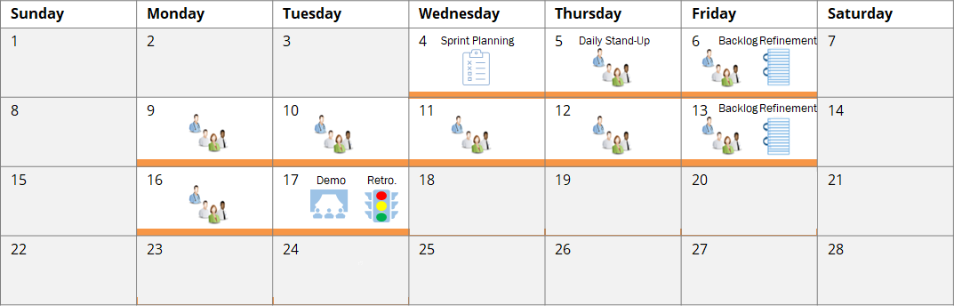
Sample delivery sprint calendar: Two-week
The following calendar illustrates a two-week scrum cadence (including ceremonies). This diagram is for illustrative purposes only; the length of the sprint and timing of ceremonies may differ from delivery team to delivery team based on their needs and schedules.
Project Backlog
Refinement
Sprint Planning
Daily Stand-Up
Sprint Demo
Sprint Retrospective
1)
2)
3)
4)
5)
6)
7)
8)
9)
10)
…
…

Slide 127


Sample delivery sprint calendar: Three-week
The following calendar illustrates a three-week scrum cadence (including ceremonies). This diagram is for illustrative purposes only; the length of the sprint and timing of ceremonies may differ from delivery team to delivery team based on their needs and schedules.
Sunday | Monday | Tuesday | Wednesday | Thursday | Friday | Saturday
1 | 2 | 3 | 4 | 5 | 6 | 7
8 | 9 | 10 | 11 | 12 | 13 | 14
15 | 16 | 17 | 18 | 19 | 20 | 21
22 | 23 | 24 | 25 | 26 | 27 | 28
Sprint Planning
Daily Stand-Up
Backlog Refinement
Backlog Refinement
Backlog Refinement
Demo
Retro.
Project Backlog
Refinement
Sprint Planning
Daily Stand-Up
Sprint Demo
Sprint Retrospective
1)
2)
3)
4)
5)
6)
7)
8)
9)
10)
…
…

Slide 128
Appendix:
Improving product management

Slide 129
Product delivery realizes value for your product family
While planning and analysis are done at the family level, work and delivery are done at the individual product level.
Defined at the
family level?
Defined at the
product level?
What are the artifacts?
What are you saying?
Product strategy
Vision
I want to...
Goals
To get there we need to...
Roadmap
To achieve our goals, we’ll deliver...
Strategic focus
Backlog
The work will be done in this order...
Release plan
We will deliver in the following ways...
Delivery focus

Slide 130
Manage and communicate key milestones
For successful product delivery you need to understand and define key milestones in your product delivery lifecycles. These need to be managed along with the product backlog and roadmap.
Q3 2022
Q4 2022
1H 2023
2H 2023
Mobility
Performance
Strategy
Learning milestone
Features A,B,C complete
MVP or major release
Info-Tech best practice
Product management isn’t just about managing the product backlog and development cycles.
Teams need to manage key milestones such as learning milestones, test releases, product releases, phase gates, and other organizational checkpoints!
Milestones
Release dates
Points in the timeline when established set of artifacts are complete (feature-based), or a status check at a particular point in time (time-based)
Typically assigned a date and used to show the progress of development
Play an important role when sequencing different types of artifacts
Releases mark the actual delivery of a set of artifacts packaged together in a new version of the product.
Release dates, firm or not, allow stakeholders to anticipate when this is coming.

Slide 131
A backlog stores and organizes PBIs at various stages of readiness
A well-formed backlog can be thought of as a DEEP backlog:
Detailed appropriately: PBIs are broken down and refined, as necessary.
Emergent: The backlog grows and evolves over time as PBIs are added and removed.
Estimated: The effort a PBI requires is estimated at each tier.
Prioritized: The PBI’s value and priority are determined at each tier.
New idea
3 – Ideas
Composed of raw, vague, and potentially large ideas that have yet to go through any formal valuation
Low-priority PBIs
Ideas
Product
backlog
2 – Qualified
Qualified
Researched and qualified PBIs awaiting refinement
1 – Ready
Ready
Discrete, refined PBIs that are ready to be placed in your development team’s sprint plans
High-priority PBIs
(Perforce, 2018)
Sprint backlog
Sprint
Adapted from Essential Scrum

Slide 132
Backlog tiers facilitate product planning steps
From the intake of an idea to a PBI ready for development, to enter the backlog each PBI must pass through a given quality filter.
Each activity is a variation of measuring value and estimating effort in order to validate and prioritize a PBI.
A PBI successfully completes an activity and passes through to the next backlog tier when it meets the appropriate criteria. Quality filters should exist between each tier.
Activity participants
Backlog
activity
Quality filter
Product
manager
Product
owner
Dev team
Scrum
master
Business
Architects
Intake
Ideas
Backlogged
Qualified
Analysis
Qualified
Refine
Ready
Ready
Sprint
Planning
Sprint
Accepted

Slide 133
Use quality filters to ensure focus on the most important PBIs
Expand the concepts of defining ready and done to include the other stages of a PBI’s journey through product planning.
Product
backlog
Sprint backlog
SPRINT
Enter the backlog
Intake
Analysis
Refine
Sprint planning
Not Started
In Progress
Completed
Quality filter
Backlogged
Qualified
Ready
Accepted
Is understood by the product team
Aligns to the product vision
Has defined benefits, acceptance criteria, and KPIs
Has undergone timeline, complexity, and effort estimations
Is decomposed into user stories, with all related requirements containing clear descriptions of what is expected of a given functionality
Has acceptance criteria, effort, value, and priority re-established at a more granular level
The PBI…
Is considered valuable, useable, and feasible
Fits within the capacity of a sprint
To ….
Enter the backlog
Invest
Prioritize
Execute
And justify
the next step of…
Initial research and design
Refinement and any other required business analysis
Sprint planning
Development
Product Demo
Info-Tech best practice
A quality filter ensures quality is met and the appropriate teams are armed with the appropriate information to work more efficiently and improve throughput.
Notes:
Discuss the importance of knowledge management for improving backlog throughput and quality.

Slide 134
Define product value by aligning backlog delivery with roadmap goals
In each product plan, the backlogs show what you will deliver. Roadmaps identify when and in what order you will deliver value, capabilities, and goals.

Slide 135
Product roadmaps guide delivery and communicate your strategy
In Deliver on Your Digital Product Vision, we demonstrate how the product roadmap is core to value realization. The product roadmap is your communicated path, and as a product owner, you use it to align teams and changes to your defined goals while aligning your product to enterprise goals and strategy.
Vision and leadership
Info-Tech Insight
The quality of your product backlog – and your ability to realize business value from your delivery pipeline – is directly related to the input, content, and prioritization of items in your product roadmap.
Guides
Is constrained by
Strategy and market research
Justifies
Product roadmap
Delivery capacity and throughput
Business value
Realization
Product lifecycle management
Manages
Product delivery pipeline
Sprint backlog
Business alignment and financials
Validates
Tiered product backlog
Adapted from: romanpichler, 2016.

Slide 136
Info-Tech’s approach
The Info-Tech difference:
Operationally align product delivery to enterprise goals.
Create a common definition of what a product is and identify products in your inventory.
Use scaling patterns to build operationally aligned product families.
Develop a roadmap strategy to align families and products to enterprise goals and priorities.
Use products and families to evaluate the delivery and organizational design improvements.
Goals & Strategy
Enterprise Goals & Strategy
Product Family
Product Family
Product Family
Product
Product
Product
Product
Enabling Capabilities
Goals & Strategy
Goals & Strategy
Changes can only be made at the product level.

Slide 137
What is a value score?
Importance of the
value driver
X
Impact of value source
= Value score
Key drivers to your key management goals
Ability to affect the Value Driver

Slide 138
What is a balanced score?
Build your balanced business value score using four key value drivers
+
Importance of value driver
x
Impact of value source
+
Importance of value driver
x
Impact of value source
+
Importance of value driver
x
Impact of value source
+
Importance of value driver
x
Impact of value source
=
Balanced business value score

Slide 139
Balanced value is one criteria to guide better decisions
Other criteria
Other criteria
Other criteria
Better
decisions
Balanced
business
value
Other criteria
Other criteria

Slide 140
Appendix:
How funding changes when applying product thinking

Slide 141
Why is funding so problematic?
“Most IT funding depends on one-time expenditures or capital-funding mechanisms that are based on building-construction funding models predicated on a life expectancy of 20 years or more. Such models don’t provide the stability or flexibility needed for modern IT investments.”
– EDUCAUSE
We often still think about funding products like construction projects.
Financial
Budget
Portfolio
CapEx
External services
Plan
Infrastructure
Build
Software licenses
Run
OpEx
Staffing
These models require increasing accuracy throughout the project lifecycle to manage actuals vs. estimates.

Slide 142
The lean enterprise funding model is an example of a different approach
A flexible funding pool akin to venture capital models is maintained to support innovative ideas and fund proofs of concept for product and process improvements.
POCs are run by standing innovation teams or a reserve of resources not committed to existing products, projects, or services.
Flexible funding pool
POC funding
POC and product line funding
Project funding
Product line funding
Product line funding
Every product line has funding for all changes and ongoing operations and support.
Common software, infrastructure, services, funding
Teams are funded continuously so that they can learn and improve their practices as much as possible.
From Info-Tech’s Develop Your Agile Approach for a Successful Transformation

Slide 143
Consider how investment spending will differ in an Agile environment
Info-Tech Insight
Traditional budgets place the focus on cost centers, whereas Agile budgets account for value streams. The value streams are based around initiatives that may span cost centers.
Traditional budgeting
Annual/quarterly budget formation
Vision
Strategy
Budgeted/ actual expenses
Budgeted/ actual revenues
End-of-year financial statements
Agile budgeting
Budget formation around value streams
Product backing (value streams)
Vision
Strategy
[Shorter timeframe]
Sprint planning and funding
Scrum funding
Adjustment
Delivery/ evaluation

Slide 144

Your strategy must include the cost to build and operate
Most investment happens after going live, not in the initial build!
Development team
Maintenance team
100%
Common perception
20%
40%-80%
Enhancements
Bug fixes and maintenance
Info-Tech Insight
While the exact balance point between development or implementation costs varies from application to application, over 80% of the cost is accrued after going live.
Research shows
?
*21%
Develop and implement
The development team’s work distribution is independent of the work distribution model for the maintenance team.
Implement deferred features
Enhancements
Bug fixes and maintenance
Source: “Does Code Decay? Assessing the Evidence from Change Management Data”
In costing of initiatives, maintenance costs are usually unaccounted for up front.
<20%
>80%
Adapted from: LOOKFAR LABS

Slide 145

Traditional accounting leaves software development CapEx on the table
Software development costs have traditionally been capitalized, while research and operations are operational expenditures.
The challenge has always been the myth that operations are only bugfixes, upgrades, and other operational expenditures.
Research shows that most post-release work on developed solutions is the development of new features and changes to support material changes in the business.
While projects could bundle some of these changes into capital expenditure, much of the business-as-usual work that goes on leaves capital expenses on the table because the work is lumped together as maintenance-related OpEx.
From Info-Tech’s How to Stop Leaving Software CapEx on the Table With Agile and DevOps

Slide 146


Budgeting approaches must evolve as you mature your product operating environment
Traditional projects with waterfall delivery
Traditional
projects
with agile
delivery
Products
with
Agile project delivery
Products
with
Agile
delivery
When is the budget tracked?
Budget tracked in major phases
Budget tracked by sprint and project
Budget tracked by sprint and project
Budget is tracked by sprint and release
How are changes handled?
Scope change is routine; budget change is by exception
Scope change is routine; budget change is by exception
Budget change is expected on roadmap cadence
All change is by exception
When are benefits realized?
Benefits realization after project completion
Benefits realization is ongoing throughout the life of the project
Benefits realization is ongoing throughout the life of the product
Benefits realization ongoing throughout life of the product
Project manager
Project team delivery role
Refines project scope, advocates for changes in the budget.
Advocates for additional funding in the forecast
Product owner
Project team delivery role
Refines project scope, advocates for changes in the budget.
Advocates for additional funding in the forecast
Product manager
Product portfolio team role
Forecasting new initiatives during delivery to continue to drive value throughout the life of the product.
Product manager
Product family team role
Forecasting new initiatives during delivery to continue to drive value throughout the life of the product.
Who ‘drives’?
Info-Tech Insight
As you evolve your approach to product delivery, you will be decoupling the expected benefits, forecast, and budget. Managing them independently will improve your ability to adapt to change and drive the right outcomes!
Hybrid operating environments

Slide 147
Appendix:
SDLC transformation steps

Slide 148
Waterfall SDLC – Valuable product delivered at the end of an extended project lifecycle, frequently in years
One-time intake of business need
Project charter, project plan, status reports
Project
manager
Plan
Define project charter
Define project plan
Approved?
Business
Business
analyst
Define
Elicit business requirements
Elicit use cases
Generate functional requirements
Approved?
Requirements document
Solution
architect
Design
Create high- level design
Create
detailed design
receive design approval
Approved?
Design document
Create unit tests
No
Yes
Unit tested code, build, deployment scripts
Development
Developer
Build
Create code
Passed?
Build QA version
Test
Create test strategy
Create test plan
Define and execute test cases
No
Yes
Inform change management
Test summary report
Tester
Passed?
Release
manager
Deploy
Build deployment plan
Approved?
Deploy prod. version
Deployment report
Operations
Incidents, issues, problems
Operations
Maintain
Accept support requests
Log incident
Redirect to resolver
Update incident
Close incident
Business is separated from delivery of technology it needs; only one third of product is actually valuable (Info-Tech, N=40,000).
In Waterfall a team of experts in specific disciplines hand off different aspects of the lifecycle.
Document signoffs are required to ensure integration between silos (business, dev, and ops) and individuals.
A separate change request process lays over the entire lifecycle to prevent changes from disrupting delivery.
Tools are deployed to support a specific role (e.g. BA) and seldom integrated (usually requirements <-> test).

Slide 149
Wagile/Agifall/WaterScrumFall SDLC – Valuable product delivered in multiple releases
Business users are closely engaged by PO to ensure the product fulfills their needs
PO as BRM
One time intake of business need
Project charter, project plan, status reports
Project
manager
Plan
Define project charter
Define project plan
Approved?
Business
Product
owner
Define
Create test strategy
Elicit business requirements
Define features and releases
Define product backlog
Refine sprint backlog
Product backlog
Sprint planning
Sprint
backlog item:
User story
Refine requirements
Define acceptance criteria
Design solution
Manually Tested code, build, deployment scripts
Scrum master
Team develops cross-functional skills to reduce time to value
Design, build, test
Sprint planning
Test
code
No
Yes
Development
Create code
Works?
Sprint
done?
No
Review sprint
User demonstration and feedback
Retrospective (refine process)
Inform change management
Update documentation required by policy
Dev
team
Release
manager
Deploy
Build deployment plan
Approved?
Deploy prod. version
Deployment report
Operations
Incidents, issues, problems
Operations
Maintain
Accept support requests
Log incident
Redirect to resolver
Update incident
Close incident
Business is more closely integrated by a business product owner accountable for day-to-day delivery of value for users.
The team collaborates and develops cross-functional skills as they define, design, build, and test code over time.
Signoffs are reduced but documentation is still focused on satisfying project delivery and operations policy requirements.
Change is built into the process to allow the team to respond to change dynamically.
Tools start to be integrated to streamline delivery (usually requirements and Agile work management tools).

Slide 150
Agile SDLC – Valuable product delivered iteratively: frequency depends on Ops’ capacity
Frequent intake of business needs
Product/portfolio
manager
Define epic backlog
Define product roadmap
Approved?
Product backlog, product roadmap, status reports
Business
Plan, define
Create test strategy
Elicit business requirements
Define features and releases
Define product backlog
Refine sprint backlog
Product
owner
Sprint
backlog
Item:
user story
Partially automated code, test, build, deployment
Sprint planning
Refine requirements
Define acceptance criteria
Design solution
Scrum master
Test
code
No
Yes
Development
Design, build, test
Create code
Works?
Sprint
done?
No
Update documentation required to enhance and support
Dev
team
Review sprint
User demonstration and feedback
Retrospective (refine process)
Inform change management
Release
manager
Deploy
Build deployment plan
Approved?
Deploy prod. version
Deployment report
Operations
Incidents, issues, problems
Operations
Maintain
Accept support requests
Log incident
Redirect to resolver
Update incident
Close incident
Business users are closely integrated through regularly scheduled demos (e.g. every two weeks).
Team is fully cross-functional and collaborates to plan, define, design, build, and test the code supported by specialists.
Documentation is focused on future development and operations needs.
Change is built into the process to allow the team to respond to change dynamically.
Explore automation for application development (e.g. automated regression testing).

Slide 151
Agile with DevOps SDLC – High frequency iterative delivery of valuable product (e.g. every two weeks)
Frequent intake of business need
Product/portfolio
manager
Define epic backlog
Define product roadmap
Approved?
Product backlog, product roadmap, status reports
Business
Plan, define
Create test strategy
Elicit business requirements
define features and releases
define product backlog
Refine sprint backlog
Product
owner
Sprint planning
Sprint
backlog
Item:
user story
Refine requirements
Define acceptance criteria
Design solution
Working code with automated test, build, and deploy
Scrum master
Test
code
No
Yes
Development
Design, build, test, deploy
Create code
Works?
Sprint
done?
No
Dev
team
Review sprint
User demonstration and feedback
Retrospective (refine process)
Deploy prod. version
Update tool-based documentation required to enhance, adopt, and support
Operations
Operations
Incidents, issues, problems
Maintain
Accept support requests
Log incident
Redirect to resolver
Update incident
Close incident
Business users are closely integrated through regularly scheduled demos.
Dev and ops teams collaborate to plan, define, design, build, test, and deploy code supported by automation.
Documentation is focused on supporting users, future changes, and operational support.
Change is built into the process to allow the team to respond to change dynamically.
Build, test, deploy is fully automated (service desk is still separated).

Slide 152
DevOps SDLC – Continuous integration and delivery
Frequent intake of business need
Product/portfolio
manager
Define epic backlog
Define product roadmap
Approved?
Product backlog, product roadmap, status reports
Business
Plan, define
Create test strategy
Elicit business requirements
Define features and releases
Define product backlog
Refine sprint backlog
Product
owner
Refine backlog
Backlog
item
Refine requirements
Define acceptance criteria
Design solution
Working code with automated test, build, and deploy
Create code
Test
code
No
Yes
Sprint
done?
Design, build, test, deploy,
maintain
Works?
No
DevOps
team
Accept support requests
Review backlog item
User demonstration and feedback
Periodic retrospective
Deploy prod. version
Update tool-based documentation required to enhance, adopt, and support
Development + Operations
Incidents, issues, problems
Maintain
Business users are closely integrated through regularly scheduled demos.
Fully integrated DevOps team collaborates to plan, define, design, build, test, deploy, and maintain code.
Documentation Is focused on future development and use adoption.
Change is built into the process to allow the team to respond to change dynamically.
There is a fully integrated development and operations toolchain.

Slide 153
Fully integrated product SDLC – Agile + DevOps + continuous delivery of valuable product on demand
Frequent intake of business need
Product/portfolio
manager
Define epic backlog
Define product roadmap
Approved?
Product backlog, product roadmap, status reports
Create test strategy
Elicit business requirements
Define features and releases
Define product backlog
Refine sprint backlog
Product
owner
Refine backlog
Backlog
item
Refine requirements
Define acceptance criteria
Design solution
Working code with automated test, build, and deploy
Create code
Test
code
No
Yes
Sprint
done?
Business + Development + Operations
Works?
Plan, define, design, build, test, deploy,
maintain
No
DevOps
team
Accept support requests
Review sprint
User demonstration and feedback
Retrospective (refine process)
Deploy prod. version
Update tool-based documentation required to enhance, adopt, and support the product
Incidents, issues, problems
Maintain
Business users are fully integrated with the teams through dedicated business product owner.
Cross-functional teams collaborate across the business and technical life of the product.
Documentation supports internal and external needs (business, users, Ops).
Change is built into the process to allow the team to respond to change dynamically.
Fully integrated toolchain (including service desk).

Slide 154
Appendix:
About Info-Tech

Slide 155
It just makes sense to leverage best-practices
Best practices you can leverage shared by 35,000 members
Millions spent developing tools and templates annually
Leverage direct access to over 100 analysts as an extension of your team
Use our massive database of benchmarks and vendor assessments
Get up to speed in a fraction of the time
Avoid starting from scratch

Slide 156
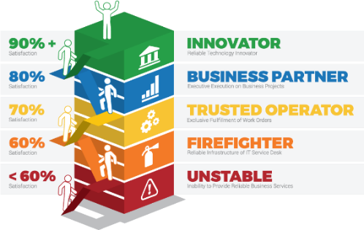
Systematically improve
IT performance
Follow our standardized path to drive IT maturity and effectiveness for your department. Each leader on your team will work with a dedicated Info-Tech executive advisor to create customized annual roadmaps to address their specific challenges and opportunities. Whether your IT department is an unstable operator, an innovative champion, or at any stage in between, Info-Tech has the proven knowledge and skills, and years of practical IT management and advisory experience to help stabilize and optimize your IT operations.
Each executive on your team receives:
Info-Tech Research Group maturity model
A dedicated executive advisor to help diagnose and drive improvement within your organization.
A customized key initiative plan based on your top priorities and a clear roadmap of how to improve their IT function.
On-demand advisory support for all your key projects.
Complete online access to tools and best-practice resources.

Slide 157
A step-by-step program to systematically improve IT performance
Info-Tech provides best-practice research to
make your job easier.
01 Manage and improve core IT processes
02 Faster and more effectively complete your technology
projects
Tools and templates
Step-by-step methodologies
Benchmarking and diagnostic programs
Training and executive coaching
Insights and advice from 20,000+ peers
03 Train and develop your IT leadership team
₀₄ Build a data-driven IT strategy
05 A step-by-step program to systematically improve IT

Slide 158
Info-Tech
Performance Difference
For over 20 years Info-Tech has provided IT teams with practical advice that helps make measurable improvement.
Since launching our systematic program to improve IT performance in 2013, Info-Tech members have dramatically outperformed their peers by delivering superior levels of business satisfaction.

Slide 159
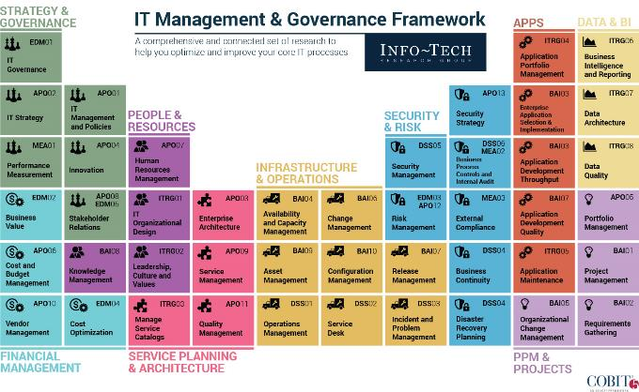
Info-Tech covers a comprehensive set of 45 core IT processes, and more

