Slide 1
Prepare to Lead Product Delivery − Executive Leadership Concierge Services
Outcomes and Next Steps
Strengthen product management in your organization through effective executive leadership by focusing on product teams on core capabilities and proper alignment.

Slide 2

Objective of this session
To develop a common understanding and foundation for product management so as leaders
we better understand how to lead product owners, product managers, and their teams.

Slide 3
Top challenges driving your organization to become product-centric
Challenge or risk | Supporting research
Establish alignment and support for your transition to product delivery | Make the Case for Product Delivery
Work toward better product development | Deliver on Your Digital Product Vision
Understand business priorities | Build a Business-Aligned IT Strategy
How to bring priorities and effectiveness together | Deliver on Your Digital Product Vision
Having a common understanding of product delivery across our teams | Mature and Scale Product Ownership
Learn a new "product" model which will help the business to better adapt and compete | Deliver Digital Products at Scale
Find a model that would help IT to deliver more efficiently | Develop Your Agile Approach for a Successful Transformation
Define the tools to be able to deploy product management/delivery in place | Implement DevOps Practices That Work
Notes:
Facilitator notes:
Write a summary of the stories on a flip chart or whiteboard that you will leave up throughout the session.
Identify which stories you will be addressing.
Park stories that are out of scope for the session and should be dealt with in an advisory call, a future four-day session, or by the company’s transformation team.
For very large groups you should send the story cards in advance and get them returned at least one week prior to the session to review, analyze, and map to the covered topics.

Slide 4
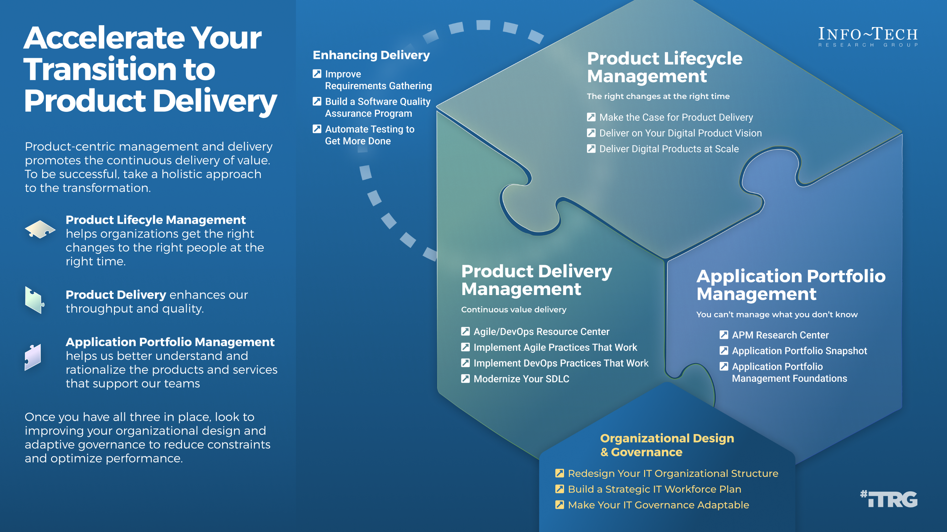

Slide 5
Define the differences between projects and product delivery
VS.
Project delivery | Product delivery
Delivery window that starts and ends​ | While there are delivery opportunities, delivery is continuous and evolves over time​
Resources brought together to accomplish something and then taken away​ | Product is something to be nurtured. Continuous delivery of value requires a long-running pipeline with resources that can be scaled up or down as required
Smaller lifecycle (do something quickly)​ | Much longer lifecycle (birth -> retirement)​
Project brings together individual silos for a given outcome​ | Continuously developed by similar groups/teams that have a consistent association with each other​
A predefined set of tasks to be completed​ | More business outcome focused – evolve over time to make it better
Hop from one thing to another​ | Dedicated – serves customers/stakeholders over time. Better aligned with customer needs
Local focus on the specific project​ | Broad focus – delivery of value to the business ​
Consumes resources (mindset: treated as a cost)​ | Is eventually the resource (mindset: treated as driving value)​
Notes:
Capture the differences here.

Slide 6

Results: What is a product?
A combination of custom applications, off-the-shelf products, or programs/services that enables the long-term and evolving delivery of value to customers, employees, and stakeholders based on business and user requirements. (This is a proposed synthesis of key notes below)
Info-Tech facilitator insight
There is flexibility as to how each organization defines a product, but certain things are required:
First, and most important, a clear statement that the product delivers value to a user/customer
Second, a product does not have to be physical in the hand or purely a piece of software, but a combination of them with associated services that enables the delivery of value
We encourage you to continue to refine this definition and ensure it is shared to those involved.
Key notes from our discussion:
Any solution which is produced to help in the business
Can be internal to the group as well as external
Developed through a process to provide value to stakeholders and org
Provides a service
Evolves with the needs of the group/stakeholders/client
Provides service, function, value to the stakeholder group
Ends when the business wants it to end
End users don’t have to understand the nuances of the product; they need to understand the outcomes they receive from the service offered to them
Notes:
This definition will be updated as a result of the exercise: “What is a “product”? Who are your “consumers”?”

Slide 7
Enablers and blockers of product ownership
Enablers | Blockers | Mitigation
High business engagement and buy-in | Significant time is required to implement and train resources | Limit the scope for pilot project to allow time to learn
Organizational acceptance for change | Geographically distributed resources | Temporarily collocate all resources and acquire virtual communication technology
Existing tools can be customized for BRM | Difficulty injecting customers in demos | Educate customer groups on the importance of attendance and what's in it for them
Notes:
Record here the results of the exercise: “Identify enablers and blockers of product ownership”

Slide 8
Projects can be a mechanism for funding product changes and improvements
Projects within products
Regardless of whether you recognize yourself as a product-based or project-based shop, the same basic principles should apply.
You go through a period or periods of project-like development to build a version of an application or product.
You also have parallel services along with your project development, which encompass the more product-based view. These may range from basic support and maintenance to full-fledged strategy teams or services like sales and marketing.
Continuous delivery of value
Product release
Product release
Product releases
Product releases
Hybrid lifecycle
Product lifecycle
Product release
Product release
Product roadmap
Project lifecycle
Product backlog
Project
Project
Project
Project
Project
Project
  Features
  Services
  Features
  Services
  Features
  Services
  Features
  Services
CI/CD delivery cycles
Notes:
Projects do not have to go away because you have products. Product owners shift away from incremental projects to product maturity and the continuous delivery of value.
Shifting to a product focus is a change in perspective. Teams need to view the product or service as a long-term entity that will be managed, enhanced, and adapted to meet the organization's changing needs.
Projects can still be the source of funding. The Project release milestones or phases are tied to the Product Releases. A project is simply the team funding method for the product lifecycle or specific product releases in the roadmap.
In a hybrid model, product owners now use their roadmaps and backlogs to generate and manage release scope. This aligns with your continuous delivery of product value and longer-term alignment with enterprise goals.
Teams still need to focus on key milestones and releases, especially when other teams are impacted. Project managers continue to manage milestones and PMO governance gates, but not long-manage tasks and work assignments (Agile uses self-managing teams). If the team does not use PMs, then the product owner or scrum master takes over these responsibilities.
As you improve product delivery maturity, product releases can follow your CI/CD delivery pipeline and coordinate timed releases when end users are impacted or require training/communication.

Slide 9
While agile and product are intertwined, they are not the same!
Delivering products does not necessarily require an Agile mindset. However, Agile methods help facilitate the journey because product thinking is baked into them.
Product delivery maturity
Continuous integration
and delivery
DevOps
Agile
Throughput
Efficiency
Iterative
ROI
Stakeholder value
Waterfall/
ad hoc
Stability

Slide 10
Product roadmaps guide delivery and communicate your strategy
In Deliver on Your Digital Product Vision, we demonstrate how the product roadmap is core to value realization. The product roadmap is your communicated path, and as a product owner, you use it to align teams and changes to your defined goals while aligning your product to enterprise goals and strategy.
Vision and leadership
Info-Tech Insight
The quality of your product backlog – and your ability to realize business value from your delivery pipeline – is directly related to the input, content, and prioritization of items in your product roadmap.
Guides
Is constrained by
Strategy and market research
Justifies
Product roadmap
Delivery capacity and throughput
Business value
realization
Product lifecycle management
Manages
Product delivery pipeline
Sprint backlog
Business alignment and financials
Validates
Tiered product backlog
Adapted from: romanpichler

Slide 11

Product delivery realizes value for your product family
While planning and analysis are done at the family level, work and delivery are done at the individual product level.
Defined at the
family level?
Defined at the
product level?
What are the artifacts?
What are you saying?
Product strategy
Vision
I want to...
Goals
To get there we need to...
Roadmap
To achieve our goals, we’ll deliver...
Strategic focus
Backlog
The work will be done in this order...
Release plan
We will deliver in the following ways...
Delivery focus

Slide 12
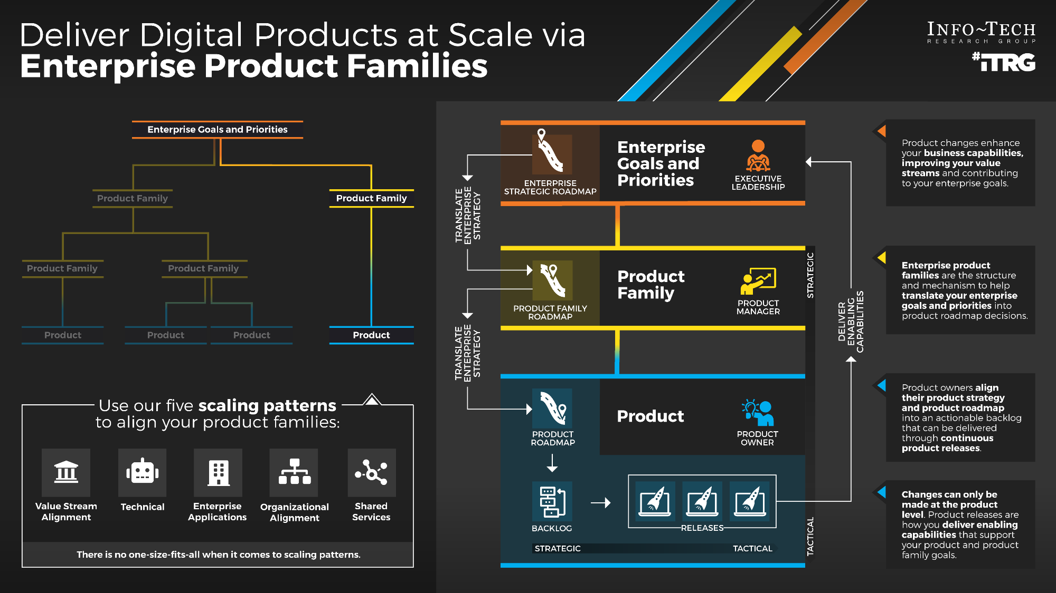
Deliver Digital Products at Scale via Enterprise Product Families – Thought Model

Slide 13

Guiding Principles
Guiding principles provide your teams with rules, goals, or themes to help frame and direct decisions.

Slide 14
Product management guiding principles
Principle | Principle in action
Think above the trees, not in the weeds. | Clearly articulate and understand customer and end-user value. Consider a longer-term vision and strategy. Consider your vision – not everything is an emergency. Consider many different classes of work as important in product delivery (build, maintain, update technology, etc.). Invest in debt reduction and other technical concerns to ensure a positive functional outcome. Create an integrated product team that is dedicated to the vision, requirements, development, and delivery of value for a given product.
Be consistent with our practices and standards. | Consistently use tools, processes, and standards across products. Treat projects and products differently; each are important and do very different things. Separate and define roles around planning and execution.
Align with what the business needs, not how we feel. | Take the right approach for the product/problem. Ensure clear coverage and accountabilities for all products and applications. Reflect and reevaluate product portfolio based on business needs and changes. Be metrics driven. Align product roadmaps with organization goals.
Focus on what your customer needs, not what they want. | Always think in the problem space about the underlying problem. Have an overall functional focus, not a technology focus. Leverage user feedback to ensure you are solving problems the correct way. Have regular touchpoints and communication with customers, users, and stakeholders. Deliver value incrementally to ensure you are delivering what is right over time.
Notes:
Use this table to record the exercise: “Define a set of guiding principles for product management”

Slide 15




Your management culture
Actual
Collaboration
Success by working together
Control
Success by getting and maintaining control
Some projects want control from the top
Perception that products will just happen to the team
Resistant to changes (concerned with the impacts)
Perception that development team is doing nothing.
Integrate IT with business needs
Info-Tech facilitator insight
We see a continuing theme around business engagement. Some of the challenges here come from the lack of trust with the business.
Building trust and credibility is a process, not a lightbulb moment. Consider opportunities to embed stakeholders within product planning to help build trust and credibility.
People
Company
Cultivation
Success by
growing people
Competence
Success by being
the best
Plan for better product owners that really own products
Some projects are very agile. POs walked the walk
Recognition that change is a constant
Groundswell culture of innovation
Technological support
Possible
Notes:
This chart will represent the results of the exercise: “Your management culture”

Slide 16

There is no such thing as painless change
Ensure Focus
People must be able to focus on the new behaviors to make them patterns.
Understand Expectations
People need to shape their own expectations to make the change.
Develop Practice
Individuals must commit to and repeat practices that will make the change stick.

Slide 17

Personal cultural stop, start, and continue
Stop… | Start… | Continue…
Working in silo, thinking of kingdoms rather than sharing information across the company. Lack of collaboration drives poor results. | Being more transparent with roles and responsibilities. | Being eager for knowledge. Learn all you can!
Operating in an order-taking style. Instead, accept the empowerment, be creative, and make your voice heard. | Thinking beyond the prescriptiveness of the job description. | Being curious – don’t be afraid of next level thinking. Take it to the next step.
Doing one-and-done initiatives. Think in the long term and about continuity. Your initiatives are typically never a one-and-done. | Enhancing the clarity of communication and understand your target audience/stakeholder. | Evangelizing an agile process and how it can help deliver value more effectively.
Trying to solve every problem. | Providing transparency of work and intent. | Building trust through consistent execution, delivery, and collaboration.
Being afraid to say “no” or “not now” when you have too much on your plate. | Building trust through consistent execution, delivery, and collaboration.
 | Building trust around products being supported longer term rather than one-and-done.
 | Working with other groups as part of the team, considering problems “ours” rather than “theirs.”
 | Incorporating supporting groups (architecture, business, etc.) in vision, roadmap, and backlog planning.
 | Managing expectations with customers.
Notes:
Record here the results of the exercise: “Personal Stop, Start, and Continue”

Slide 18
Use CLAIM to guide your journey
Product-centric delivery and Agile are a radical change in how people work and think. Structured, facilitated learning is required throughout the transformation to help leaders and practitioners make the shift.
Value is best created by self-managing teams who deliver in frequent, short increments supported by leaders who coach them through challenges.
Learning
Automation
Culture
Metrics and governance
Integrated teams
Successful implementations require the disciplined use of metrics that support developing better teams.
  Product management, Agile, and DevOps have inspired SDLC tools that have become a key part of delivery practices and work management.
Self-organizing teams that cross business, delivery, and operations are essential to gain the full benefits of product-centric delivery.

Slide 19

Communicate reasons for changes and how they will be implemented
Five elements of communicating change
Leaders of successful change spend considerable time developing a powerful change message; that is, a compelling narrative that articulates the desired end state and that makes the change concrete and meaningful to staff.
The organizational change message should:
Explain why the change is needed.
Summarize what will stay the same.
Highlight what will be left behind.
Emphasize what is being changed.
Explain how change will be implemented.
Address how change will affect various roles in the organization.
Discuss the staff’s role in making the change successful.
What is the change?
What will the role be for each department, individual?
Why are we doing it?
Communicating the change
How long will it take us to do it?
How are we going to go about it?
Source: Cornelius and Associates, 2010.

Slide 20



Now, next, later roadmap to support product owners
Now | Next | Later
Work on stakeholder mapping. | Bring more stakeholders to the table to create better prioritization. | Ask to be an observer in some of the other teams’ sprint planning to see how they are doing things that our team can improve on.
Build standardized roadmaps. | Firm up agreements on milestones and roadmaps through stakeholder consensus and funding approvals. | Enable new or increased revenue streams through the product with novel and enhanced functionality.
Review our PBI quality filter for the backlog. | Step back and look at a higher view of what we are doing. | Identify ROI.
Redefine roadmap milestones. | Make visible the progress being done. | Make clearer connections between roadmap and epics and features.
Prioritize product functionality. | Prioritize product enhancements. | Need less granular milestones and roadmaps and shift stakeholders to visionary mindset for product potential.
Create different roadmaps for the different audiences. | Review and standardize agile processes across silos as necessary. | Standardize and improve business/customer feedback loop?
Establish stakeholder trust and renewed commitment through frequent meetings and delivering a stable product. | Work on communication.
Define metrics to assess performance.
Continue improving our current agile practices.
Notes:
Record here the results of the exercise: “Now, Next, Later to support product owners”

Slide 21
Thank you!

Slide 22
Supporting Research
Transformation topics and supporting Info-Tech research to make the journey easier, with less rework.

Slide 23
Supporting research and services
Improving IT alignment
Build a Business-Aligned IT Strategy
Create an IT View of the Service Catalog
Application Portfolio Management Foundations
Success depends on IT initiatives clearly aligned to business goals, IT excellence, and driving technology innovation.
Make Your IT Governance Adaptable
Governance isn’t optional, so keep it simple and make it flexible.
Unlock the full value of your service catalog with technical components.
Ensure your application portfolio delivers the best possible return on investment.

Slide 24
Supporting research and services
Shifting toward Agile DevOps
Perform an Agile skills assessment
Define the Role of Project Management in Agile and Product-Centric Delivery
Find tools and advice you need to be successful with Agile.
Develop Your Agile Approach for a Successful Transformation
Understand Agile fundamentals, principles, and practices so you can apply them effectively in your organization.
Implement DevOps Practices That Work
Streamline business value delivery through the strategic adoption of DevOps practices.
Being Agile isn’t about processes, it’s about people.
Projects and products are not mutually exclusive.
Agile/DevOps Resource Center

Slide 25
Supporting research and services
Shifting toward product management
Mature and Scale Product Ownership
Build a Value Measurement Framework
Align your organization on the practices to deliver what matters most.
Deliver on Your Digital Product Vision
Build a product vision your organization can take from strategy through execution.
Deliver Digital Products at Scale
Deliver value at the scale of your organization through defining enterprise product families.
Strengthen the product owner's role in your organization by focusing on core capabilities and proper alignment.
Focus product delivery on business value-driven outcomes.
Make the Case for Product Delivery

Slide 26
Supporting research and services
Improving value and delivery metrics
Build a Value Measurement Framework
Be careful what you ask for because you will probably get it.
Reduce Time to Consensus with an Accelerated Business Case
Expand on the financial model to give your initiative momentum.
Mature your IT department by measuring what matters.
Select and Use SDLC Metrics Effectively
Focus product delivery on business value-driven outcomes.
Create a Holistic IT Dashboard

Slide 27
Supporting research and services
Improving governance, prioritization, and value
Make Your IT Governance Adaptable
Governance isn’t optional, so keep it simple and make it flexible.
Maximize Business Value from IT Through Benefits Realization
Embed benefits realization into your governance process to prioritize IT spending and confirm the value of IT.
Drive Digital Transformation with Platform Strategies
Innovate and transform your business models with digital platforms.
Succeed with Digital Strategy Execution
Building a digital strategy is only half the battle: create a systematic roadmap of technology initiatives to execute the strategy and drive digital transformation.
Build a Value Measurement Framework
Focus product delivery on business value-driven outcomes.
Create a Holistic IT Dashboard
Mature your IT department by measuring what matters.

Slide 28
Supporting research and services
Improving requirements management and quality assurance
Requirements Gathering for Small Enterprises
Right-size the guidelines of your requirements gathering process.
Improve Requirements Gathering
Back to basics: great products are built on great requirements.
Build a Software Quality Assurance Program
Build quality into every step of your SDLC.
Automate Testing to Get More Done
Drive software delivery throughput and quality confidence by extending your automation test coverage.
Manage Your Technical Debt
Make the case to manage technical debt in terms of business impact.
Build a Winning Business Process Automation Playbook
Optimize and automate your business processes with a user-centric approach.

Slide 29
Supporting research and services
Improving release management
Optimize Applications Release Management
Effective maintenance ensures the long-term value of your applications.
Streamline Application Management
Move beyond maintenance to ensure exceptional value from your apps.
Optimize Change Management
Right-size your change management process.
Manage Your Technical Debt
Make the case to manage technical debt in terms of business impact.
Improve Application Development Throughput
Drive down your delivery time by eliminating development inefficiencies and bottlenecks while maintaining high quality.
Build trust by right-sizing your process using appropriate governance.
Streamline Application Maintenance

Slide 30
Supporting research and services
Business relationship management
Embed Business Relationship Management in IT
Leverage knowledge of the business to become a strategic IT partner.
Improving security
Build an Information Security Strategy
Create value by aligning your strategy to business goals and business risks.
Develop and Deploy Security Policies
Enhance your overall security posture with a defensible and prescriptive policy suite.
Simplify Identity and Access Management
Leverage risk- and role-based access control to quantify and simplify the IAM process.

Slide 31
Supporting research and services
Improving and supporting business-managed applications
Embrace Business-Managed Applications
Empower the business to implement their own applications with a trusted business/IT relationship.
Enhance Your Solution Architecture Practices
Ensure your software systems solution is architected to reflect stakeholders’ short- and long-term needs.
Satisfy Digital End Users With Low- and No-Code
Extend IT, automation, and digital capabilities to the business with the right tools, good governance, and trusted organizational relationships.
Build Your First RPA Bot
Support RPA delivery with strong collaboration and management foundations.
Automate Work Faster and More Easily With Robotic Process Automation
Embrace the symbiotic relationship between the human and digital workforce.

Slide 32
Supporting research and services
Improving business intelligence, analytics, and reporting
Modernize Data Architecture for Measurable Business Results
Enable the business to achieve operational excellence, client intimacy, and product leadership with an innovative, agile, and fit-for-purpose data architecture practice.
Build a Reporting and Analytics Strategy
Deliver actionable business insights by creating a business-aligned reporting and analytics strategy.
Build Your Data Quality Program
Quality data drives quality business decisions.
Design Data-as-a-Service
Journey to the data marketplace ecosystems.
Build a Robust and Comprehensive Data Strategy
Key to building and fostering a data-driven culture.
Build an Application Integration Strategy
Level the table before assembling the application integration puzzle or risk losing pieces.

