Slide 1
Prepare to Lead Product Delivery − Executive Leadership Concierge Services
Outcomes and Next Steps
Strengthen product management in your organization through effective executive leadership by focusing on product teams’ core capabilities and proper alignment.

Slide 2

Objective of this session
To develop a common understanding and foundation for product management so as leaders
we better understand how to lead product owners, product managers, and their teams.

Slide 3
Top challenges driving your organization to become product-centric
Challenge or risk | Supporting research
Notes:
Facilitator notes:
Write a summary of the stories on a flip chart or whiteboard that you will leave up throughout the session.
Identify which stories you will be addressing.
Park stories that are out of scope for the session and should be dealt with in an advisory call, a future four-day session, or by the company’s transformation team.
For very large groups you should send the story cards in advance and get them returned at least one week prior to the session to review, analyze, and map to the covered topics.

Slide 4
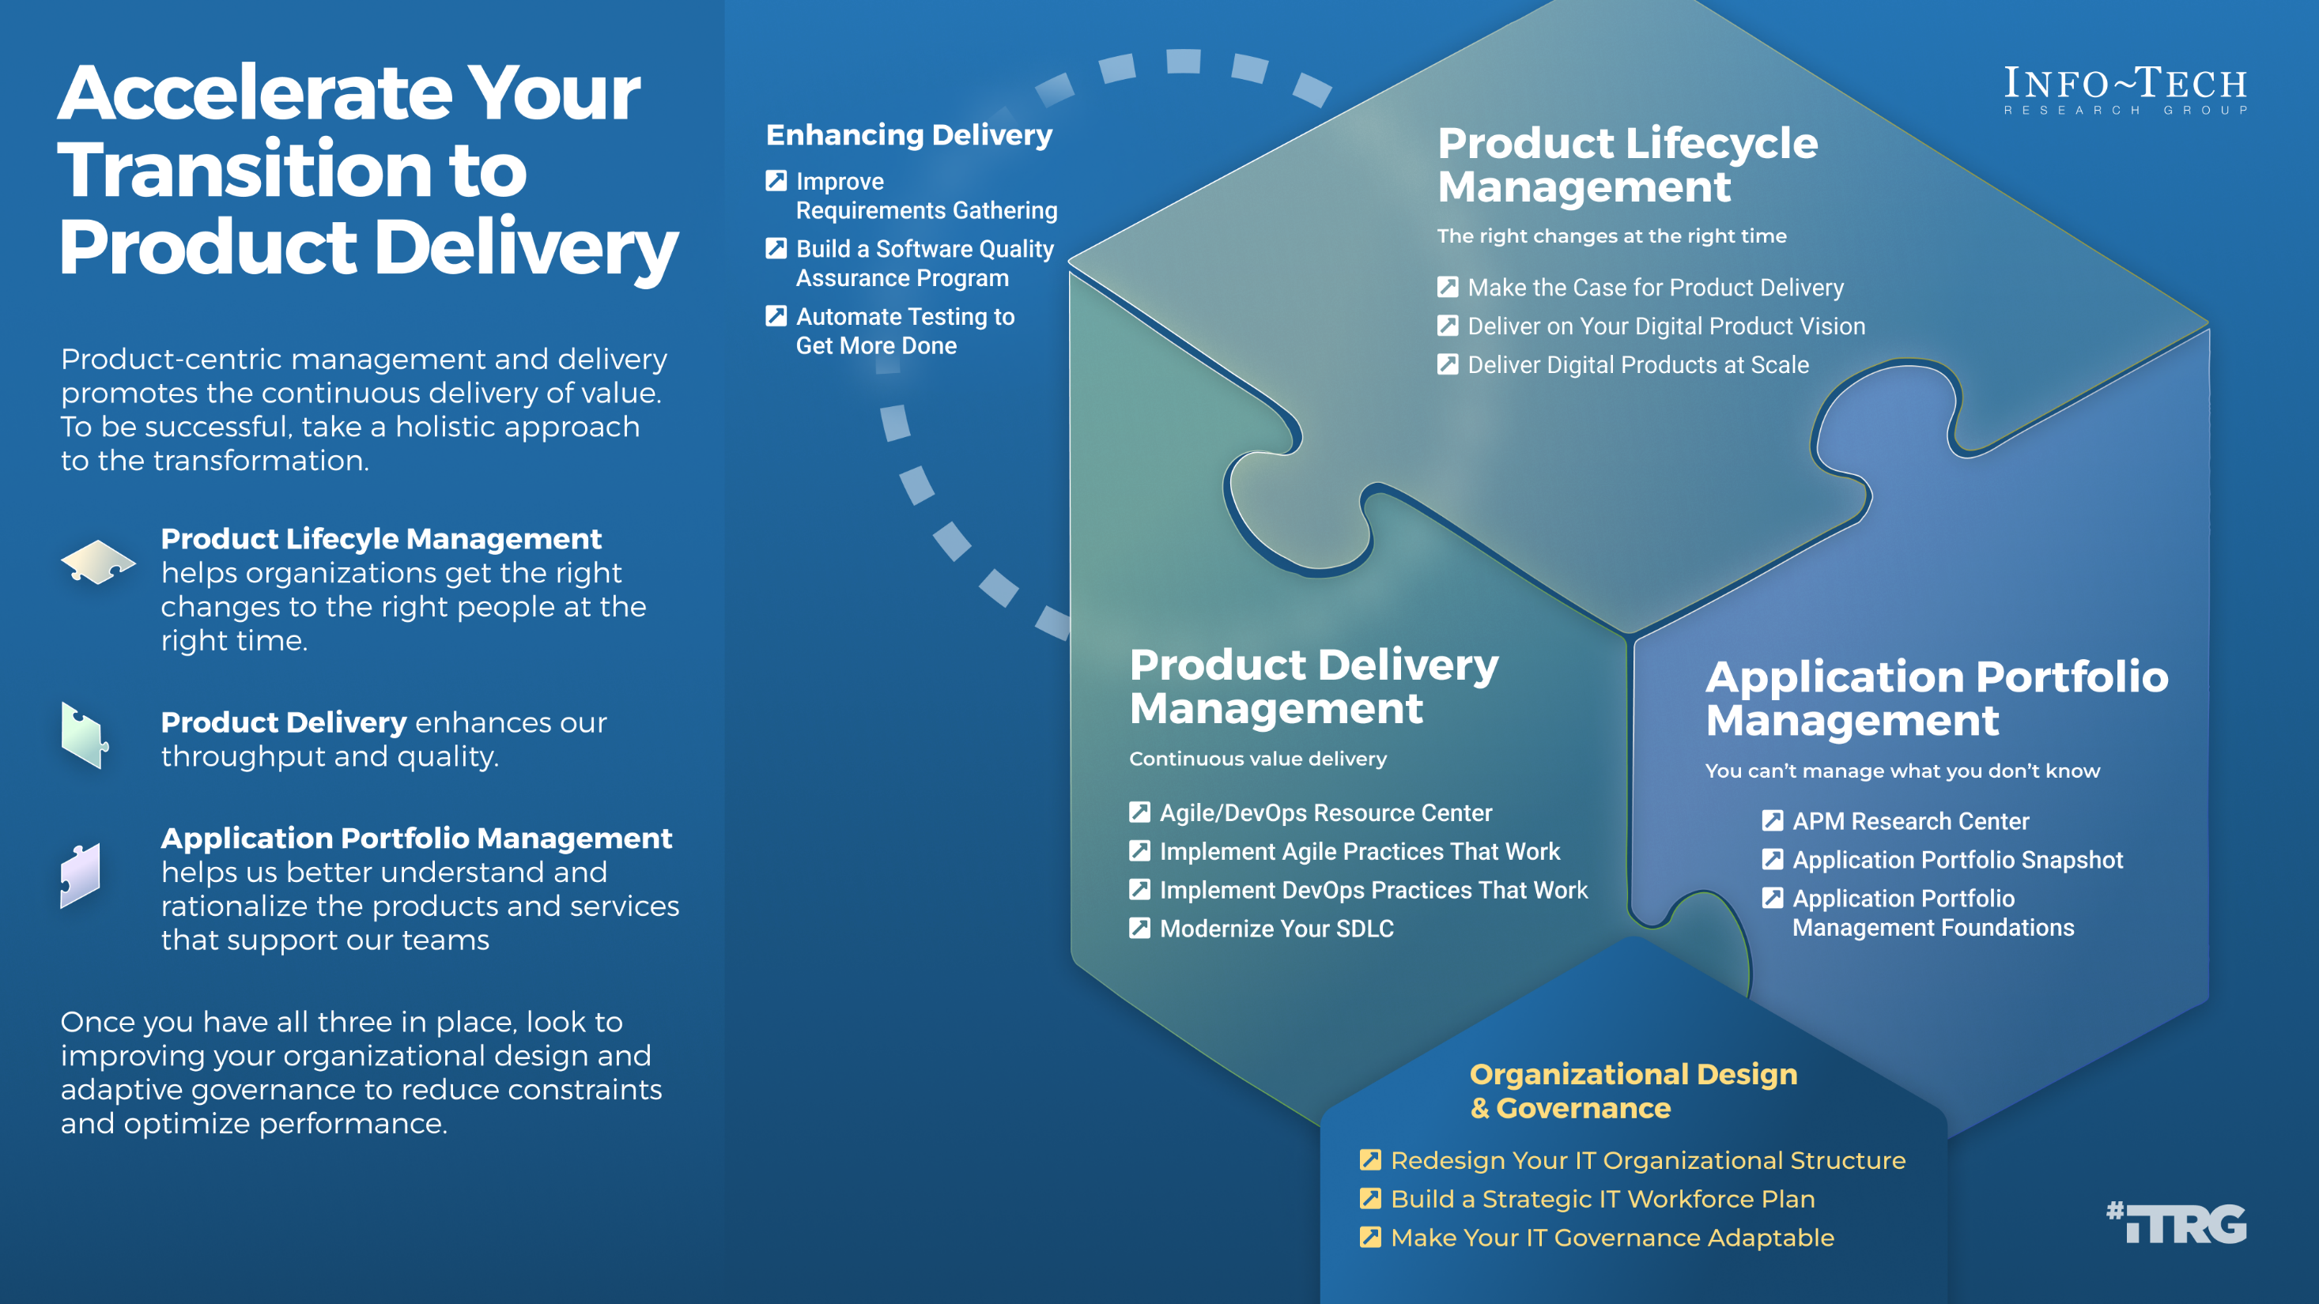

Slide 5
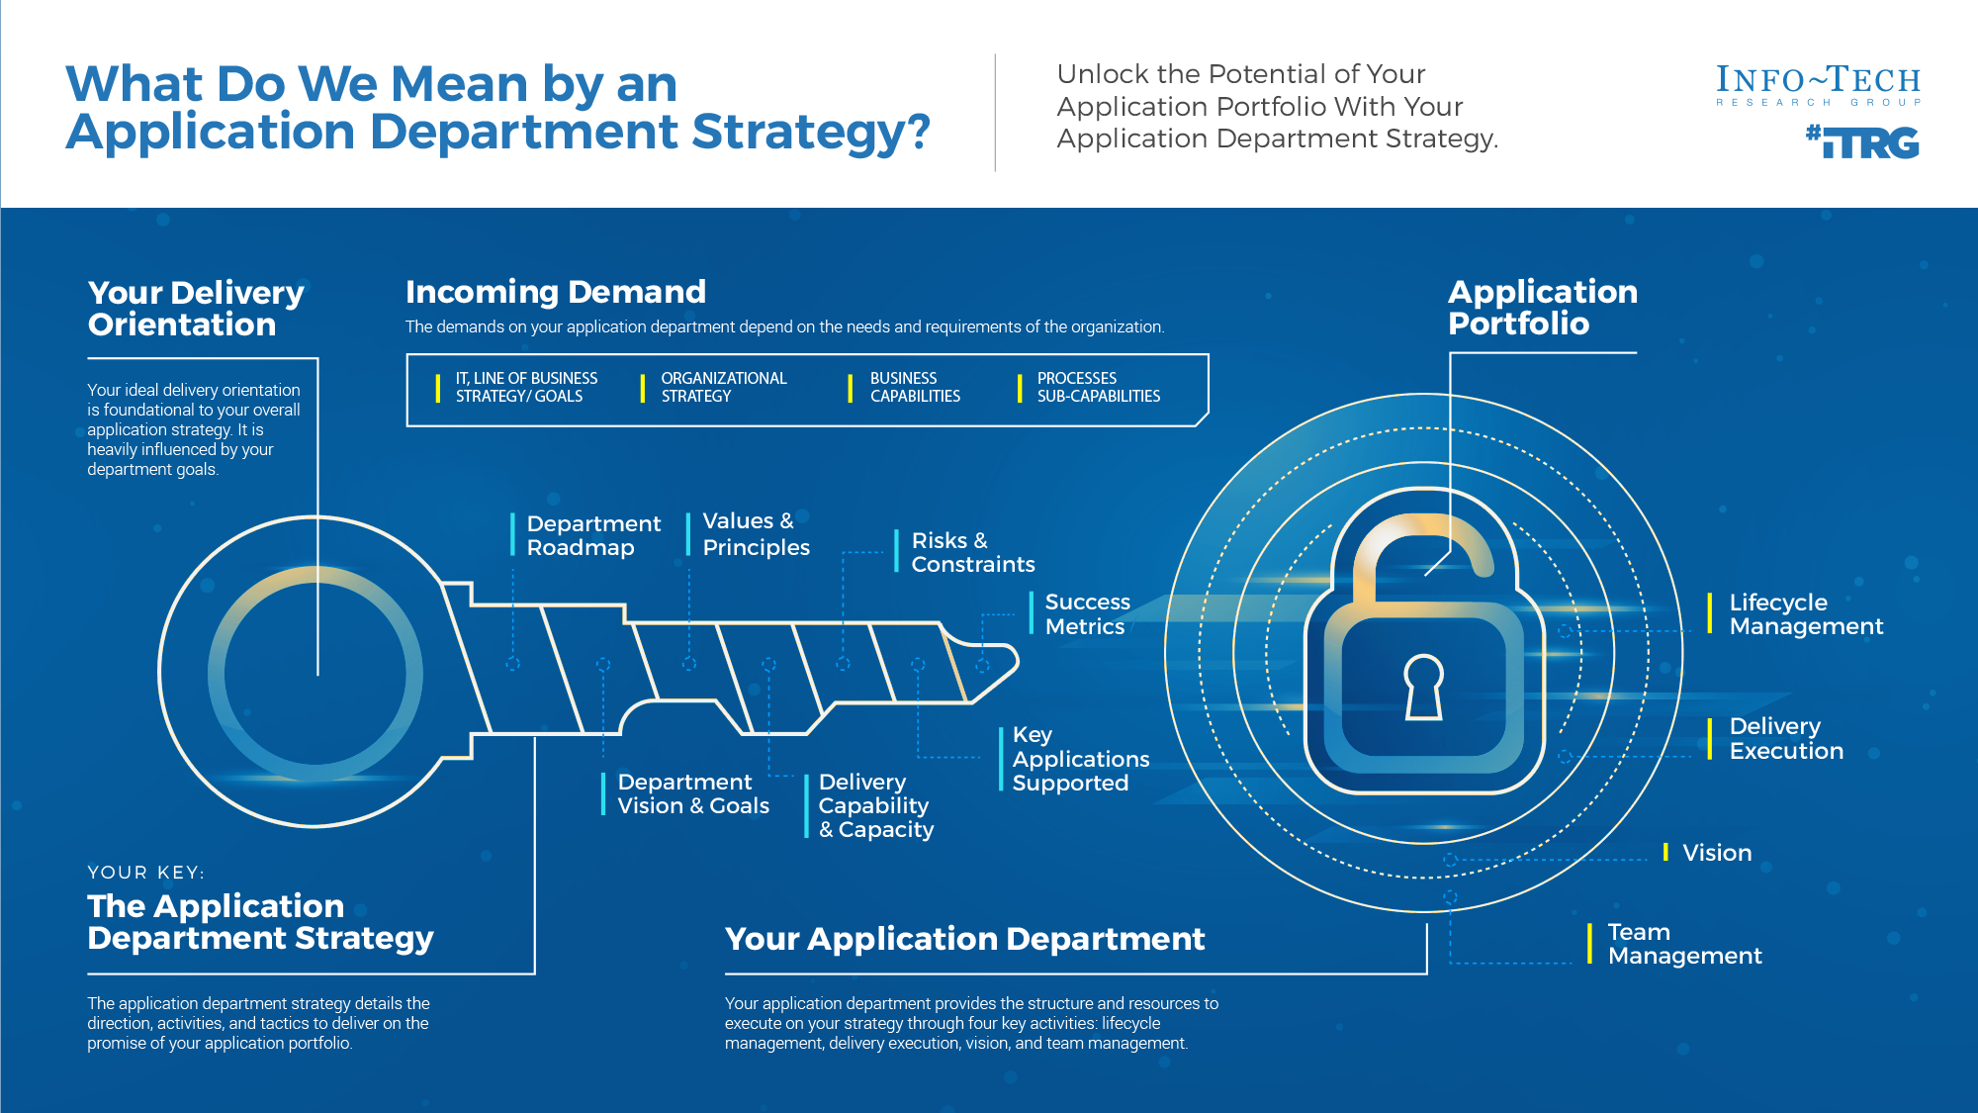
Start by understanding your application landscape and performance. Use APM Foundations to connect and update your application department orientation.
For more information, download Build an Application Department Strategy

Slide 6
Define the differences between projects and product delivery
VS
Project delivery | Product delivery
Point in time | What is changed
Method of funding changes | Needs an owner
Notes:
Capture the differences here.

Slide 7

Example definition of a product
Update
A product is a solution, tool, or managed service that continuously delivers evolving value over the product’s lifecycle to its stakeholders (internal and external) based on their needs. This means continually evolving priorities over the life of a product rather than focusing only on a defined start and end.
Info-Tech Insight
A proper definition of a product recognizes three key facts:
Products are long-term endeavors that don’t end after the project finishes.
Products are not just apps but can be software or services that drive value.
There is more than one stakeholder group that derives value from the product or service.
Notes:
This definition will be updated as a result of the exercise: “What is a “product”? Who are your “consumers”?”

Slide 8
Enablers and blockers of product ownership
Enablers | Blockers | Mitigation
Notes:
Record here the results of the exercise: “Identify enablers and blockers of product ownership”

Slide 9
Projects can be a mechanism for funding product changes and improvements
Projects within products
Regardless of whether you recognize yourself as a product-based or project-based shop, the same basic principles should apply.
You go through a period or periods of project-like development to build a version of an application or product.
You also have parallel services along with your project development, which encompass the more product-based view. These may range from basic support and maintenance to full-fledged strategy teams or services like sales and marketing.
Continuous delivery of value
Product release
Product release
Product releases
Product releases
Hybrid lifecycle
Product lifecycle
Product release
Product release
Product Roadmap
Project lifecycle
Product Backlog
Project
Project
Project
Project
Project
Project
  Features
  Services
  Features
  Services
  Features
  Services
  Features
  Services
CI/CD delivery cycles
Notes:
Projects do not have to go away because you have products. Product owners shift focus to product maturity
Shifting to a product focus is a change in perspective. Teams need to view the product or service as a long-term entity which will be managed, enhanced, and adapted to meet the organization's changing needs.
Projects can still be the source for funding. The project release milestones or phases are tied to the product releases. Project is simply the team funding method for the product lifecycle.
In a hybrid model, product owners now use their roadmaps and backlogs to generate and mange release scope. This aligns to your continuous delivery of product value and longer-term alignment to enterprise goals.
Teams still need to focus on key milestones and releases, especially when other teams are impacted. Project managers continue to manage milestones and PMO governance gates, but not long-manage tasks and work assignments (Agile uses self-managing teams). If the team does not use PMs, then the product owner or scrum master takes over these responsibilities.
As you improve product delivery maturity, product releases can follow your CI/CD delivery pipeline and coordinate timed releases when end users are impacted or require training/communication.

Slide 10
While Agile and product are intertwined, they are not the same!
Delivering products does not necessarily require an Agile mindset. However, Agile methods help facilitate the journey because product thinking is baked into them.
Product delivery maturity
Continuous integration
and delivery
DevOps
Agile
Throughput
Efficiency
Iterative
ROI
Stakeholder value
Waterfall/
ad hoc
Stability

Slide 11
Product roadmaps guide delivery and communicate your strategy
In Deliver on Your Digital Product Vision, we demonstrate how the product roadmap is core to value realization. The product roadmap is your communicated path, and as a product owner, you use it to align teams and changes to your defined goals while aligning your product to enterprise goals and strategy.
Vision and leadership
Info-Tech Insight
The quality of your product backlog – and your ability to realize business value from your delivery pipeline – is directly related to the input, content, and prioritization of items in your product roadmap.
Guides
Is constrained by
Strategy and market research
Justifies
Product roadmap
Delivery capacity and throughput
Business value
realization
Product lifecycle management
Manages
Product delivery pipeline
Sprint backlog
Business alignment and financials
Validates
Tiered product backlog
Adapted from: Pichler, “What Is Product Management?”

Slide 12

Product delivery realizes value for your product family
While planning and analysis are done at the family level, work and delivery are done at the individual product level.
Defined at the
family level?
Defined at the
product level?
What are the artifacts?
What are you saying?
Product strategy
Vision
I want to...
Goals
To get there we need to...
Roadmap
To achieve our goals, we’ll deliver...
Strategic focus
Backlog
The work will be done in this order...
Release plan
We will deliver in the following ways...
Delivery focus

Slide 13
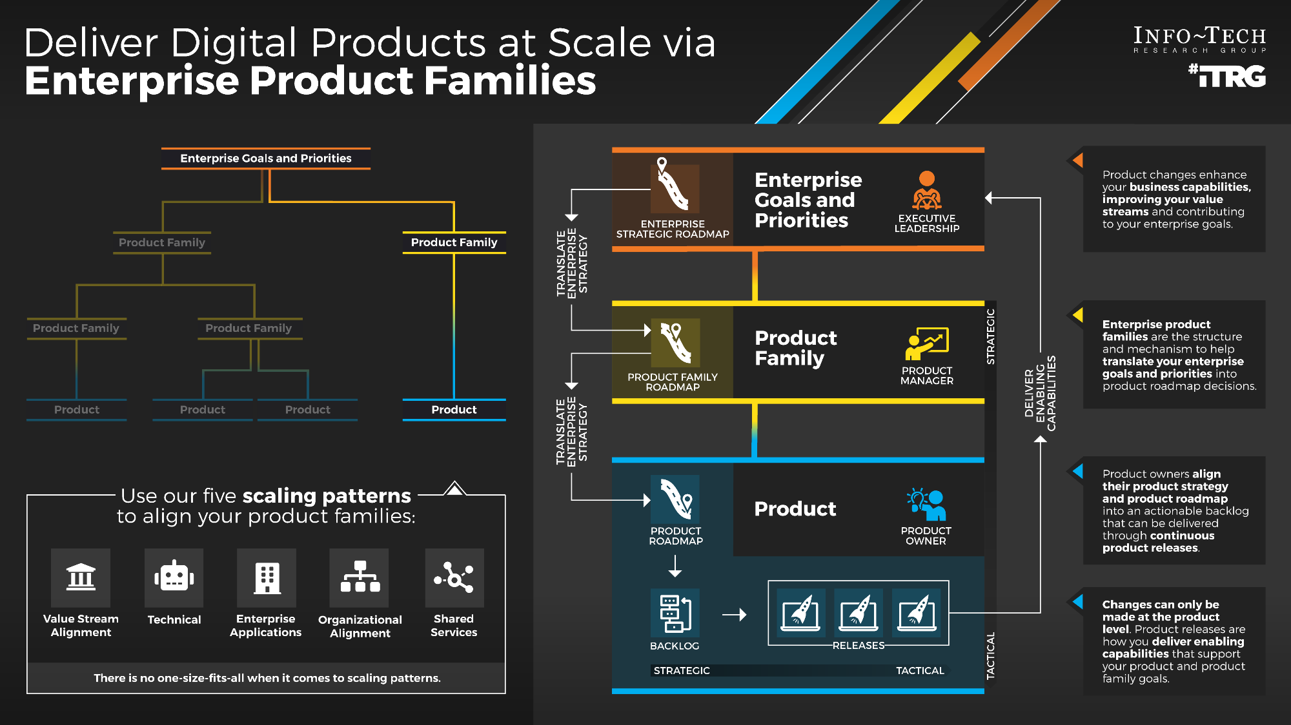
Deliver Digital Products at Scale via Enterprise Product Families – Thought Model

Slide 14
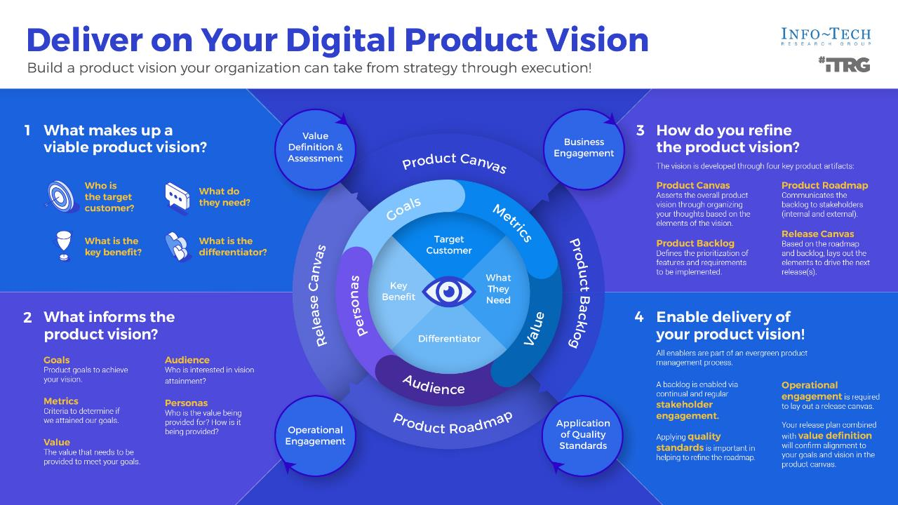

Slide 15

Guiding principles
Guiding principles provide your teams with rules, goals, or themes to help frame and direct decisions.

Slide 16
Product management guiding principles
Principle | Rationale
Prioritize opportunities to improve customer value and retention | The organization prioritizes customer needs and opportunities above all else.
Notes:
Use this table to record the exercise: “Define a set of guiding principles for product management”

Slide 17




Your management culture
Actual
Insert items | Insert items
Insert items | Insert items
Collaboration
Success by working together
Control
Success by getting and maintaining control
People
Company
Cultivation
Success by growing people
Competence
Success by being the best
Possible
Notes:
This chart will represent the results of the exercise: “Your management culture”

Slide 18

There is no such thing as painless change
Ensure focus
People must be able to focus on the new behaviors to make them patterns
Understand expectations
People need to shape their own expectations to make the change
Develop practice
Individuals must commit to and repeat practices that will make the change stick

Slide 19

Personal stop, start, and continue
Stop | Start | Continue
Being territorial | Be more collaborative | Respecting each other
Notes:
Record here the results of the exercise: “Personal Stop, Start, and Continue”

Slide 20
Use CLAIM to guide your journey
Value is best created by self-managing teams who deliver in frequent, short increments supported by leaders who coach them through challenges.
Product-centric delivery and Agile are a radical change in how people work and think. Structured, facilitated learning is required throughout the transformation to help leaders and practitioners make the shift.
Learning
Automation
Culture
Metrics and governance
Integrated teams
Successful implementations require the disciplined use of metrics that support developing better teams.
  Product management, Agile, and DevOps have inspired SDLC tools that have become a key part of delivery practices and work management.
Self-organizing teams that cross business, delivery, and operations are essential to gain the full benefits of product-centric delivery.

Slide 21

Communicate reasons for changes and how they will be implemented
Five elements of communicating change
Leaders of successful change spend considerable time developing a powerful change message; that is, a compelling narrative that articulates the desired end state, and that makes the change concrete and meaningful to staff.
The organizational change message should:
Explain why the change is needed.
Summarize what will stay the same.
Highlight what will be left behind.
Emphasize what is being changed.
Explain how change will be implemented.
Address how change will affect various roles in the organization.
Discuss the staff’s role in making the change successful.
What is the change?
What will the role be for each department, individual?
Why are we doing it?
Communicating the change
How long will it take us to do it?
How are we going to go about it?
Source Cornelius and Associates, 2010.

Slide 22



Now, next, later roadmap to support product owners
Now | Next | Later
Being territorial | Be more collaborative | Respecting each other
Notes:
Record here the results of the exercise: “Now, Next, Later to support product owners”

Slide 23
Aha Moments!
Aha moment | Follow-up?
Notes:
Record the most important discoveries and their follow-up actions.

Slide 24
Thank you!

Slide 25
Supporting Research
Transformation topics and supporting Info-Tech research make the journey easier, with less rework.

Slide 26
Supporting research and services
Improving IT alignment
Build a Business-Aligned IT Strategy
Create an IT View of the Service Catalog
Application Portfolio Management Foundations
Success depends on IT initiatives clearly aligned to business goals, IT excellence, and driving technology innovation.
Make Your IT Governance Adaptable
Governance isn’t optional, so keep it simple and make it flexible.
Unlock the full value of your service catalog with technical components.
Ensure your application portfolio delivers the best possible return on investment.

Slide 27
Supporting research and services
Shifting toward Agile DevOps
Perform an Agile Skills Assessment
Define the Role of Project Management in Agile and Product-Centric Delivery
Tools and advice you need to be successful with Agile.
Develop Your Agile Approach for a Successful Transformation
Understand Agile fundamentals, principles, and practices so you can apply them effectively in your organization.
Implement DevOps Practices That Work
Streamline business value delivery through the strategic adoption of DevOps practices.
Being Agile isn’t about processes, it’s about people.
Projects and products are not mutually exclusive.
Agile/DevOps Resource Center

Slide 28
Supporting research and services
Shifting toward product management
Mature and Scale Product Ownership
Build a Value Measurement Framework
Align your organization on the practices to deliver what matters most.
Deliver on Your Digital Product Vision
Build a product vision your organization can take from strategy through execution.
Deliver Digital Products at Scale
Deliver value at the scale of your organization through defining enterprise product families.
Strengthen the product owner role in your organization by focusing on core capabilities and proper alignment.
Focus product delivery on business value-driven outcomes.
Make the Case for Product Delivery

Slide 29
Supporting research and services
Improving value and delivery metrics
Build a Value Measurement Framework
Be careful what you ask for because you will probably get it.
Reduce Time to Consensus with an Accelerated Business Case
Expand on the financial model to give your initiative momentum.
Mature your IT department by measuring what matters.
Select and Use SDLC Metrics Effectively
Focus product delivery on business value-driven outcomes.
Create a Holistic IT Dashboard

Slide 30
Supporting research and services
Improving governance, prioritization, and value
Make Your IT Governance Adaptable
Governance isn’t optional, so keep it simple and make it flexible.
Maximize Business Value from IT Through Benefits Realization
Embed benefits realization into your governance process to prioritize IT spending and confirm the value of IT.
Drive Digital Transformation with Platform Strategies
Innovate and transform your business models with digital platforms.
Succeed with Digital Strategy Execution
Building a digital strategy is only half the battle: create a systematic roadmap of technology initiatives to execute the strategy and drive digital transformation.
Build a Value Measurement Framework
Focus product delivery on business value-driven outcomes.
Create a Holistic IT Dashboard
Mature your IT department by measuring what matters.

Slide 31
Supporting research and services
Improving requirements management and quality assurance
Requirements Gathering for Small Enterprises
Right-size the guidelines of your requirements gathering process.
Improve Requirements Gathering
Back to basics: great products are built on great requirements.
Build a Software Quality Assurance Program
Build quality into every step of your SDLC.
Automate Testing to Get More Done
Drive software delivery throughput and quality confidence by extending your automation test coverage.
Manage Your Technical Debt
Make the case to manage technical debt in terms of business impact.
Create a Business Process Management Strategy
Avoid project failure by keeping the “B” in BPM.
Build a Winning Business Process Automation Playbook
Optimize and automate your business processes with a user-centric approach.
Create a Winning BPI Playbook
Don’t waste your time focusing on the “as is.” Focus on the improvements and the “to be.”

Slide 32
Supporting research and services
Improving release management
Optimize Applications Release Management
Effective maintenance ensures the long-term value of your applications.
Streamline Application Management
Move beyond maintenance to ensure exceptional value from your apps.
Optimize Change Management
Right-size your change management process.
Manage Your Technical Debt
Make the case to manage technical debt in terms of business impact.
Improve Application Development Throughput
Decrease your delivery time by eliminating development inefficiencies and bottlenecks while maintaining high quality.
Build trust by right-sizing your process using appropriate governance.
Streamline Application Maintenance

Slide 33
Supporting research and services
Business relationship management
Implement Business Relationship Management
Leverage knowledge of the business to become a strategic IT partner.
Improving security
Build an Information Security Strategy
Create value by aligning your strategy to business goals and business risks.
Develop and Deploy Security Policies
Enhance your overall security posture with a defensible and prescriptive policy suite.
Simplify Identity and Access Management
Leverage risk- and role-based access control to quantify and simplify the IAM process.

Slide 34
Supporting research and services
Improving and supporting business managed applications
Embrace Business-Managed Applications
Empower the business to implement their own applications with a trusted business/IT relationship.
Enhance Your Solution Architecture Practices
Ensure your software systems solution is architected to reflect stakeholders’ short- and long-term needs.
Satisfy Digital End Users With Low- and No-Code
Extend IT, automation, and digital capabilities to the business with the right tools, good governance, and trusted organizational relationships.
Build Your First RPA Bot
Support RPA delivery with strong collaboration and management foundations.
Automate Work Faster and More Easily With Robotic Process Automation
Embrace the symbiotic relationship between the human and digital workforce.

Slide 35
Supporting research and services
Improving business intelligence, analytics, and reporting
Modernize Data Architecture for Measurable Business Results
Enable the business to achieve operational excellence, client intimacy, and product leadership with an innovative, agile, and fit-for-purpose data architecture practice.
Build a Reporting and Analytics Strategy
Deliver actionable business insights by creating a business-aligned reporting and analytics strategy.
Build Your Data Quality Program
Quality data drives quality business decisions.
Design Data-as-a-Service
Journey to the data marketplace ecosystems.
Build a Robust and Comprehensive Data Strategy
Key to building and fostering a data-driven culture.
Build an Application Integration Strategy
Level the table before assembling the application integration puzzle or risk losing pieces.

