Slide 1
Cost Optimization Recommendations
April 23, 2022
Prepared by: Jane Doe, CIO, OrganizationX

Slide 2
Executive Summary
Situation | Considerations | Results
ITS has a current operating budget of $8,000,000 | Due to the economic impact of current global circumstances, ITS was asked by senior management to reduce its budget by 15% or $1,200,000 for 2023. | Through the cost-cutting measures outlined in this document, we have identified and are recommending a total cost reduction of 21% or $1,713,500. This would bring our total operating budget for 2023 to $6,286,500.
ITS was asked to identify savings opportunities across its operations. | ITS took a strategic approach to identify savings, looking at current spending on assets, projects, vendors, and workforce. Through this strategic lens, 17 potential cost-cutting opportunities were initially identified. | Upon further analysis, we are recommending OrganizationX proceeds with 10 of the 17 cost-cutting initiatives. Combined, these 10 actions comprise the estimated $1,713,500 in savings.
Counselors: Update this text to reflect the client's situation.
Lean on data points in tab 4 of Info-Tech’s Cost Optimization Analysis Tool to help complete your analysis.
The remainder of this document explains the details and the potential impacts of these cost-cutting measures in more detail.

Slide 3
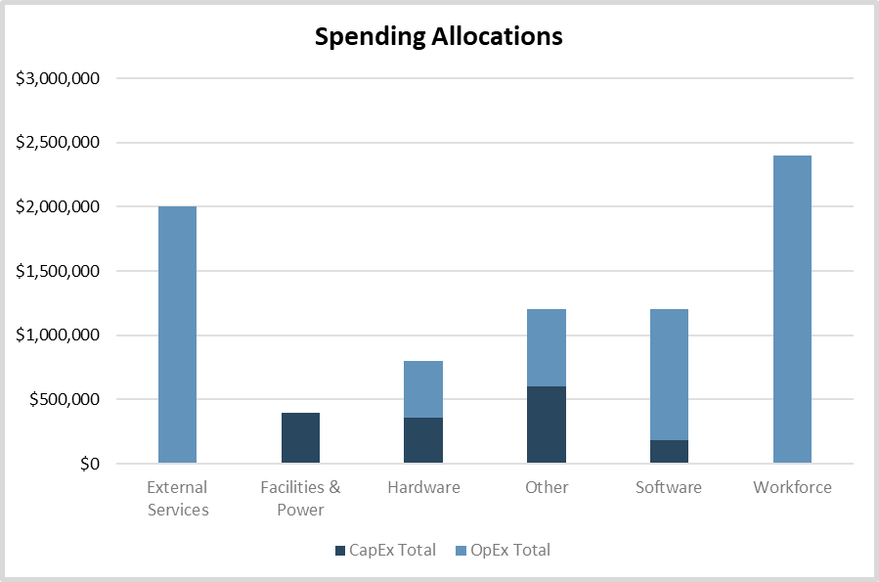
Business context and current state
Current State Spending
Total Current IT Budget:
$8,000,000
Our situation prior to the COVID-19 pandemic:
For 2022, our total budget was $8,000,000.
Of this $8,000,000, approximately $1,540,000 was allocated to CapEx spending while $6,460,00 was allocated to OpEx Spending.
The chart to the right shows how this total budget was allocated across spending highlight IT spending categories.
Our goal in undertaking this cost-cutting initiative is to effectively respond to our current global crisis without sacrificing the ability of IT to support the business during this difficult time.
Counselors: Update screenshot with Chart 1 from tab 4 of the Cost Optimization Analysis Tool.
Counselors: Update this text to reflect the client's situation.
There is data on tab 4 of Info-Tech’s Cost Optimization Analysis Tool to help you fill out the details in this text box.

Slide 4
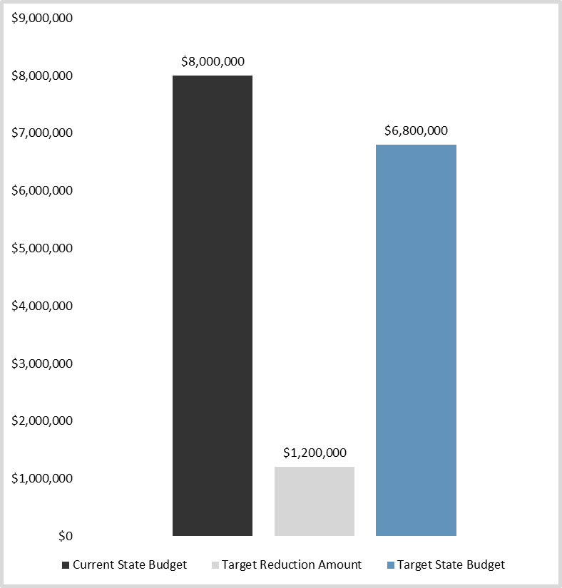
Target reduction details
Our Initial Reduction Goal(%):
15%
Our current situation has changed:
COVID-19 has impacted our business operations and we anticipate that our revenues will be impacted to the point of missing our targets.
We estimate between 10-15% reduction in revenues against projections.
To address this expected shortfall, management asked all departments, including IT, to identify cost-savings opportunities and associated impacts to be presented for approval to the board.
Our objective coming into this activity was to reduce the IT budget by 15%.
IT has identified cost efficiencies across its operations with a view to mitigating any adverse impacts on the business.
Counselors: Update screenshot with Chart 2 from tab 4 of the Cost Optimization Analysis Tool.
Counselors: Update this text to reflect the client's situation.

Slide 5
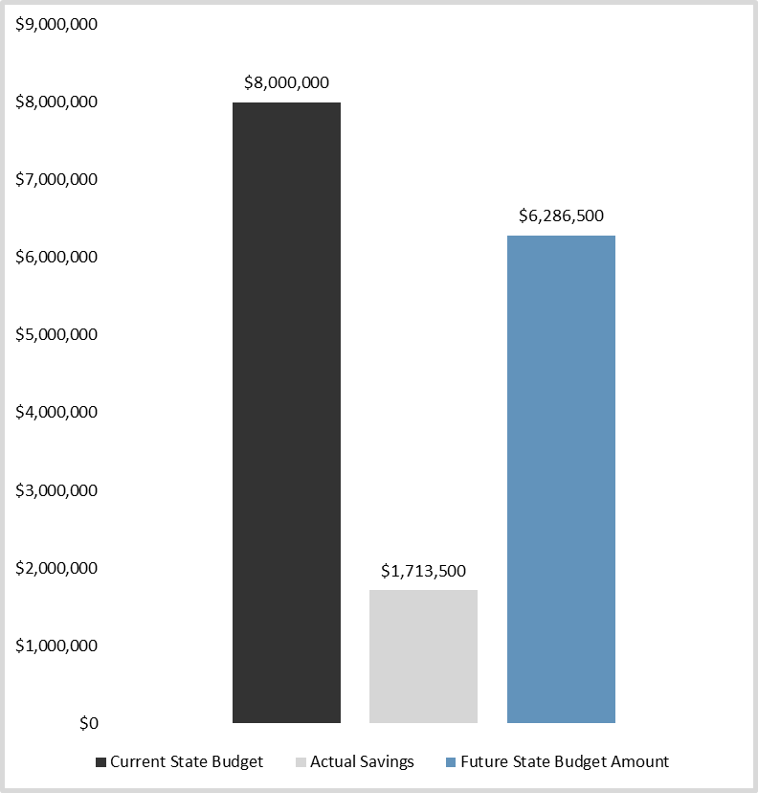
Actual reduction details
Our Actual Reduction Amount (%):
21%
Our recommended cost-cutting actions in this document exceed targets:
While our target reduction amount was 15%, if actioned as described the recommended actions in the previous slides will reduce IT’s overall budget by 21% in the next 12 months.
While our target budget was $6,800,00, we estimated the recommend actions will bring our 2021 budget down to $6,337,500.
While it’s unfortunate these cuts need to be made, they are shared across IT and several business units. We have analyzed the risk and impacts of these actions, and we are confident that if implemented properly they can be absorbed without having significant impacts to service quality or to strategic directions.
Counselors: Update screenshot with Chart 3 from tab 4 of the Cost Optimization Analysis Tool.
Counselors: Update this text to reflect the client's situation.
There is data on tab 4 of Info-Tech’s Cost Optimization Analysis Tool to help you fill out the details in this text box.

Slide 6
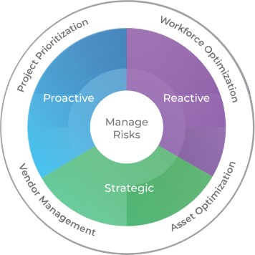
Our approach
Info-Tech’s Budget & Cost Center Management Framework:
ITS took a strategic approach to identifying cost savings, looking at current spending on assets, projects, vendors, and workforce.
Using the approach recommended by Info-Tech Research Group, ITS looked at four focus areas of cost cutting to identify opportunities for OrganizationX:
Workforce optimization
Asset optimization
Vendor management
Project prioritization
Because COVID-19 has forced us into a reactive mode of cost management, we sought to identify the reactive short-term cost cuts that would have the least impact on our long-term objectives.
The next slide contains our cost-cutting recommendations based upon this approach. Subsequent slides show the financial and organizational impacts of these cost-cutting actions.
Counselors: Update this text with proper organizational and departmental titles.
The rest of the text on this slide, should be suitable as is (but of course can be customized if need be).
Info-Tech Research Group | 6

Slide 7
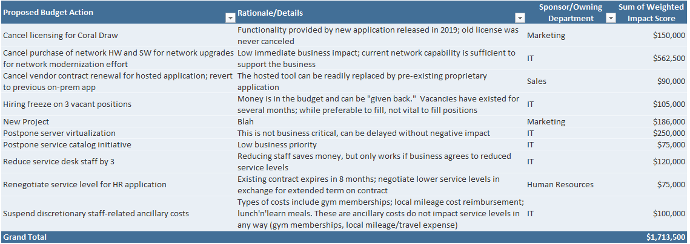
Recommended cost-cutting initiatives
Based upon our approach, we’re recommending the 10 cost-cutting actions below:
Counselors: Update this screenshot with a screenshot of the table from tab 5 of the Cost Optimization Analysis Tool.
If your table is too big to fit on one slide, insert a subsequent slide and take more than one screenshot.
Alternatively, if screenshotting the table is too finicky, insert a table within the PowerPoint slide and manually transfer the content from the table in tab 5 into the table.
Counselors: Update this number.

Slide 8
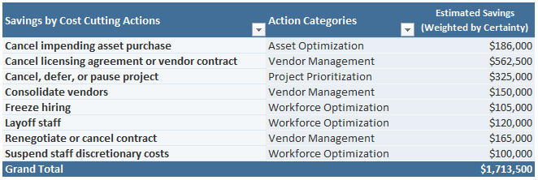
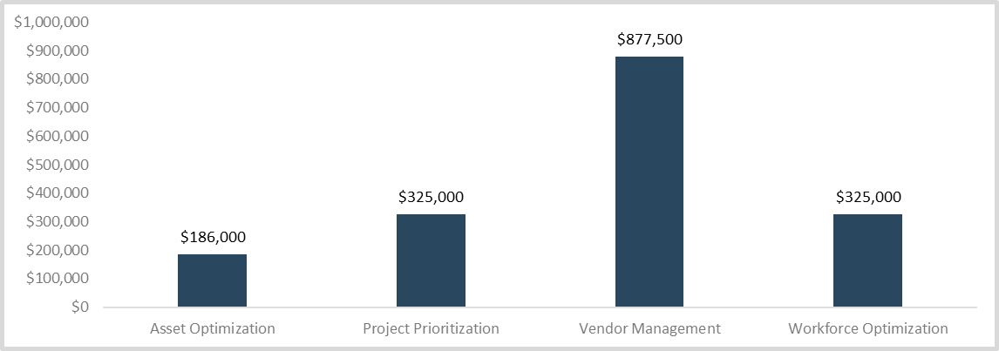
Savings by cost-cutting categories
Across the four areas where cost savings were pursued, ITS has identified the most savings under the category of vendor management.
Actions such as consolidating, cancelling or renegotiating vendor contracts will save ITS more than $850,000 in the next 12 months.
While we tried to avoid workforce optimizations (most notably layoffs), some were unavoidable. Three layoffs are necessary. While regrettable, these will save $120,000 in the next 12 months. A hiring freeze and a suspension of staff discretionary costs for the next 12 months will reclaim an addition $205,000.
An additional $511,000 can be reclaimed through project reprioritization and asset optimization.
We are confident that we have chosen the most appropriate cuts to help us maintain a high quality of service delivery not jeopardize long-term objectives.
.
Counselors: Update this screenshot with the table from tab 6 of the Cost Optimization Analysis Tool.
If your table is too big to fit within this space, you may need to move or delete the screenshot below. Alternatively, if screenshotting the table is too finicky, insert a table within the PowerPoint slide and manually transfer the content from the table in tab 6 into the table.
Counselors: Update this text to reflect the client's situation.
Counselors: Update screenshot with Chart 4 from tab 4 of the Cost Optimization Analysis Tool.

Slide 9
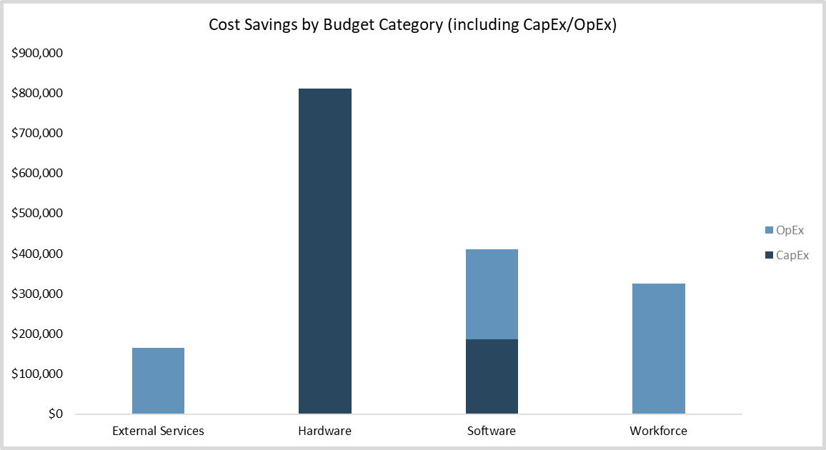
Savings by budget category (1 of 2)
In addition to the cost-cutting categories, we also assessed these cost savings across our budget categories: workforce, software, hardware, external services, facilities and power, and other.
As the chart on the next slide shows, while we did not meet our reduction goals across all budget categories, we exceeded our goals in others.
The decision not to pursue budget cuts that would meet all targets was made based upon a difficulty and risk analysis that considered the impact on future business recovery and the impact on IT performance. An overview of these impacts by business unit can be found in the slides ahead.
Counselors: Update screenshot with Chart 5 from tab 4 of the Cost Optimization Analysis Tool.
Update the CapEx/OpEx totals below with the data above the chart on tab 4.
Counselors: Update this text to reflect the client's situation.
If you did not set targets across budget categories, take the analysis in this text box in a different direction and delete the next slide.
Total CapEx Savings | $998,500
Total OpEx Savings | $715,000

Slide 10
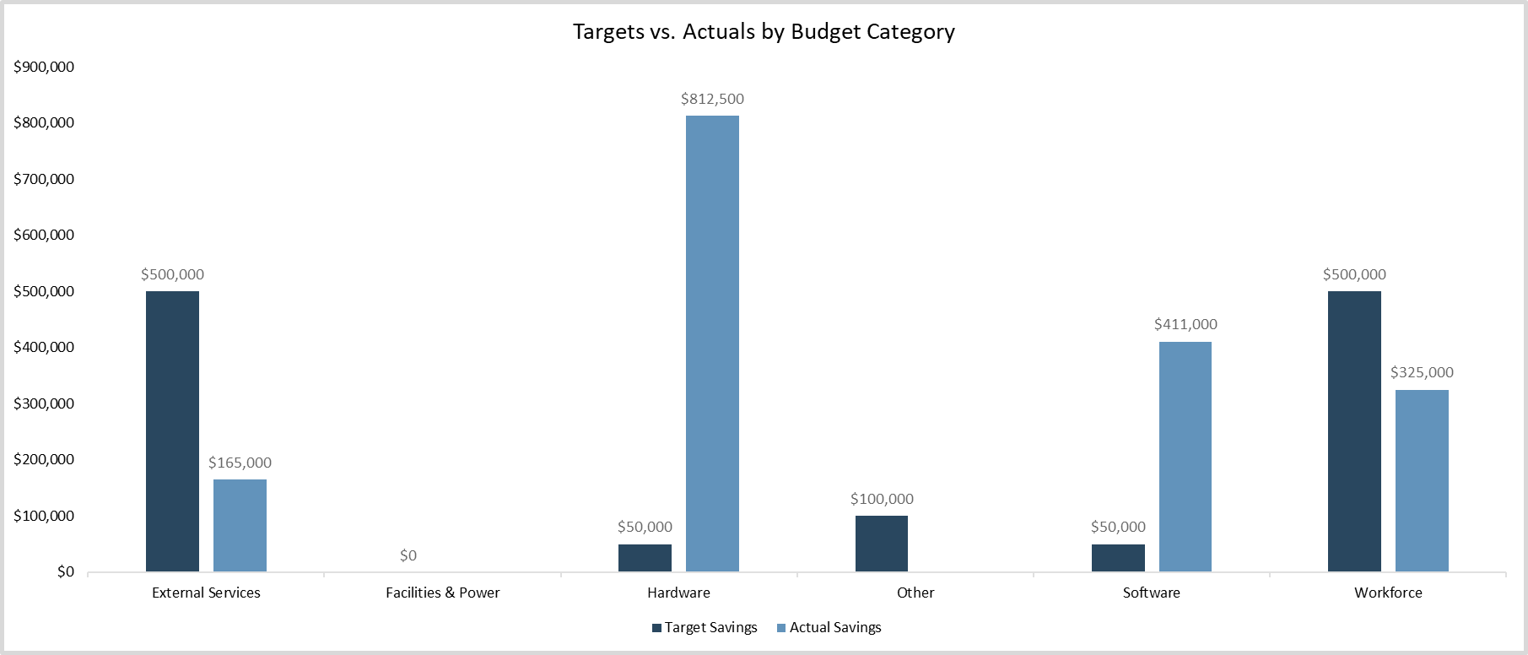
Savings by budget category (2 of 2)
Counselors: Update screenshot with Chart 6 from tab 4 of the Cost Optimization Analysis Tool.
If you did not set targets across budget categories, that’s fine. Simply delete this slide.

Slide 11
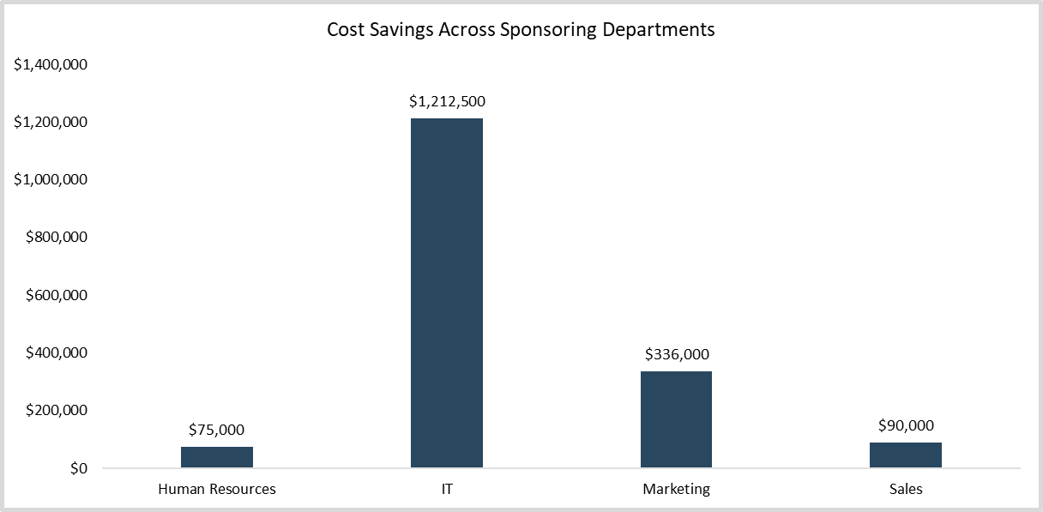
Affected departments
4 business units are primarily impacted our cost optimization recommendations.
Counselors: Update screenshot with Chart 7 from tab 4 of the Cost Optimization Analysis Tool.
Of those business units, IT’s own operations budget is most heavily impact, with over $1,000,000 in estimated cuts.
The next most impacted business unit is Marketing, with two initiatives that it sponsors and over $300,000 in funding being proposed as cuts.
As the chart shows, Sales and HR will also experience some of the financial impacts of these proposed cost savings. The next slide details approval rights for proceeding with these cuts.
Counselors: Update this text to reflect the client's situation.
If you did not set targets across budget categories, take the analysis in this text box in a different direction and delete the next slide.

Slide 12
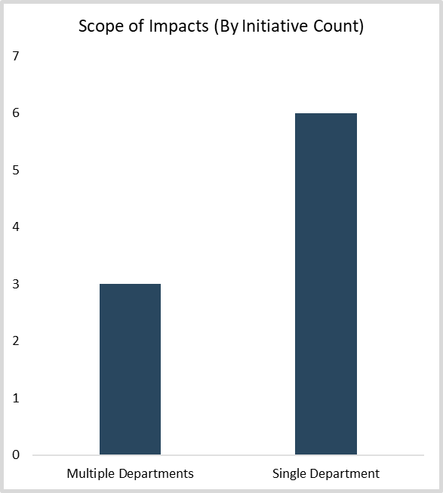
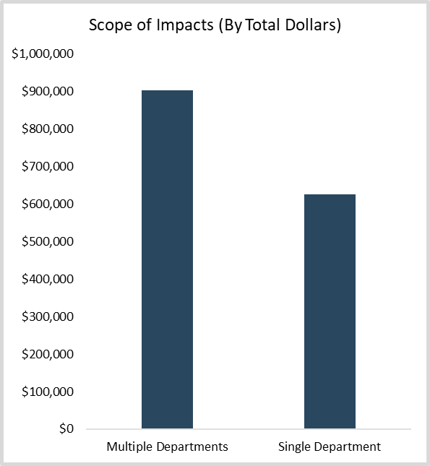
Scope of impacts
The impacts of these cost savings will mostly be localized.
Counselors: Update screenshots with Charts 8 and 9 from tab 4 of the Cost Optimization Analysis Tool.
Of the ten initiatives we are recommending for cost optimization, six of them are localized to single departments, in fact, four of them are within IT.
The other four initiatives are limited to two to four departments. None of our recommendations apply to enterprise-spanning initiatives.
This is not to minimize the impact these cuts will have on these departments, but suggests OrganizationX should be able to implement and absorb the cost-cutting actions with minimal strategic direction cuts.
Counselors: Update this text to reflect the client's situation.

Slide 13
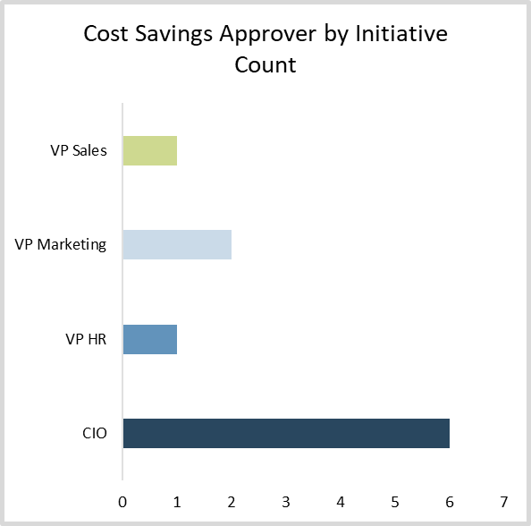
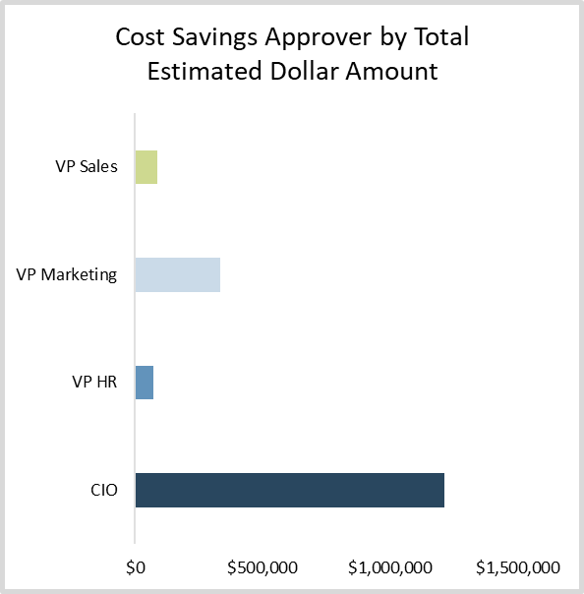
Approval rights for proposed initiatives
As suggested on the previous slide, these savings recommendations will impact four sponsoring departments.
Pending the approval of the approach recommended in this document, ITS will work with these individuals to implement these cost-saving actions in the manner that is least impactful to the operations of their business units.
Next steps for implementing these cost savings are outlined in the next section of this document.
Counselors: Update these screenshots with Charts 10 and 11 from tab 4 of the Cost Optimization Analysis Tool.

Slide 14
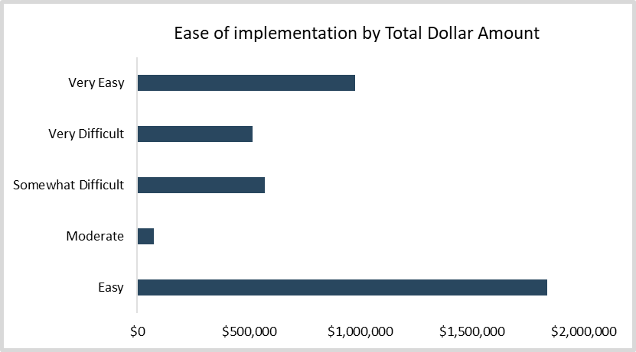
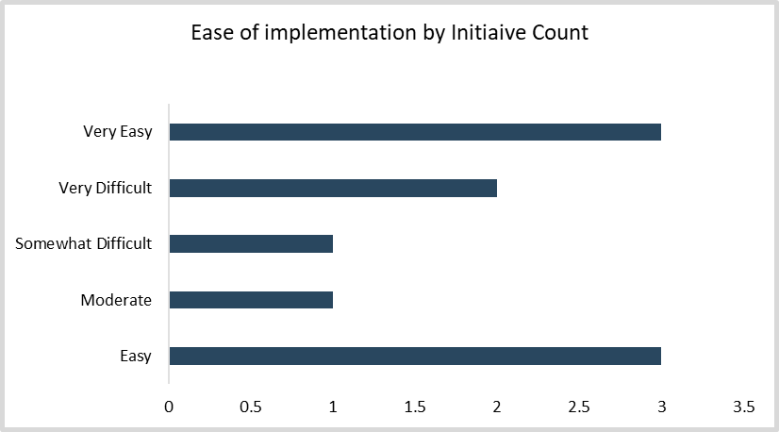
Implementation considerations
Counselors: Update these graphs with screenshots of Charts 12 and 13 from tab 4 of the Cost Optimization Analysis Tool.
Implementation factors have informed our final recommendations.
In choosing what cost-saving initiatives to pursue and recommend in the previous section of this document, we considered the ease of implementing each cost-saving action and the potential impact of that action on future potential business recovery and IT performance.
As the charts to the right show, almost $1,600,000 of the estimated $1,713,500 is associated with cost-cutting measures that will be very easy-to-moderate to implement.
As the graph on next slide shows, there are some negative impacts associated with these cost-cutting measures. These impacts will need to be managed to implement these changes effectively. This need is reflected in our recommended next steps at the end of this section.
Counselors: Update this text to reflect the client's situation.

Slide 15
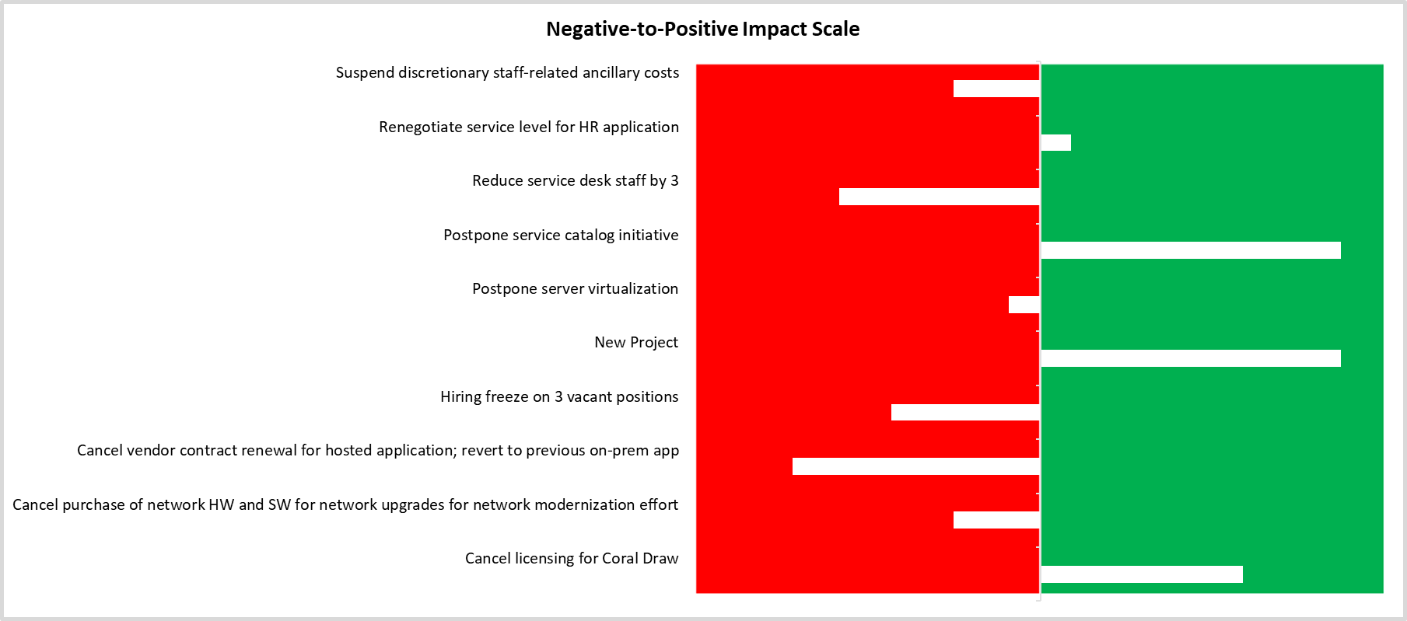
Potential negative and positive impacts
Counselors: Update screenshot with Chart 14 from tab 4 of the Cost Optimization Analysis Tool.

Slide 16
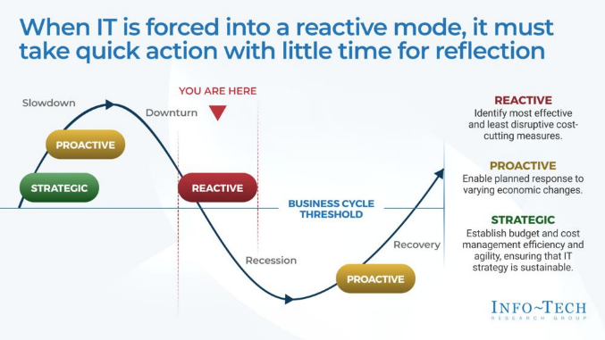
Next steps
ITS is recommending the following next steps based upon the analysis in this document.
Get approval for cost-cutting strategy from senior leadership
We are asking senior leadership to review our recommendations and suggest alterations as needed. We are happy to show you the raw data and decision-making process that led us to the recommendations in this document.
Develop an action plan
Once there is consensus on our course of action, we will develop an action plan to achieve cost and optimization goals. This will include building a timeline for actioning cost-cutting initiatives and for realization of cost-cutting estimates.
Build a communication plan
Once a timeline is developed, we will build out a communication plan to ensure these cost-cutting measures are implemented with minimal negative impact. Communications tactics will include answers to “what’s in it for me” questions from all impacted stakeholders; roles and responsibilities before, during, and after the initiatives are completed; and key dates, deliverables, impacts, and descriptions of specific changes being made.
IT Cost Optimization in Recessionary Times
Related Info-Tech Research
Info-Tech’s IT Cost Optimization in Recessionary Times research will help us to facilitate these next steps.

