Slide 1
Cost Optimization Analysis Service
Delivery Process

Slide 2
Table of Contents
3 Cost Optimization Analysis Service Overview
8 Methodology Framework
14 Scoping Call Overview
19 Working Session Prep Overview
27 Working Session Overview
37 Report Creation Overview
43 Appendix: Working Session Delivery Slides

Slide 3
Cost Optimization Analysis Service
Cost Optimization Analysis Service Overview

Slide 4
Concierge Service: Cost Optimization Analysis Service
This document applies this high-level process detailed on the previous two slides to the Cost Optimization Analysis Service.
This document covers what the analysts, executive advisors, and others delivering this service will need to do prepare for each step along the way, and what they will need to communicate to their members.
In addition, this document also equips those delivering this service with the content, the tools (and an understanding of those tools), and the other materials they will need to successfully facilitate each step.
The Analyst’s Role:
This service requires member inputs and participation to make it a success. The analyst’s primary role is to facilitate a brainstorming session with the client and apply Info-Tech’s methodology to the client’s situation during that session to help drive decisions.
Once decisions have been made, the analyst will then take those away and prepare the final deliverable for this service, the Cost Optimization Recommendations Template. This is a 17-slide template that can be completed with moderate ease using the outputs of the Cost Optimization Analysis Tool—an Excel tool that should be used during the main brainstorming session with the client to help structure the analysis and drive the decision-making process.
This document will explain how to use the Cost Optimization Recommendations Template and the Cost Optimization Analysis Tool in detail.
Timing Expectations
In total, it is estimated this engagement will consume no more than eight hours of analyst time, from the kick-off call to report delivery.
Depending on how the client would like to proceed, these eight hours may be condensed within a single day or spread out over a period. This will be determined during the initial call with Engage and/or during initial scoping call with analyst.
Not all eight hours will be spent with the client. Time has been budgeted for the analyst to do solitary data analysis and report creation. See slide 6 for more details.

Slide 5
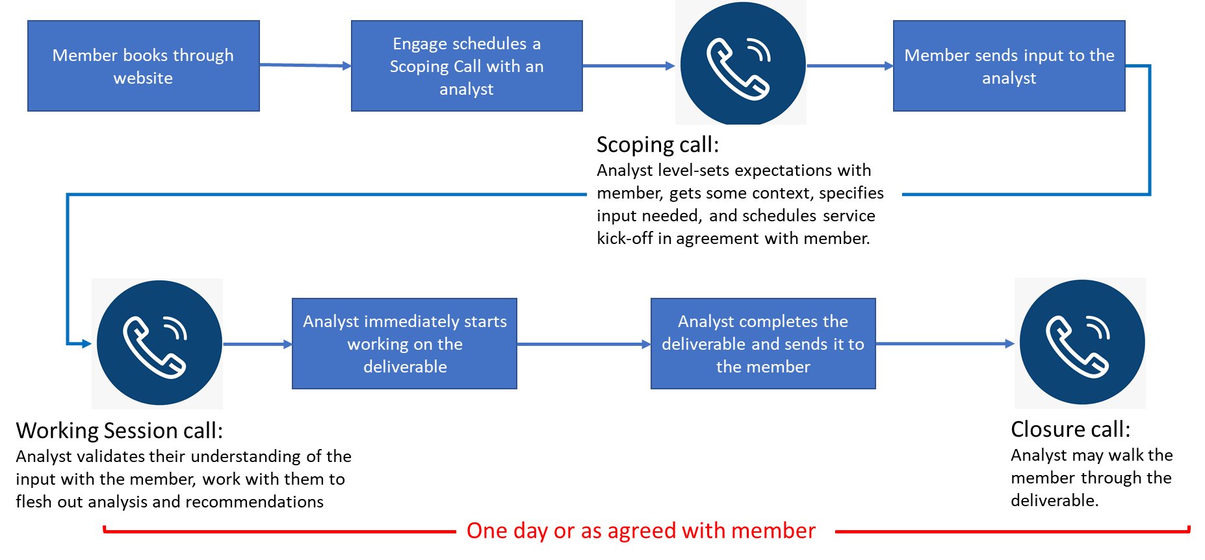
Cost Optimization Analysis High-Level Service Workflow

Slide 6
Cost Optimization Analysis Service Process Overview
Step | Details | Inputs | Outputs | Participation |  | Analyst Time Estimate
 |  |  |  | Member | Analyst
Scoping Call | This session will be booked by Engage unless EA/analyst initiated. The purpose of this call is for the analyst to understand the member situation and provide a fly-by of the service. In addition, the call should focus on logistical details: a service timeframe that suits the client's needs, member understandings of inputs for next call(s). | SFDC case | Working session call(s) scheduled. Pre-Engagement Worksheet sent to client. | Yes | Yes | 60 mins
Gather Inputs | Client compiles an initial proposed cost-cutting initiatives list, as well as other relevant budget information, and sends to the analyst prior to the working session call – no later than two working days in advance of the session. | Pre-Engagement Worksheet | Completed Pre-Engagement Worksheet | Yes | No
Working Session Prep | Analyst reviews and analyzes client docs (e.g., Worksheet, budget docs, project lists) at a high level. Also copies and pastes proposed initiatives list into the Cost Optimization Analysis Tool. | Completed Pre-Engagement Worksheet | Preliminary set up of Cost Optimization Analysis Tool | No | Yes | 30 to 60 mins
Working Session Call(s) | Using the methodology and tools covered in this document, the analyst facilitates an extended brainstorming session with the member to analyze potential cost-optimization actions and determine cost-cutting recommendations. | Documents from client Cost Optimization Analysis Tool | Decisions on cost cutting recommendations | Yes | Yes | 1.5 to 3 hours
Report Creation | Using the chart gallery in the output tabs of the Cost Optimization Analysis Tool the analyst updates the Cost Optimization Recommendations Template with the member’s data. The slide required analysis are updated to reflect the client’s situation. | Decisions on cost cutting recommendations | Completed Cost Optimization Recommendations Template | No | Yes | 1 to 2 hours
Deliverable Handoff | Send final deliverable to client. Depending on what the client wants, this may simply be an email or it may also require a call to walk the client through the deliverable. | Cost Optimization Recommendations Template | Close SFDC case and send MV | Yes | Yes | 5 to 30 mins

Slide 7



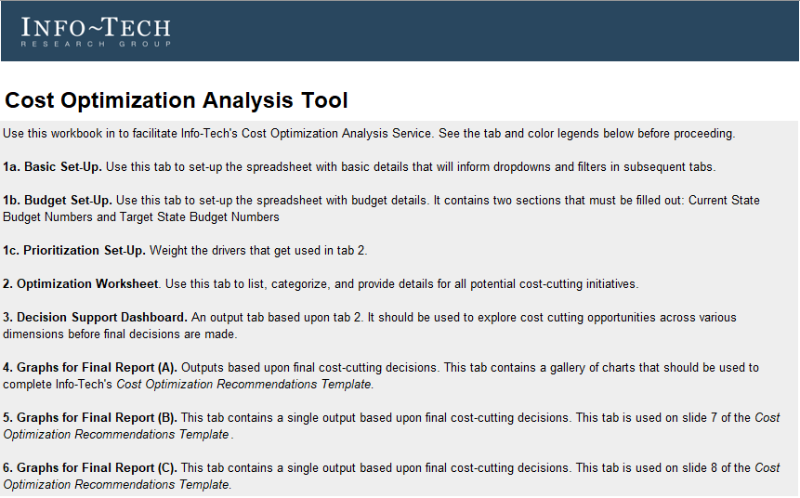
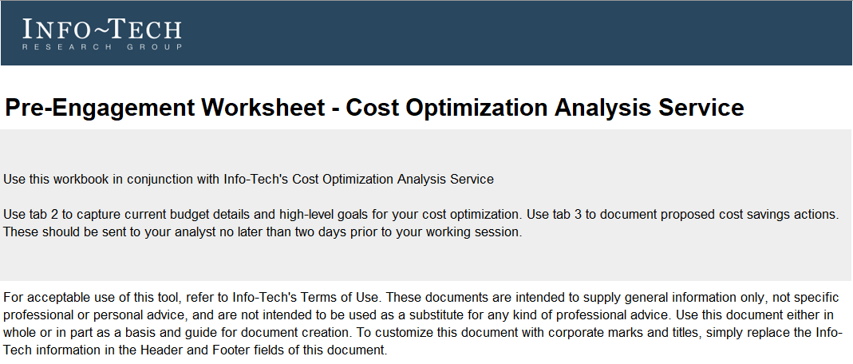
Supporting tools and templates
Main deliverable:
Cost Optimization Recommendations Template
This is the main deliverables that is sent to the client at the end of the service.
It is a 17 slide PPT template containing cost-optimization recommendations agreed upon during the working session.
It is completed by the analyst post-working session using the outputs of the Cost Optimization Analysis Tool.
Pre-Engagement Worksheet
Cost Optimization Analysis Tool
This is an Excel workbook that should be sent to the client after the scoping call.
Prior to the working session, the client should use this tool to capture required inputs and a preliminary list of cost saving actions. These will serve as inputs into the Cost Optimization Analysis Tool.
This tool is the focal point for the working session. Most of that session will focus on tool inputs, which then drive a dashboard tab that can help drive final decisions.
Once final decisions have been made, additional output tabs in the tool are used by the analyst post-working session to complete the Cost Optimization Recommendations Template.

Slide 8
Cost Optimization Analysis Service
Cost Optimization Methodology Overview

Slide 9
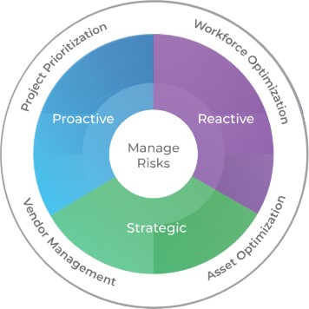
Our Approach
The purpose of this service is to help clients identify potential cost cutting actions and prepare recommendations for organizational stakeholders that meet organizational budget goals.
To help identify potential cost savings, the content for this service encourages members to consider the four focus areas within Info-Tech’s Budget and Cost Management Framework. These focus areas should help to thoroughly assess all potential options:
Workforce optimization
Asset optimization
Vendor management
Project prioritization
In normal times, Info-Tech recommends avoiding costly mistakes by executing cost management and budgeting with a three-pronged approach: Strategic Cost Management, Proactive Cost Management, and Reactive Cost Management. However, as covered on the next two slides, given the current global situation, this service will focus on Reactive Cost Management for the near-term.
Info-Tech’s Budget & Cost Center Management Framework:

Slide 10
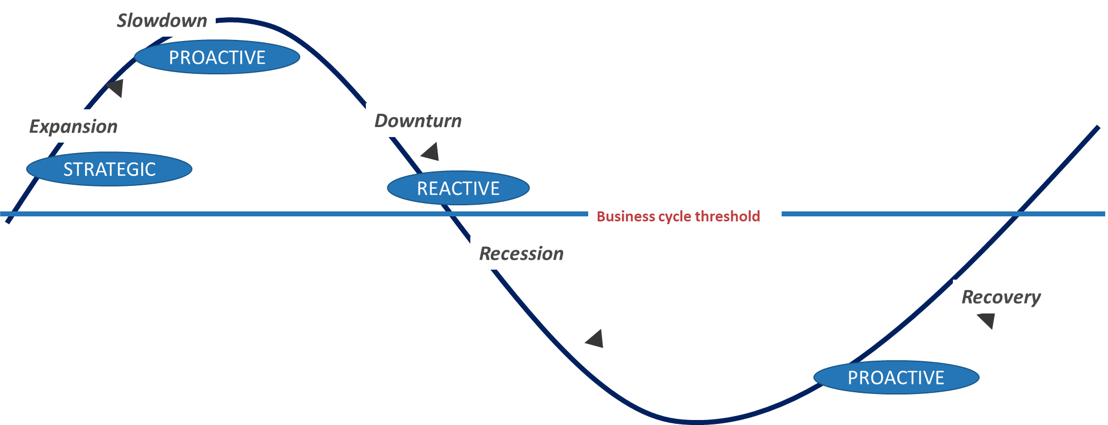

COVID-19 has forced organizations into reactive modes of cost management
You are here
Reactive (<3 months)
Identify the most-effective and least-disruptive cost-cutting measures in response to changing economic conditions.
The COVID-19 Recession forces you into reactive modes of budget and cost planning.
Proactive (3-12 months)
Enable the organization to respond appropriately to different types and magnitudes of a slowdown in a planned manner.
Reactive
Strategic (>12 months)
Establish budget and cost management efficiency and agility across all stages of the business cycle, ensuring that the IT strategy is sustainable regardless of changing economic conditions.
Info-Tech’s Business Cycle Framework
We have turned our focus to Reactive Mode, as that is where most organizations are due to COVID-19.

Slide 11
Info-Tech’s four focus areas for budget and cost management
 | 1. WORKFORCE OPTIMIZATION | 2. ASSET OPTIMIZATION | 3. VENDOR MANAGEMENT | 4. PROJECT PRIORITIZATION
Reactive | Determine optimal staffing levels Identify core/critical training program elements Determine expendable staff-related ancillary costs | Reduce SW license costs Consolidate assets Delay upgrades and refreshes for applications and hardware | Renegotiate current contracts Cancel current contracts Renegotiate/suspend/cancel pending contracts | Existing projects: resize/rescope Existing projects: postpone/cancel New projects: delay/cancel
Proactive | Determine current staff skill and capability levels Prioritize associated workloads by business value Determine workforce deployment against prioritized workloads | Optimize capacity utilization Extend asset maintenance schedules vs. purchase new equipment Move services to cloud (SaaS) | Assess existing vendor contracts for performance Renegotiate existing terms Evaluate switch to lower-cost vendors | Develop criteria for project intake Prioritize projects in portfolio based on business value Develop criteria for project approvals
Strategic | Develop a workforce strategy to optimize staffing capabilities aligned with business value Adopt a Lean approach to managing workloads and workforce capacity Identify automation opportunities to augment workforce capacity | Develop a sourcing strategy Build application rationalization framework Establish a comprehensive ITAM practice | Establish a VMO Align VM strategy with sourcing strategy Implement smart contracts | Establish PPM practice Establish PMO Establish demand and resource management capabilities
The Cost Optimization Analysis Tool is configured with these four focus areas and comes pre-populated with some of the sample optimization actions that are bulleted above. These should be used to categorize the member’s raw data during the working session.

Slide 12
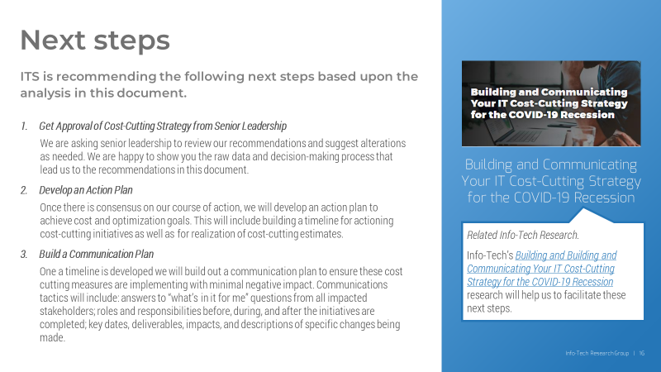
AdditionalCOVID-19 resource on this topic
The four focus areas covered in this section help to structure some of the client-facing content in the sections ahead and some of the data categorizations in the Cost Optimization Analysis Tool.
If you would like a deeper dive into the parent research upon which this service is based, see Info-Tech’s Building and Communicating Your IT Cost-Cutting Strategy for the COVID-19 Recession. This blueprint will help to structure next steps for the client coming out of this service.
The final slide of the Cost Optimization Recommendations Template recommends this blueprint to help the member build their action and communication plan. The Cost Optimization Analysis Service Overview PDF also uses content from this research.

Slide 13
Tier 1 of IT Cost Model
Tier 1
Tier 2
Tier 3
IT Employees
IT Contractors
This service employs Tier 1 of Info-Tech’s Budget Spending Categories.
Training
Data & Analytics
Workforce
Information Security
Within the Pre-Engagement Workbook and the Cost Optimization Analysis Tool, Tier 1 of ITRG’s IT Spending Model (see diagram to right) of the costing model to the right is used.
Tier 1 contains the highest-level cost categories. These are typically understood by both the business and IT as standard across organizations and can be found in the general ledger.
The client is asked to estimate the percentage of their overall IT budget that is allocated to these categories. Additionally, the member can set cost-savings targets across these categories if desired.
Other Software
Software
Information Security
Hardware
Other Hardware
Infrastructure-as-a-Service
External Services
Consultants
Platform-as-a-Service
Cloud Services
Software-as-a-Service
Facilities & Power
Telecommunications
Data-as-a-Service
Managed Services
Security-as-a-Service
Other
Internal Facilities & Power
External Facilities & Power
Operational Technology
Other OpEx

Slide 14
Cost Optimization Analysis Service
Scoping Call Overview

Slide 15
Scoping call overview
Goal | The purpose of this call is threefold: (1) meet the member and scope their situation to ensure the service is a proper fit; (2) provide an overview of the service; (3) determine service logistics based upon the client's needs and schedule a working session.
Inputs | SFDC case based upon Engage or EA booking
Tools/Templates | Pre-Engagement Worksheet (Excel)
Outputs | Working session call(s) scheduled Pre-Engagement Worksheet sent to client
 | Agenda Item | Comments | Time Allocation
1 | Introductions and scoping | Sample scoping questions: What does IT need to achieve (e.g. cost reduction, cost reallocation)? What are your budget targets? What is your timeline? | 10 mins
2 | Service Overview | Discuss service inputs to ensure client can access the right information within the necessary timeframe. Inputs include an initial list of proposed cost-cutting actions. as well as current budget documents, project lists, org-charts/staff lists, etc. Review Pre-Engagement Worksheet (Excel). | 25 mins
3 | Scheduling and logistics | Determine if client would like service to occur over one day of over the course of a few days. Settle on a time for next steps that works with your calendar. | 10 mins

Slide 16

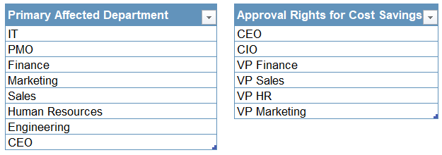
Pre-Engagement Worksheet – Costs Optimization Analysis Service
Devote a few minutes during the scoping call to the Worksheet. It should be sent to the client after the call.
Download the Pre-Engagement Worksheet
Worksheet details:
Three-tab workbook (a set-up tab to configure departments and organizational approvers; a tab to document current state budget and reduction goals; a main working tab to document potential cost-saving actions).
During the scoping call, the analyst should walk the client through the tabs to make sure they understand the tool. After the call, the Worksheet should be sent to the client. This worksheet is the client’s “homework” for the working session call.
Other inputs that the client can send include current budget documents, project lists, org-charts/staff lists, etc.
The Worksheet should be sent to the analyst no later than two days before the working session call.
Screenshot of tab 1 of the Pre-Engagement Worksheet. The client can use the two tables to document affected departments and potential organizational approvers.
As Excel tables, to add or delete rows the client can either drag the blue markers in the bottom right-hand corners or right click within the individual tables and click add or delete according to their needs.
See subsequent slides for more details on the use of this tool.

Slide 17
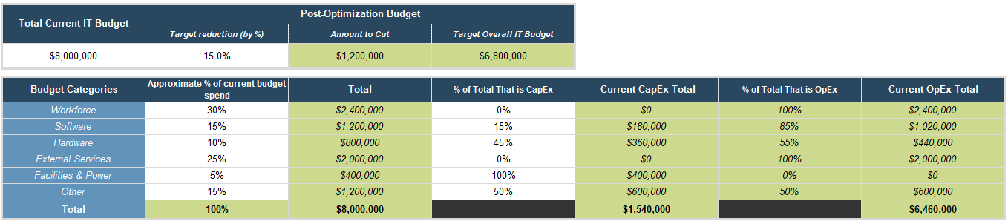
Pre-Engagement Worksheet continued
Screenshot from tab 2 of the Pre-Engagement Worksheet (columns B to H).
Enter the current overall IT budget in column B6 and target reduction amount for this optimization in C6. Subsequent cells in row 6 will auto-update to reflect target state goals. There is the option in column L (not pictured here) to set more granular or detail budget reduction goals than the overall amount set in C6, if you so choose.
Use column C9:14 to approximate what percentage of the overall amount in B6 is currently allocated to the spending categories in Info-Tech’s Budget Spending Categories.
In column E, work horizontally from columns B and D to approximate the total of the amount in column D that is CapEx spending. Column G will auto-populate the OpEx total with what’s left over.

Slide 18
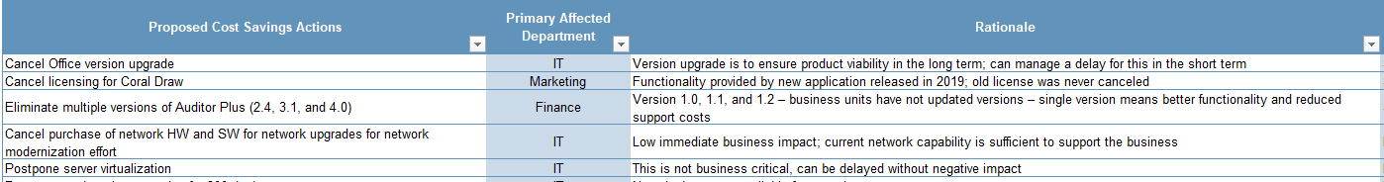
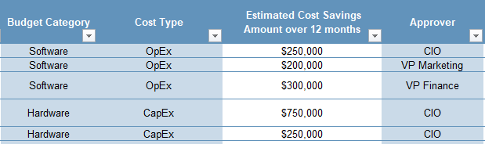
Pre-Engagement Worksheet continued
Screenshots from tab 3 of the Pre-Engagement Worksheet (columns B to H).
2. Then read this: Use the dropdowns in columns D, F, and H to further categorize the proposed actions. In column G, estimate the cost savings that could be achieved by actioning this item over the next twelve months.
1. Start here: Clients can document potential cost savings actions in column B of tab 3. The dropdowns configured on tab 1 of the tool with affected departments can be applied here to record who will be most impacted by the potential cost saving action. The business or operational rationale for each proposal can be documented in tab D.
Analyst will take the inputs of tabs 2 and 3 to configure the Cost Optimization Analysis Tool for the working session.

Slide 19
Cost Optimization Analysis Service
Working Session Prep Overview

Slide 20
Working session prep overview
Goal | Prepare for the working session by reviewing client data Configure Cost Optimization Analysis Tool with client data from the Pre-Engagement Worksheet.
Inputs | Pre-Engagement Worksheet completed by client
Tools/Templates | Cost Optimization Analysis Tool
Outputs | Tool and analysis prepped for working session
 | Agenda Item | Comments | Time Allocation
1 | Review client documents | This may be required if the client sends you budget documents, projects lists, etc. Review lists to identify potential actions across four focus areas (assets, projects, vendors, and workforce). Identify trends that may help you further customize the Cost Optimization Actions table on tab 1a of the Cost Optimization Workbook. | 30 to 60 minutes
2 | QA the data in the Pre-Engagement Worksheet and transfer it over into the Cost Optimization Tool. | See slides ahead for proper and quick way to transfer data between spreadsheets. | 5 to 10 minutes

Slide 21
Transferring data between spreadsheets
The Pre-Engagement Worksheet is an input into the Cost Optimization Analysis Tool.
The most important tactical thing to do for working shop prep is to ensure the Cost Optimization Analysis Tool is as ready as it can be.
Initial completion of the Pre-Engagement Workbook by the member before the working session is required for this service.
The slides ahead detail the key data points that should be transferred from the one spreadsheet to the other prior to the working session.
The Worksheet should be sent to the analyst no later than two days before the working session call.
Download the Cost Optimization Tool

Slide 22
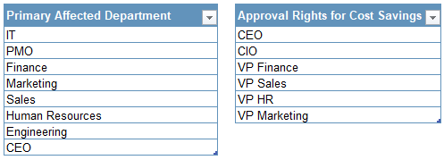
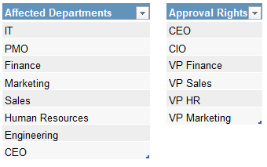

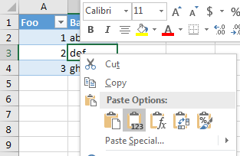
Transferring data continued
Screenshots from tab 1 of the Pre-Engagement Worksheet (columns B and D).
Screenshots from tab 1a of the Cost Optimization Analysis Tool (columns I and K).
Always Paste Values. Default pasting behavior can interrupt formula references and introduce unwanted external links.
As a result, always right-click and select Paste Values when transferring data from one spreadsheet to another.
Departments and approval rights can be transferred to the basic set-up tab of the Cost Optimization Analysis Tool.

Slide 23
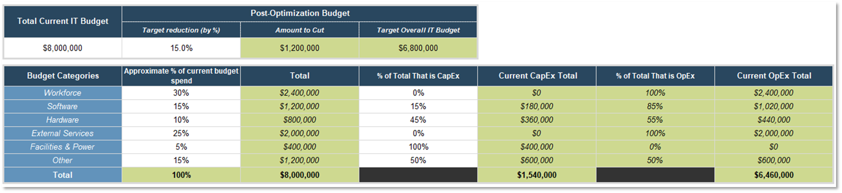
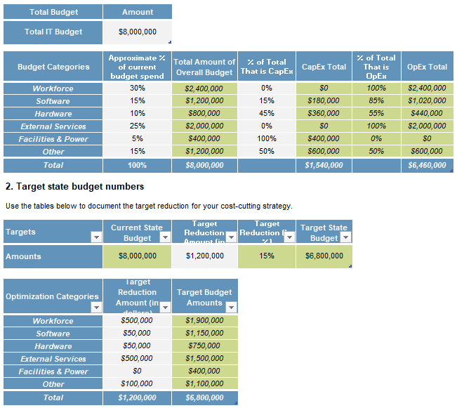
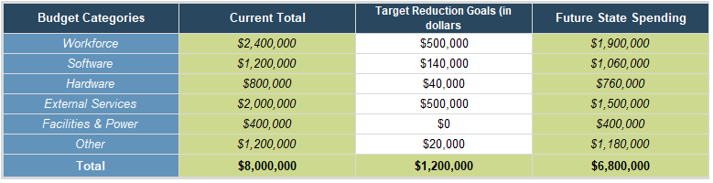
Transferring data continued
Screenshots from tab 2 of the Pre-Engagement Worksheet (columns B6: M15).
Screenshots from tab 1b of the Cost Optimization Analysis Tool (columns B6:H30).
Always Paste Values. Default pasting behavior can interrupt formula references and introduce unwanted external links.
As a result, always right-click and select Paste Values when transferring data from one spreadsheet to another.
Current state budget information and future state targets can be transferred to the basic set-up tab 1b of the Cost Optimization Analysis Tool.

Slide 24
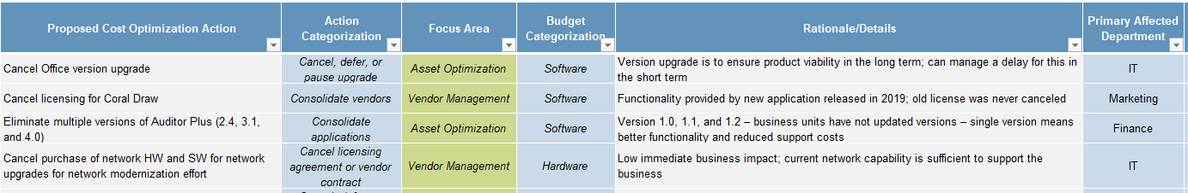
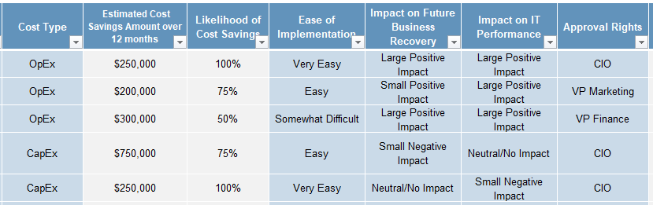
Transferring data continued
Screenshots from tab 3 of the Pre-Engagement Worksheet (columns B:H).
Screenshots from tab 2 of the Cost Optimization Analysis Tool (columns B:O).
See the transfer table on the next slide for help reconciling these two tabs.

Slide 25
Transferring data continued
Pre-Engagement Worksheet Tab 3 | Cost Optimization Analysis Tool Tab 2
Column B, Proposed Cost Optimization Actions | Column B, Proposed Cost Optimization Actions
Column C, Primary Affected Department | Column G, Primary Affected Department
Column D, Rationale | Column F, Rationale/Details
Column E, Budget Category | Column E, Budget Category
Column F, Cost Type | Column I, Cost Type
Column G, Estimated Cost Savings Amount Over 12 Months | Column J, Estimated Cost Savings Amount Over 12 Months
Column H, Approver | Column O, Approval Rights
Always Paste Values. Default pasting behavior can interrupt formula references and introduce unwanted external links.
As a result, always right-click and select Paste Values when transferring data from one spreadsheet to another.

Slide 26
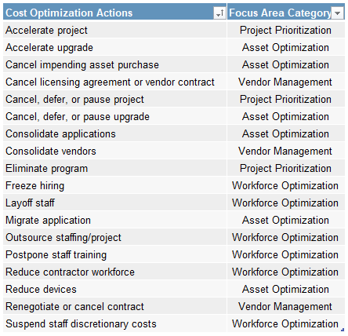
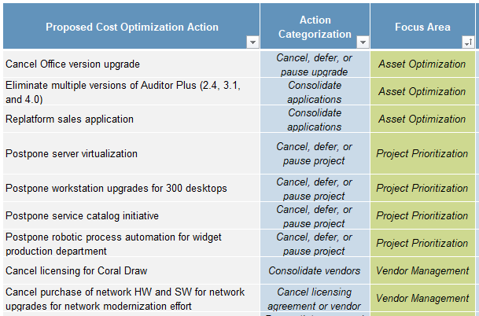
Other configurations
Screenshot of tab 1a of the Cost Optimization Analysis Tool.
Go through column B and C on tab 2 prior to the session and make some recommended categorizations. The dropdown in column C is driven by column F from tab 1a. The value in column D will auto-populate based upon your selection.
During the working session, you can filter or sort by column D to help structure the analysis and utilize some of the slides in the next section.
Prior to the working session the analyst can make preliminary categorizations of the client’s proposed actions. This will help save time and structure the analysis during the working session.
Screenshot of tab 1a of the Cost Optimization Analysis Tool.
On tab 1a, QA the Cost Optimization Actions table (columns F and G) to ensure nothing needs to be added or changed to align with the client’s proposed actions.

Slide 27
Cost Optimization Analysis Service
Working Session(s) Call Overview

Slide 28
Working session overview
Goal | Work with client to brainstorm possible cost saving actions across Info-Tech’s Cost and Budget Management Focus Areas (Assets, Projects, Vendors, and Workforce). Help facilitate the client’s decision-making process on best cost cutting recommendations for the organization.
Inputs | Documents from client. Completed Pre-Engagement Worksheet. Configured Cost Optimization Analysis Tool.
Tools/Templates | Cost Optimization Analysis Tool
Outputs | Decisions on cost cutting recommendations. Set delivery expectations with the client for the final report.
 | Agenda Item | Comments | Time Allocation
1 | Complete Set-up on Cost Optimization Analysis Tool (tabs 1a to 1c) | Outstanding items to review with client before set-up can be considered complete: The Cost Optimization Actions table on tab 1a (columns F:G). Are there any items missing or that need to be changed? Review the budget set-up tab (1b). Have client explained how numbers were derived. Priority Weightings for the three criteria on tab 1c. | 10 to 15 mins
2 | Brainstorm additional items | Did your analysis of pre-working session documents reveal any additional items that were not included in Pre-Engagement Worksheet? If so, discuss and add them to tab 2 as needed. Additionally, go through focus areas (see slides ahead) to further brainstorm ideas. | 20 to 40 mins
3 | Complete the analysis on tab 2 | Complete columns C through P on tab 2. | 30 to 45 mins
4 | Review Decision Support Dashboard and Determine Recommendations | Review the results on tab 3 of the tool and use the slicers to explore different scenarios. If upon reviewing the data a decision is made to not recommend an item for cost cutting, it can be removed from the data by toggling tab 2, column Q. | 30 to 45 mins

Slide 29
Confirm tool set-up (1 of 2)
Start the working session by reviewing tabs 1a through 1c of the Cost Optimization Analysis Tool with the client.
On tab 1a, confirm there are no additional departments or approvers to be added. Additionally, review the cost optimization actions table (columns F and G with the client) to explain how cost actions will be categories.
A note about the spending categories and focus areas tables in columns B and D on tab 1a: these tables come prepopulated with Info-Tech's Budget Spending Categories and Cost Optimization Focus Area Categories.
While these tables can be customized, it is not recommended for two reasons:
First, these categorizations are based on the best practices research of the analyst teams who cover these topics.
Second, if they are changed, it will require rework of existing tables on subsequent tabs to recover full tool functionality. This is not hard to do, but it will eat up time during the working session.
If you have a client who insists on changing these tables, even after your recommendations not to, follow the steps below to update tool.
If you’ve had to make a change to the Spending Categories table (column B):
On tab 1b, you will need to update the budget categories within the tables B9:H16 and B23:D30. Use the dropdowns in column B to populate the cells with the updated categories. You will need to add or delete any unused/needed rows within these tables to align to the number of categories in the client’s list.
If you’ve had to make a change to the Focus Areas table (column D):
Update the dropdowns in column G on tab 1a to align the updated focus areas with the categorizations in column F.

Slide 30
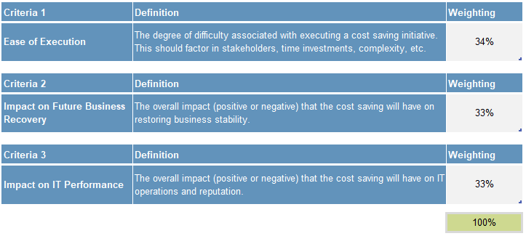
Confirm tool set-up (2 of 2)
Start the working session by reviewing tabs 1a through 1c with the client.
Screenshot of tab 1c of the Cost Optimization Analysis Tool.
Go through each of the criteria with the client early during the working session. Have the client determine the weightings in column D. The total of all three weightings should equal 100%.
On tab 1b, review the budget details with the client. The client should have produced these numbers during their time with Pre-Engagement Worksheet, so have them walk you through their process in determining current state totals and target state goals.
On tab 1c, review the prioritization drivers with the client (see screenshot to right). The categories are ease of executing or implementing the proposed cost saving action (a feasibility category), the impact of the action on future business recovery, and the impact of the action on IT performance (both risk/benefit categories).
Spend some time with the client reviewing the criteria and setting the weightings according to their organizational values.

Slide 31
Brainstorm additional cost saving actions
Info-Tech’s Budget & Cost Center Management Framework:
You should now be ready to proceed to the main worksheet of the working session, tab 2.
Start on tab 2 of the Cost Optimization Analysis Tool with the client by reviewing the preliminary list of cost saving actions they provided via the Pre-Engagement Worksheet.
Remind the client of the focus areas in our Budget and Cost Center Management Framework and show them any pre-work you may have done in categorizing their initial list of initiatives (see the “Other configurations” slide above), as well as any other suggestions or edits you may have made to their initial list.
As a suggestion, you could start brainstorming by filtering or sorting tab 2 by column D. You can use the slides in the appendix to help structure the conversation about uncovering and adding more potential actions to the initial list.
You can use the delivery slides in the appendix of this document to structure the brainstorming portion of the working session.

Slide 32

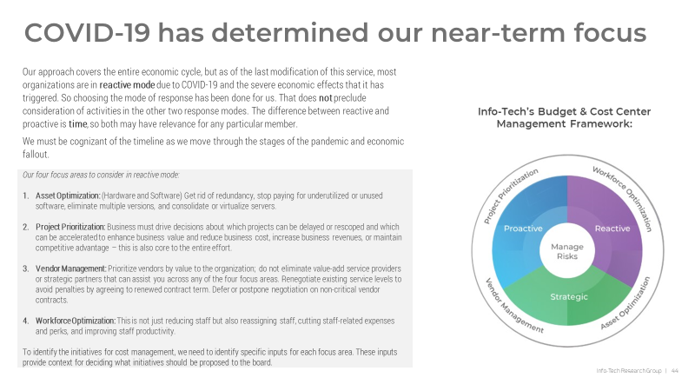
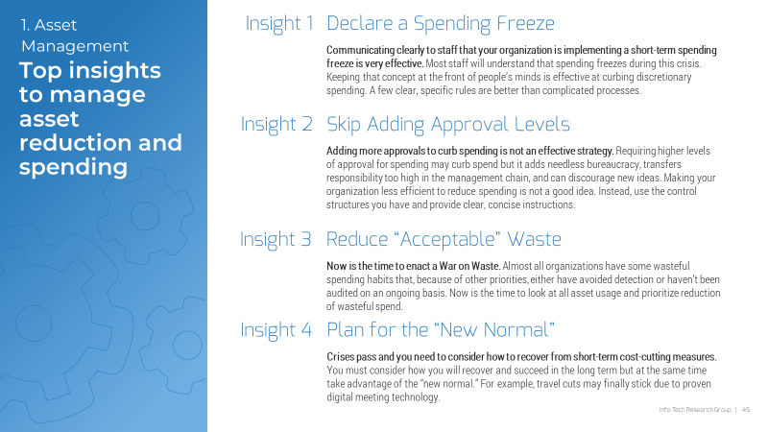
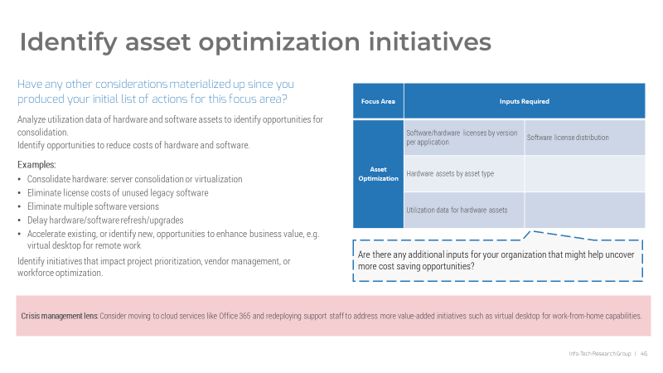
Use tab 2 to help brainstorm cost-cutting actions
Start on tab 2 by exhausting columns B to F.
Screenshots of Appendix slides from this document.
The primary function of columns B to F is to capture all proposed cost-cutting actions (in column B), and provide a business or operational rationale for each of them in column F.
Columns C through F allow you to categorize each item by action and budget categorization.
The list in column B should be as exhaustive as possible. This is the final list you and the client will be analyzing and making final recommendations upon.
Analysts can use the appendix section of this document as content slides during the working session to help with brainstorming.

Slide 33
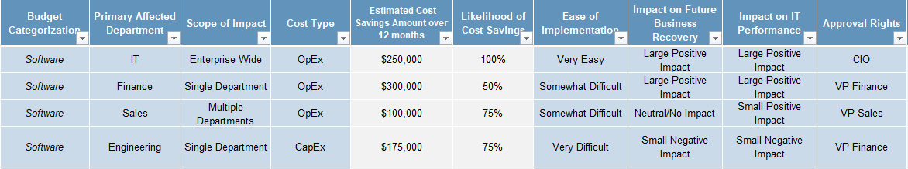
Complete tab 2
Once columns B to F are complete, proceed with the rest of the analysis in tab 2.
Use the dropdowns in columns E to categorize proposed initiatives by their budget categorization (i.e., Workforce, Software, Hardware, External Services, Facilities & Power, or Other).
Use the dropdown in column G to designate the department or business unit most affected by the potential cost cutting action.
This dropdown can be customized in the set-up tab.
Use the dropdown in column H to designate scope of impact (i.e., will the impact of the cost cutting action be felt by a single department, multiple departments, or the entire enterprise).
Use the dropdown in column I to categorize the cost type as CapEx or OpEx.
Use column K to analyze the likelihood of achieving the cost savings estimated in column H.
Enter this as a percentage. While you can enter any amount you would like, we recommend using rounded amounts (e.g., 100%, 75%, 50%, 25%, 0%), to avoid getting too into the weeds.
The % entered in this column will determine the weighted cost savings amount that gets reported out in the remaining tabs of this spreadsheet.
Columns L through N contain the prioritization criteria weighted on tab 1c.
Use the drop-downs to determine the potential difficulty of implementing each cost cutting action, as well as the potential impact and risk to the business and IT.
The inputs here will inform some of the reporting outputs on the next tab.
In column O, document the decision maker accountable for approving this potential cost cutting measure.
Once you have completed your inputs on this tab, hit “Refresh Data” in the Data Ribbon bar.

Slide 34
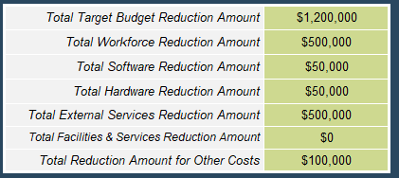
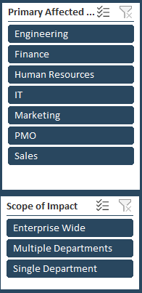
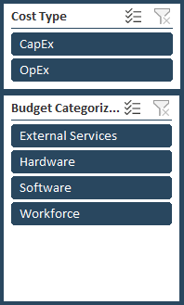
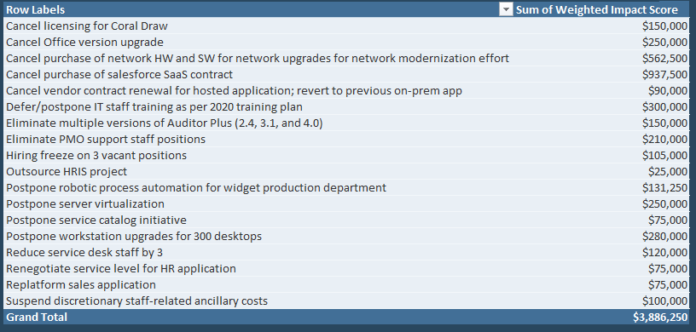
Determine recommendations
Screenshots from tab 3 of the Cost Optimization Analysis Tool.
Use the interactive reports in the Decision Support Dashboard on tab 3 to help the client determine final recommendations.
Everything is included in the final recommendation tabs (tabs 4 to 6) by default. The Decision Support Dashboard should help to determine items that need to be removed from the final reports (see “Force exclude items” two slides from now).
The targets set on tab 1b will appear on the dashboard from on tab 3, columns F6:K12.
Use the slicers in columns B and E to manipulate the data in the rest of the charts.
The table in columns C and D will reflect the slicers and let you know, among other things, how close to hitting the targets in F6:K12 you are.
The 2X2 quadrant that starts in column E will also respond to the slicers.

Slide 35
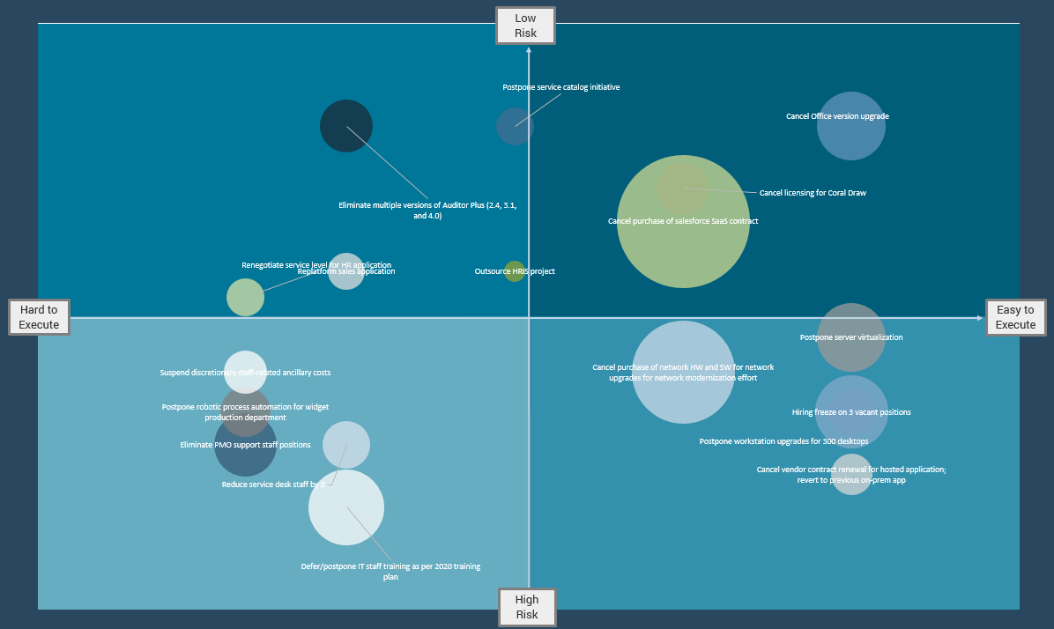
Determine recommendations continued
Screenshot from tab 3 of the Cost Optimization Analysis Tool.
1. Start here: Items in the upper right quadrant are cost saving actions that will be relatively easy to implement and pose low risk to business recovery and IT performance.
These savings should be included in recommendations.
2. Then move here: Items in the upper left quadrant are cost saving actions that will be relatively hard to implement but pose lower risk to the business and IT.
Deliberate on these.
3. Over here next. Items in the lower right quadrant are cost saving actions that will be relatively easy to implement but pose high risk to business recovery and IT performance.
Deliberate on these. Avoid recommending high-risk items if possible.
4. Here last. Items in the lower left quadrant are cost saving actions that will be relatively hard to implement and pose high risk to the business and IT.
Deliberate on these but avoid recommending if possible.

Slide 36
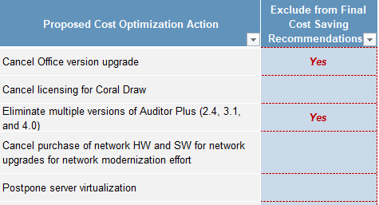
Force exclude items
Screenshot of columns B and Q from tab 2 of the Cost Optimization Analysis Tool.
End the working session by having the client make force exclude decisions.
As noted, by default everything is included in the final recommendation tabs (tabs 4 to 6).
The Decision Support Dashboard should help to determine items that need to be removed from the final recommendations and report.
Once those considerations have been analyzed and discussed and final decisions have been made, you’ll need to go back to tab 2 to force exclude items not being recommended in the final report.
Steps for force excluding items and finalizing final report tabs:
On the relevant rows on tab 2, toggle the dropdown in column Q to “Yes.”
Hit “Refresh Data” in the data ribbon.
Your working session is now complete.
Before hopping off the line, and time permitting, you may wish to review the final graphs and charts in tabs 4, 5, and 6.
Most importantly, you should set expectations with the client for delivery of their Cost Optimization Recommendations report.

Slide 37
Cost Optimization Analysis Service
Report Creation Overview

Slide 38
Report creation overview
Goal | Prepare final report for client using the Cost Optimization Recommendations Template and the chart gallery in the output tabs of the Cost Optimization Analysis Tool.
Inputs | Working session with results of Cost Optimization Analysis Tool.
Tools/Templates | Cost Optimization Recommendations Template Cost Optimization Analysis Tool (tabs 4, 5, and 6)
Outputs | Final report ready to send to client.
 | Agenda Item | Comments | Time Allocation
1 | Transfer charts from the Cost Optimization Analysis Tool to the Cost Optimization Recommendations Template | Each of the slides within the Recommendations Template contains call-outs explaining what data/graphs to use from the Cost Optimization Analysis Tool and where this data can be found within the Tool. Similarly, tabs 4, 5, and 6 of the Tool also contain directions on what slide within the Template the data/charts should be placed. | 20 to 30 minutes
2 | Update text on slides to reflect client’s outcomes | Once the charts have been transferred, the analyst should update the analysis on each relevant slide to reflect the client’s outcomes. Use the sample text that is on each slide as inspiration, and lean on the numbers coming from the charts and graphs to drive the analysis as much as possible. | 45 to 60 minutes

Slide 39
Cost Optimization Recommendations Template
You should now be ready to complete the main deliverable of the service.
Download the Cost Optimization Recommendations Template
Document details:
This is the main deliverable that is sent to the client at the end of the service.
It is a 17 slide PPT template containing cost-optimization recommendations agreed upon during the working session.
It is completed by the analyst post-working session using the outputs of the Cost Optimization Analysis Tool.

Slide 40
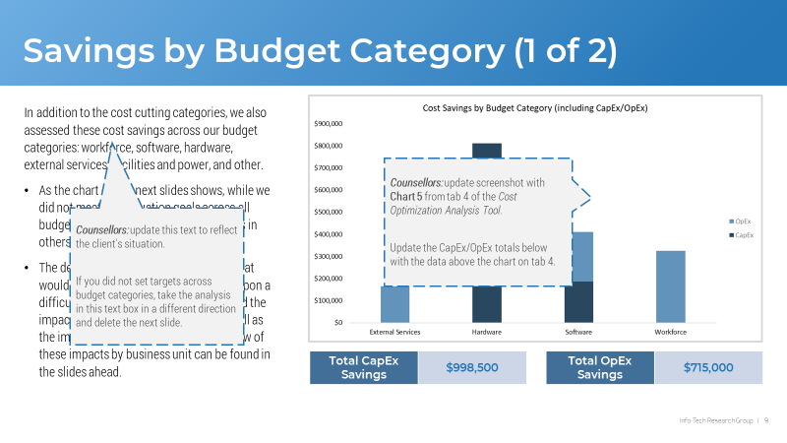
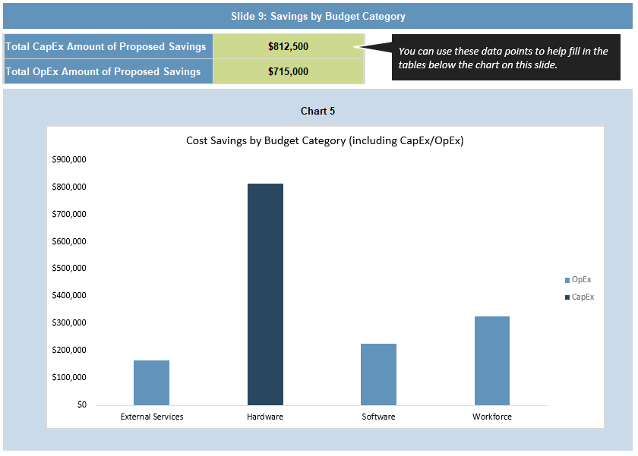
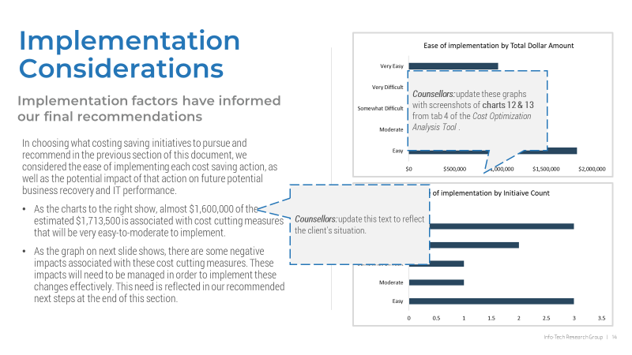
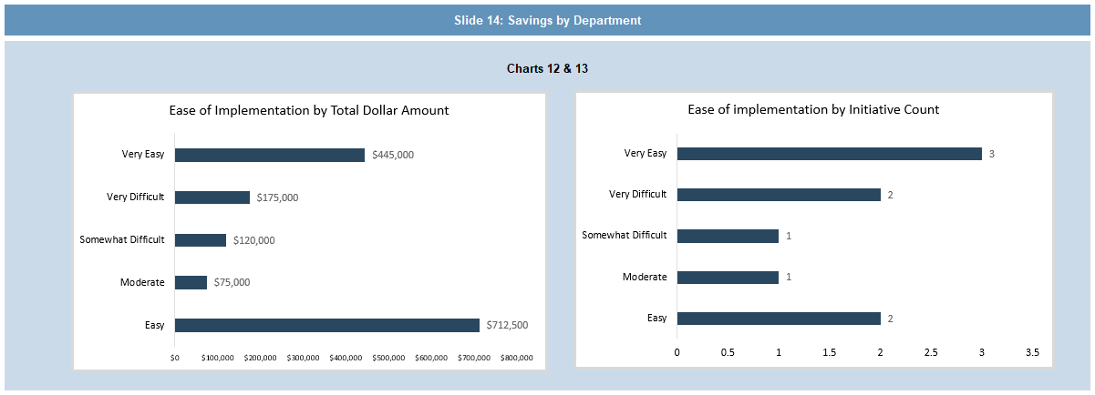
Transfer data and charts
Screenshots of slides 9 and 14 of the Recommendations Template.
Screenshots from tab 4 of the Cost Optimization Analysis Tool.
Graphs on tab 4 are sized to fit well into the slide design with hopefully minimal adjustments.
Rows above charts on tab 4 inform of relevant slide location. Call-outs on slides inform of relevant charts to use.

Slide 41
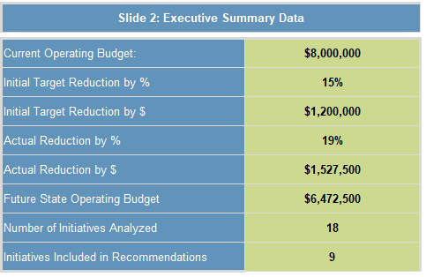
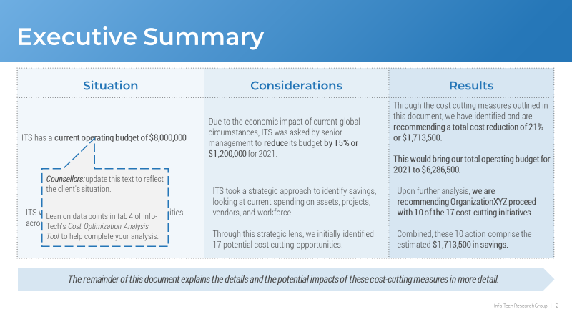
Update recommendations analysis
Slides within the Cost Optimization Recommendations Template have been designed to let the graphs do the work. That said, some customized analyst recommendations are required on some of the slides. Analysts should budget about an hour to update the recommendations text.
To help ease the work of analysts, tab 4 of in the Cost Optimization Analysis Tool contains various data points that the analyst can use in his/her recommendations to quicken the process of completing this document.
Screenshot from tab 4 of the Cost Optimization Analysis Tool.
Screenshot of slide 2 of the Recommendations Template.
Use the data points provided on tab 4 to help flesh out your analysis on the slides in the Recommendations Template.

Slide 42
Send the report to the client!
You’re now ready to send the final deliverable and complete the engagement.
Screenshot of slide 16 of the Recommendations Template.
Depending on what the client wants, the deliverable handoff may simply be an email, or it may be an email and a short call to walk the client through the deliverable. This should be determined at the end of the working session.
The last slide of the Template contains some clear next steps and recommendations. In your deliverable handoff, you should offer to help facilitate some of these next steps by offering to set-up a GI on Phase 3 of the Building and Communicating Your IT Cost-Cutting Strategy for the COVID-19 Recession blueprint.
After deliverable handoff you should close the SFDC case and send MV to the client.

Slide 43
Cost Optimization Analysis Service
Work Session Delivery Slides

Slide 44
Info-Tech’s Business Cycle Framework
Our framework contains 3 phases:
Reactive (<3 months)
Identify the most-effective and least-disruptive cost-cutting measures in response to changing economic conditions.
Proactive (3-12 months)
Enable the organization to respond appropriately to different types and magnitudes of a slowdown in a planned manner.
Strategic (>12 months)
Establish budget and cost management efficiency and agility across all stages of the business cycle, ensuring that the IT strategy is sustainable regardless of changing economic conditions.

Slide 45
COVID-19 has forced organizations into reactive modes of cost management
You are here
Reactive (<3 months)
Identify the most-effective and least-disruptive cost-cutting measures in response to changing economic conditions.
The COVID-19 Recession forces you into reactive modes of budget and cost planning.
While choosing the mode of response has been done for us, this is not to preclude consideration of activities in the other two response modes. The difference between reactive and proactive is time, so both may have relevance.
We must be cognizant of the timeline as we move through the stages of the pandemic and economic fallout.
Reactive
Info-Tech’s Business Cycle Framework
We have turned our focus to Reactive Mode, as that is where most organizations are due to COVID-19.

Slide 46
Info-Tech’s Four Focus Areas for Cost Optimization
Our four focus areas to consider in reactive mode:
Asset Optimization: (Hardware and Software) Get rid of redundancy, stop paying for underutilized or unused software, eliminate multiple versions, and consolidate or virtualize servers.
Project Prioritization: Business must drive decisions about which projects can be delayed or rescoped and which can be accelerated to enhance business value and reduce business cost, increase business revenues, or maintain competitive advantage – this is also core to the entire effort.
Vendor Management: Prioritize vendors by value to the organization; do not eliminate value-add service providers or strategic partners that can assist you across any of the four focus areas. Renegotiate existing service levels to avoid penalties by agreeing to renewed contract term. Defer or postpone negotiation on non-critical vendor contracts.
Workforce Optimization: This is not just reducing staff but also reassigning staff, cutting staff-related expenses and perks, and improving staff productivity.
To identify the initiatives for cost management, we need to identify specific inputs for each focus area. These inputs provide context for deciding what initiatives should be proposed to the board.
Info-Tech’s Budget & Cost Center Management Framework:

Slide 47
Top insights to manage asset reduction and spending
1. Asset Management
Insight 1
Declare a Spending Freeze
Communicating clearly to staff that your organization is implementing a short-term spending freeze is very effective. Most staff will understand that spending freezes during this crisis. Keeping that concept at the front of people’s minds is effective at curbing discretionary spending. A few clear, specific rules are better than complicated processes.
Insight 2
Skip Adding Approval Levels
Adding more approvals to curb spending is not an effective strategy. Requiring higher levels of approval for spending may curb spend but it adds needless bureaucracy, transfers responsibility too high in the management chain, and can discourage new ideas. Making your organization less efficient to reduce spending is not a good idea. Instead, use the control structures you have and provide clear, concise instructions.
Insight 3
Reduce “Acceptable” Waste
Now is the time to enact a War on Waste. Almost all organizations have some wasteful spending habits that, because of other priorities, either have avoided detection or haven’t been audited on an ongoing basis. Now is the time to look at all asset usage and prioritize reduction of wasteful spend.
Insight 4
Plan for the “New Normal”
Crises pass and you need to consider how to recover from short-term cost-cutting measures. You must consider how you will recover and succeed in the long term but at the same time take advantage of the “new normal.” For example, travel cuts may finally stick due to proven digital meeting technology.

Slide 48
Identify asset optimization initiatives
Have any other considerations materialized up since you produced your initial list of actions for this focus area?
Analyze utilization data of hardware and software assets to identify opportunities for consolidation. Identify opportunities to reduce costs of hardware and software.
Examples:
Consolidate hardware: server consolidation or virtualization
Eliminate license costs of unused legacy software
Eliminate multiple software versions
Delay hardware/software refresh/upgrades
Accelerate existing, or identify new, opportunities to enhance business value, e.g. virtual desktop for remote work
Identify initiatives that impact project prioritization, vendor management, or workforce optimization.
Focus Area | Inputs Required
Asset Optimization | Software/hardware licenses by version per application | Software license distribution
 | Hardware assets by asset type
 | Utilization data for hardware assets
Are there any additional inputs for your organization that might help uncover more cost saving opportunities?
Crisis management lens: Consider moving to cloud services like Office 365 and redeploying support staff to address more value-added initiatives such as virtual desktop for work-from-home capabilities.

Slide 49
Top insights to manage projects in reactive cost-cutting mode
2. Project Prioritization
Insight 1
Everything Is on the Table
This is about survival and everything is on the table. The COVID-19 pandemic forced governments to enact measures that most would never have conceived of supporting. Follow their example. Organizations and businesses need to make deep cuts that previously would have seemed impossible.
Insight 2
Make Decisions With Limited Information
Perfect is the enemy of good, and decisions with limited information are required. Timelines are crunched and higher-risk decisions are required. You will make mistakes, and you’ll need to adjust as you go.
Insight 3
Don’t Give Up on Long-Term Objectives
While you need to survive in the short term, that’s not good enough. While short-term survival is the prime focus, you still need to thrive in the long term. As much as possible, match every short-term decision with an associated long-term risk assessment. Again, all assessments must be done quickly and efficiently.
Insight 4
Focus on Value-Creation Projects
Always think of IT as a value creator rather than a cost center. It is tempting to quickly make short-term reductions, especially when under great pressure to cut significant costs. However, keep projects that generate revenue or affect customer experience. These may be more important than a short-term cost-cutting exercise.

Slide 50
Identify project prioritization initiatives
Have any other considerations materialized since you produced your initial list of actions for this focus area?
For each project in your portfolio, identify a proposed cost management initiative. Examples of initiatives might include:
Rescope existing projects that are underway.
Accelerate planned or existing projects that enable business cost savings or competitive advantage and revenue growth.
Cancel or postpone existing projects that are underway.
Cancel or postpone planned projects that haven’t started.
Identify net-new opportunities to provide business value: enhance business capabilities or save business costs.
Identify initiatives that impact asset optimization, vendor management, or workforce optimization.
Focus Area | Inputs Required
Project Prioritization | List of current and planned projects
 | Strategic roadmaps
Are there any additional inputs for your organization that might help uncover more cost-saving opportunities?
Crisis management lens: Some projects may be related to enabling the business to reduce costs or save money through business process efficiency; position them to improve competitive advantage, provide superior customer experience in tough times, generate new revenue streams, etc. Info-Tech can help with best practices on Preparing Your Project for Post-Pandemic Pressure.

Slide 51
Top insights to effectively manage vendors during drastic and reactive cost cutting
3. Vendor Management
Insight 1
Negotiate Collaboratively With Your Vendors
If you are too demanding or take unnecessary advantage of the situation, there is a strong chance the vendor will treat you the same when conditions change to their favor. Vendors are experiencing the same cash flow challenges as you. Key partnerships providing long-term essential services may be more willing to negotiate than short-term contractors who are facing the same cutbacks you are.
Insight 2
Assess the Current Situation
Don't rush in blindly and go into slash-and-burn mode unnecessarily. While time is of the essence, there are always long-term considerations and relationships. How you treat your vendors now will shape your relationship in the long run.
Insight 3
Be Creative
Negotiations (when required) will be atypical for both parties. New solutions should be considered and worked through with partners. Be patient and don't be afraid to put forward unusual ideas.

Slide 52
Identify vendor management initiatives
Have any other considerations materialized up since you produced your initial list of actions for this focus area?
Focus Area | Inputs Required
Vendor Management | Current Vendor Contracts
 | Proposed or pending contracts
Example actions:
Renegotiate existing contracts or service levels
Cancel existing contracts
Postpone pending contract negotiation.
Advice: Prioritize contracts based on necessity. Vendors are experiencing the same cutbacks as you are, and most will be willing to negotiate. Prioritize your key partnerships/largest contracts and work with them first. Postpone any new contracts but communicate a clear “re-evaluate” date.
Are there any additional inputs for your organization that might help uncover more cost-saving opportunities?
Crisis management lens: Have open conversations with your vendors to work with you through the crisis. Approach this collaboratively as vendors are likely also facing economic issues. Be transparent and respectful in negotiations and look for new solutions, as this is an unusual situation for both parties. Do not be afraid to ask for concessions. Info-Tech analysts can walk you through a methodology for reducing current vendor costs, and you can refer to Cost-Reduction Planning for IT Vendors.

Slide 53
Top insights to manage IT employees during cost-cutting
4. Workforce Optimization
Insight 1
Deal With Low Performers Now
This is an opportunity to expedite dealing with low performance. It may sound insensitive, but in times where cost cutting is required, you may have the opportunity to quickly and decisively address low performance with targeted staff reductions. This option is not open to every organization due to union regulations or political circumstances. However, at the very least up your performance management tactics. Many low performers leave of their own volition when faced with clear, fair, and exacting performance expectations.
Insight 2
Leave Layoffs Until Last
Other short-term cost-cutting measures should be considered before enacting short-term layoffs. Layoffs appear to be the low-hanging fruit. However, if you intend for those laid off to return, you will see a long-term negative impact on engagement and productivity if other more obvious measures are not taken first.
Insight 3
Engage and Thank Remaining Staff
Clear, empathetic, and honest communication is required when dealing with any staff reductions. It is important to be thankful to remaining staff and recognize the extra effort the entire organization will need to make to return to a more normal state. The right tone must be communicated. Neither an overly rosy nor an overly bleak message will be appreciated.

Slide 54
Top insights to manage IT employees during cost-cutting (continued)
4. Workforce Optimization
Insight 4
Check In Regularly With Staff on Layoff
Maintain support for affected employees. Check in regularly with staff who have been laid off and update them on developments and outlook. Ask if there are ways that the organization can help. Avoid the risk of return-to-work disengagement.
Insight 5
Continue to Hire Great People
A spending freeze does not have to mean a hiring freeze. Don’t miss an opportunity to add great people to your company. Keep looking to staff your organization for future needs and be prepared to advocate for the right targeted hires even through a spending freeze.
Insight 6
Cutting Staff Is Hard, but Probably Necessary
No aspect of cost reduction is more emotional and difficult than staff reductions. If cost management initiatives involve staff reductions, then significant time must be spent on planning, communicating, treating affected staff with respect, and ensuring that remaining staff stay engaged. Before enacting staff reductions, careful consideration should be given to redeployment of existing resources from longer-term initiatives to short-term ones.

Slide 55
Identify workforce optimization initiatives
Have any other considerations materialized since you produced your initial list of actions for this focus area?
Focus Area | Inputs Required
Workforce Optimization | Current staffing lists/levels | Travel budgets
 | Workload analysis
 | Training program details
Additional workforce cost-cutting actions that could be considered:
Reduce service levels | Eliminate all discretionary spending
Shift work to more efficient locations | Freeze hiring
Overdue terminations | Reduce or remove employer contributions/matching to savings plans
Raise employee contributions to benefits | Outsourcing
Unpaid leave of absence | Voluntary burnout offers/early retirement
Cut temporary staff/contractors | Reduce work hours/days with commensurate wage reduction
Job sharing | Local/federal government programs
Freeze salaries, delay raises, eliminate bonuses | Cut salaries
Copy asset optimization inputs determined via the slide above if it makes working through this slide easier.
Crisis management lens: There is no aspect of cost cutting that is more painful for an organization than staff reduction. Reductions have a long-term effect on the morale and long-term future of your organization. It is important to understand your organization’s overall approach to this topic. It is extremely important that organizations consider recovery following the specific crisis or downturn.

