Slide 1

Insert Organization Name/Logo
Application Portfolio Snapshot Executive Presentation
Maximizing the value of [COMPANY]’s application portfolio and supporting APM transformation.
Instructions
(optional) Change title to preferred initiative name.
Search [COMPANY] and replace with your organization’s name.
Add sponsor (if relevant) and date.
Add organization logo.
Prepared for:
[COMPANY]
Name, Title
Date
Info-Tech Research Group Inc. is a global leader in providing IT research and advice. Info-Tech’s products and services combine actionable insight and relevant advice with ready-to-use tools and templates that cover the full spectrum of IT concerns.
© 1997-2023 Info-Tech Research Group Inc.

Slide 2
Application Portfolio Snapshot Executive Presentation Template
This deck is intended to act as a template for the Application Portfolio Snapshot. It uses sample data to demonstrate an ideal presentation to make the case for application portfolio transformation (APT).
Content identified in GREY is intended to be edited or replaced with your organization’s specific data. Slides requiring input are marked “UPDATE” in the comments. Certain information will require adjusting the slide master to be removed or changed.
In some instances, additional information may be necessary, but where additional slides are added, every effort should be made to ensure the following:
The additional content is relevant and required and provides value
The format follows the other slides within the deck
The flow remains logical and clear
Instructions
Review these instructions and delete before sharing with your audience.

Slide 3
Executive Summary
State of the Application Portfolio
Impact on the Organization
Achieving Our Strategic Goals
The intensity of the application portfolio has presented several technical issues:
High functional redundancy and numerous duplicate or unnecessary applications
Disparate applications have caused a reliance on system integration complexity
This intensity has surfaced as:
High, unnecessary costs
Process inefficiencies
Poor analytics capabilities
Barriers to growth and evolution.
[Initiative Name] will ensure the application portfolio supports the strategic direction of [COMPANY].
This process will produce and inform the corrective actions to our applications to achieve:
Organizational scalability
Data harmonization
Process modernization
Reduced costs
Instructions
Use the “State of the Portfolio” section to highlight technical issues.
Use the “ Impact on the Organization” to highlight the business pain points.
Use the “Achieving Our Strategic Goals” section to highlight APT and how it will support the organization’s goals.

Slide 4
Table of Contents
Executive Summary
Application Portfolio Findings
Next Steps: Application Portfolio Transformation
Next Steps: Blueprints and Diagnostics
About Info-Tech Research Group
Instructions
Update the TOC at the end.

Slide 5
Technical Pain Points
Why is APM needed?
The Intensity of [COMPANY]’s application portfolio has encumbered specific business capabilities and compromised our strategic goals.
Business Pain Points
Back-End Complexity
Hurdles to Growth/Change
Instructions
Update slide with outcomes from the exercises.
Disparate Data/Apps
Poor Business Analytics
Poor Architectural Fit
Process Inefficiency
Redundancy
Software Costs

Slide 6
Technical Objectives
How does APM support the business goals?
Application portfolio transformation achieved via application rationalization will enable our established goals listed in {insert organization’s strategic materials].
[COMPANY] Goals
Platform Standardization
Organizational Scalability
Instructions
Update slide with outcomes from the exercises.
Data Harmonization
Customer Insights
Application & Data Modernization
Process Modernization
Reduced Redundant Applications
Reduced Costs

Slide 7
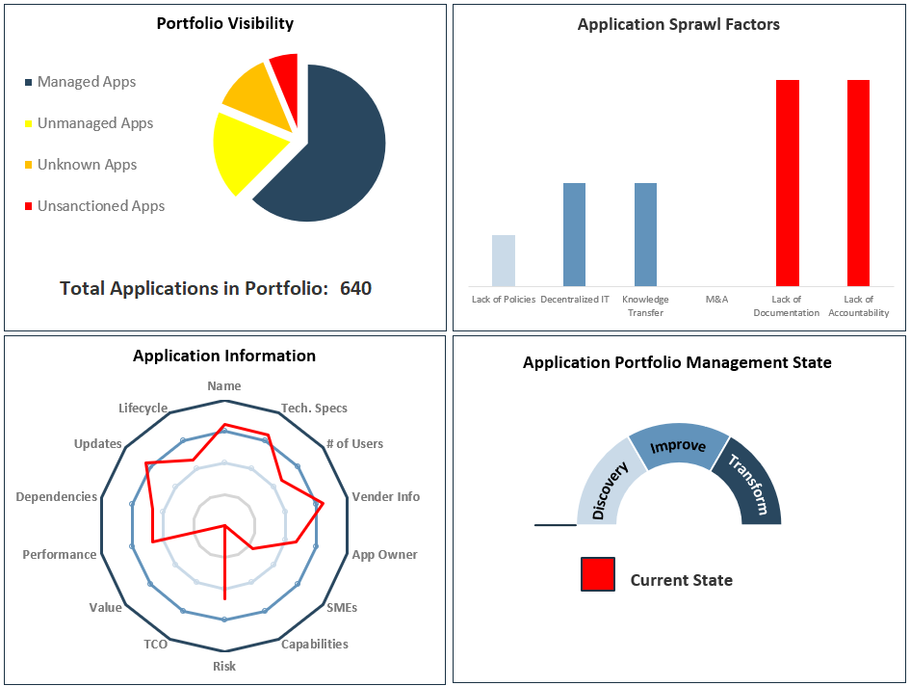
What is our current APM situation?
Key Insights
[Replace with key insights from the APM Diagnostic Tool.]
Instructions
Replace image with result worksheet from APM Diagnostic Tool.
Highlight key insights from the diagnostic, positive and negative.

Slide 8
Assessing the state of our application portfolio
Key Insights
{7 critical business capabilities are considered high risk.
35 applications have high significant functional overlap and are likely redundant.
[insert capabilities] will not be included in [technology initiative] due to incompatibility.}
Our initial assessment comprises high-level evaluation of our applications’ alignment to our business capabilities key risk indicators, including:
Policy noncompliance
Immediacy of software expiration or end of life
Application maintainability
Compatibility with technology strategy
The objective is to showcase how the application portfolio relates to and impacts specific business capabilities.
Instructions
Replace with key findings from the previous steps and any other noteworthy problems.
Adjust description on assessment if you are not including risks indicators.
Instructions
Update slide with outcomes from the exercises.

Slide 9
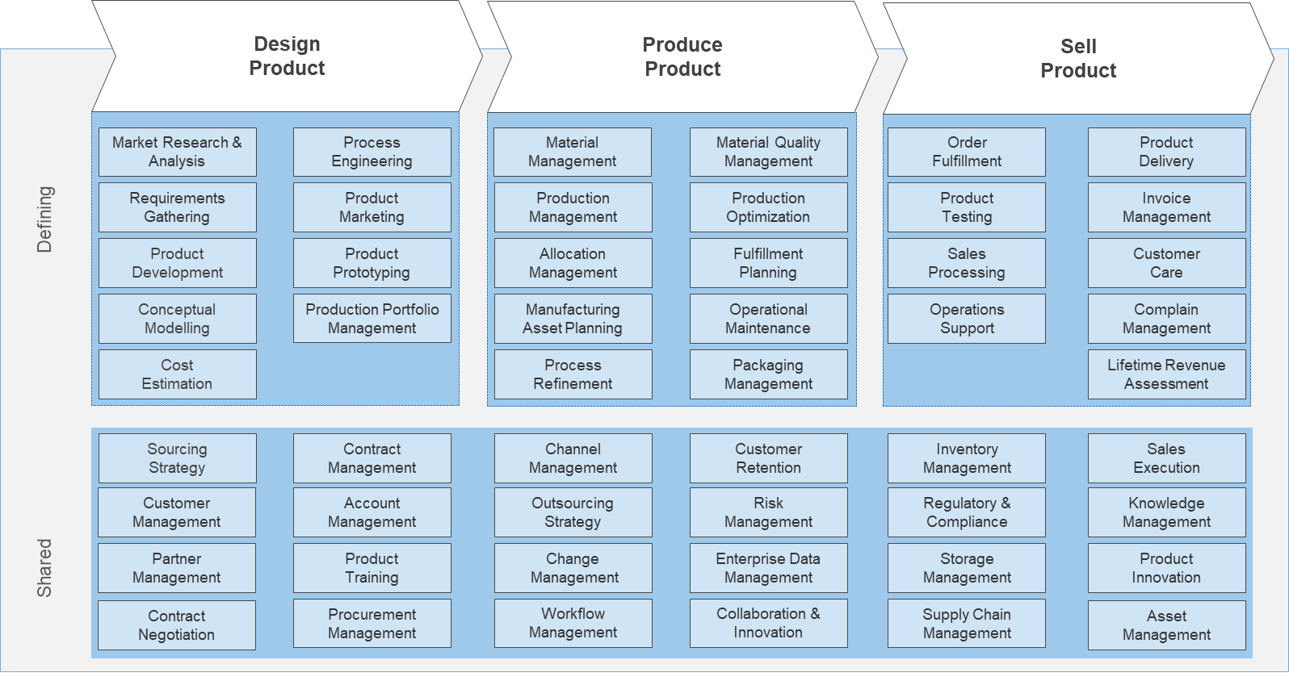
The organization-wide view
To perform this assessment, we used [our BCM/Industry Reference Architecture].
The model represents the core building blocks of what [COMPANY] does to deliver its [products/ services].
Applying this assessment revealed for each business capability:
Which specific applications support the capability
If they are excessively supported by applications
If they are not supported by applications
A business capability map provides a visual of the functional side of the application portfolio at a glance.
Instructions
Update this slide with your business capability map (BCM) or reference business architecture.

Slide 10
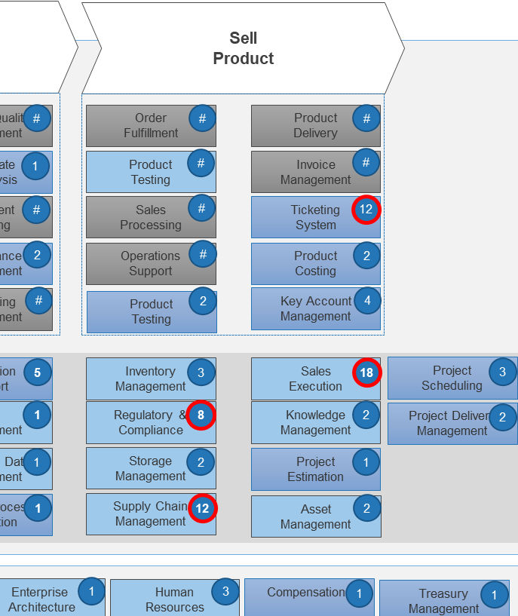
Application Portfolio Snapshot – How to Interpret
Unmitigated Risk
The Product Delivery capability is at high risk, which is an aggregate measure of:
Non-adherence to policies
Immediacy of software expiration or end of life
Maintainability of application (cost/time)
Misalignment to technology strategy
This means the business continuity of the capability is threatened both in the sense of frequent short-term (hour/day) interruptions and long-term (weeks+ ) stoppage, which can cause existential threats to the organizations. This can also expose the areas where data is exposed to theft or loss. Lastly, this can also highlight which capabilities are incompatible with strategic plans, preventing technical advancement for that capability.
Application Excessiveness
This example shows 13 individual applications supporting the Allocation Management capability.
“Excessiveness” refers to the relationship between capability and the number of applications. Many-to-many relationships (meaning an app can support several capabilities and a capability can be supported by multiple applications) are not necessarily harmful, especially at this high level. However, an excess of applications supporting one capability is cause for concern.
This illustrates high likelihood of functional redundancy. The organization is overspending on the software needs of this capability and placing additional burdens onto maintenance and support teams. This also indicates application disparity. The automation of this capability relies on a complex integration of multiple individual systems, which can surface as inconsistent or inefficient processes, duplicate or contradictory data and reporting, and additional demand on operational teams.
Technology Gaps
The Change Management capability is not supported by any application. Often the processes of a capability are manual and do not require automation. This at least provides the opportunity to showcase gaps that may exist and explore if technology could provide opportunities.

Slide 11
Application Portfolio Snapshot
Design
Product
Produce
Product
Sell
Product
Risk is an aggregate measure of:
Non-adherence to security policies
Immediacy of software expiration or end of life
Maintainability of application (cost/time)
Misalignment to technology strategy
Market Research & Analysis
#
Process Engineering
#
Material Management
#
Material Quality
Management
#
Order
Fulfillment
#
Product
Delivery
#
#
#
#
Requirements
Gathering
Product Marketing
#
Production
Management
Certificate of Analysis
Product
Testing
Invoice
Management
Defining
4
1
#
Product
Prototyping
#
12
#
Fulfillment
Planning
Sales
Processing
Ticketing System
Product Development
#
Allocation
Management
#
Instructions
Replace with BCM from previous slides.
Update capability count and evaluation with outcomes from the exercises.
Update key.
#
Minimal Risk
#
Production Portfolio
Management
#
2
#
Conceptual
Modelling
Manufacturing Asset Planning
Maintenance Management
Operations
Support
2
Product Costing
#
2
4
Cost
Estimation
1
Key Account Management
Indeterminate Risk
#
Handling of Dangerous Goods
Packaging
Management
Product
Testing
No App Support Identified
Collaboration & Innovation
Sourcing
Strategy
Resource Capacity Management
1
Integration Support
Inventory
Management
Sales
Execution
2
4
5
3
18
6
#
EDI Support
Account
Management
3
Risk
Management
1
Regulatory & Compliance
8
Knowledge
Management
Capability Not Evaluated
Customer
Management
2
Procurement
Management
Training
Change
Management
Enterprise Data Management
Storage
Management
Project Estimation
Capability Added to Reference Architecture
Shared
6
2
1
1
2
1
2
Procurement
Management
Workflow Management
Robotic Process Automation
Supply Chain
Management
Budgeting
4
4
1
12
2
Asset
Management
#
Number of Applications
Remediation Recommended
Strategic
Planning
Accounting & Reporting
#
3
5
9
1
3
Corporate
Governance
Operations
Management
Enterprise
Architecture
Human
Resources
Compensations
3
1
Enabling
1
2
Research & Development
Legal
IT
Management
11
Payroll
3
Corporate
Finance
2
Facilities
Management
Logistics
Management
4
1

Slide 12
Application Portfolio Snapshot
Business capability | Number of apps | App management model | Immediacy of software expiration or end of life | Maintainability of application | Misalignment to technology strategy | Non-compliant with IT policies | Overall risk
Instructions
Insert Snapshot results table.
Bold indicates business capabilities to prioritize management and planning.

Slide 13
How do we transform the application portfolio?
Application Modernization:
People, process, and technical changes that extend an application’s lifetime, increase its value, and introduce a new or enhance an existing business capability with modern technology.
Central to transformation is application modernization.
Business Is Able to Change
IT Is Ready to Change
IT Is Able to Change
Tactical Modernization
Organizational Modernization
Partial-stack customization
User experience enhancements
Outsource modernization
Business Value
Full-stack customization
System replacement
System removal
Relationship
and network
building
Fit for purpose
User-centric
High
Business Is Ready to Change
Seamless
application
connection
Continuous Modernization
Application System Knowledge
Keep-the-Lights-On Modernization
Adaptable
Progressive Modernization
Core updates and upgrades
Maintenance
Application assessment
Proof of concept
Business process improvement
IT operations improvement
Informative
and insightful
Low
Accessible
Private and secured

Slide 14
Improving application portfolio management and strategic alignment
Discover and Rationalize
Application Portfolio Snapshot (Complete)
Application Portfolio Management Foundations
Assess Alignment
Document Your Business Architecture
Info-Tech Diagnostic: Application Portfolio Assessment
Transition to Product Delivery
Align and Modernize
Build a Business-Aligned IT Strategy
Optimize IT Project Intake, Approval, and Prioritization
Streamline Application Management
Instructions
Update with recommended next steps and related research.
Details and links to research/diagnostics can be found in Next Steps: Blueprints and Diagnostics

Slide 15
[COMPANY] Application Portfolio APM Findings
The following slides provide a summary of the Application Portfolio Snapshot working sessions and serve as a starting point for your transformation.

Slide 16
Why is APT needed?
Application portfolio transformation achieved via application rationalization will enable our established goals listed in IT Application Services – Roadmap and Applications Operations Report.
[REPLACE with Narrative APM Theme]
Business Goals | Technical Objectives
Instructions
Repeat this slide and the recommended resources slide for each Narrative Theme uncovered during the workshop.

Slide 17
Why is APT needed?
Application portfolio transformation for each business goal theme can be supported by leveraging Info-Tech’s research and diagnostics.
Supporting resources for [REPLACE with Narrative APM Theme]
Instructions
Repeat this slide and the recommended resources slide for each Narrative Theme uncovered during the workshop.
Insert recommendations and related blueprints supporting the Narrative APM Theme.

Slide 18
Next Steps: Application Portfolio Transformation
The application portfolio snapshot is the first step on your application portfolio management journey.

Slide 19
How do we transform the application portfolio?
Application Rationalization:
The process of evaluating your applications to determine their ideal strategic direction.
Central to transformation is application rationalization.
Objectively evaluate our application
Business Value
TCO
End-User Perspective
Application Alignment
Technical Health
to determine which we should:
Maintain: Keep the application but adjust its support structure.
Modernize: Create a new initiative to address an inadequacy.
Consolidate: Create a new initiative to reduce duplicate functionality.
Retire: Phase out the application.

Slide 20
How do we transform the application portfolio?
Application Discovery:
The process of revealing application information through interviewing users and dissecting business processes and their connection to applications.
Central to transformation is application discovery.
Abstract our business processes and align our applications
Business Process
Step
Step
Step
Step
App
App
App
App
Understand users and categorize apps by their functionality.
Identify redundancies across the organization.
Identify your technology gaps and opportunities to add value.
Identify hidden apps exposing the organization to risk.

Slide 21




How do we transform the application portfolio?
Application Portfolio Management (APM):
The ongoing practice of
Providing visibility into applications across the organization.
Recommending corrections or enhancements to decision makers.
Showcasing the direction of applications to stakeholders.
Central to transformation is application portfolio mgmt.
Application Alignment
Application Rationalization
The process of revealing application information through interviewing stakeholders and determining alignment to business capabilities.
The process of collecting information and assessing your applications to determine recommended dispositions.
Application Inventory
Application Roadmap
The artifact that documents and informs the business on your portfolio of applications.
The artifact that showcases the strategic directions for your applications over a given timeline.

Slide 22
How do we transform the application portfolio?
Business Architecture
A unified view as to how strategy connects to execution so that it is clearly understood by all levels of the organization.
Strategy Mapping: Connects business goals to value generation activities, which are further supported by business capabilities.
Value Stream Mapping: Groups, segments, and creates coherent narratives for the organization’s value generation activities.
Business Capability Mapping: Breaks down an organization into its component parts at various levels of granularity and helps connect them to specific value realization activities.
Central to transformation is business architecture.
Business architecture is the cornerstone that sets the foundation for all other architectural domains. Follow our blueprint Document Your Business Architecture to define your key capabilities. Use one of our reference architectures as your starting point with the additions noted in this report.
Enterprise Architecture
Data Architecture
Technology Architecture
Business Architecture
Infrastructure
Security
Application Architecture

Slide 23
Involvement in application portfolio transformation
Application Portfolio Manager
Enterprise Architecture Team
Application Users and Application Owners
Steering Committee
Application Development Team
Collect Application Inventory
Create Application-Process Maps
Compile Application Data
Application Rationalization
Update Application Roadmap
Define Business Capability Model
Participate in Application Discovery
Participate in Evaluate Applications
Approve Application Initiatives
Execute Application Initiatives

Slide 24
Timeline of application portfolio transformation
Business Goals | Initiatives | 2020 |  | 2021 |  |  |  | 2022 |  |  |  | Ongoing
 |  |  | Q4 | Q1 | Q2 | Q3 | Q4 | Q1 | Q2 | Q3 | Q4
Application Discovery | Core value discovery
 | Regional application discovery
 | Admin application discovery
Application Rationalization | Priority Applications
 | Enterprise-Wide Applications
 | Department A Applications
 | Department B-F Applications
Application-Specific Initiatives | Ongoing Dev projects
 |  |  |  |  |  |  |  |  |  |  |  | →
 |  |  |  |  |  |  |  |  |  |  |  | →
 |  |  |  |  |  |  |  |  |  |  |  | →
 |  |  |  |  |  |  |  |  |  |  |  | →
Instructions
Include and adapt as appropriate.

Slide 25
Next Steps: Blueprints and Diagnostics
Info-Tech has a full library of topics to support the different aspects of application portfolio management, including metrics, management, delivery, and support. This section contains the overviews for the recommended next topics.
Instructions
Delete or add blueprint and diagnostic overview slides as defined for your Member journey.

Slide 26
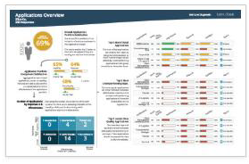
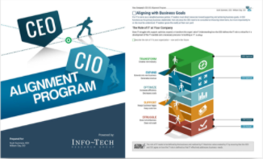
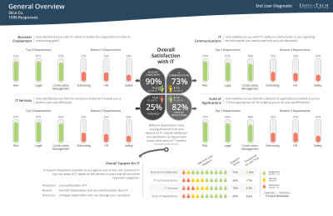
Build a data-driven strategy using Info-Tech diagnostic programs
Info-Tech diagnostics are one of the fastest, easiest, and best ways to gather important insights into your organization and operations. These infographic-rich reports provide you with information to help guide decisions and prioritize initiatives. By conducting a diagnostic on an annual basis, you can quantify the value of services and changes delivered.
Application Portfolio Assessment
Don’t guess what’s important, measure application satisfaction.
CEO-CIO Alignment Program
Improve IT-business alignment to operate effectively and generate tangible value.
End User Satisfaction Program
Find out what users really think of IT services.
Diagnostics: Build a Data-Driven Strategy Using Info-Tech Diagnostic Programs

Slide 27
Info-Tech’s methodology for APM Foundations
 | 1. Lay Your Foundations | 2. Improve Your Inventory | 3. Rationalize Your Apps | 4. Populate Your Roadmap
Phase Activities | 1.1 Define Goals and Metrics 1.2 Define Application Categories 1.3 Determine Steps and Roles 1.4 Weight Value Drivers | 2.1 Populate Inventory 2.2 Assign to Business Capabilities 2.3 Review Outstanding Data | 3.1 Assess Business Value 3.2 Assess End-User Perspective 3.3 Assess TCO 3.4 Assess Technical Health 3.5 Assess Redundancies 3.6 Determine Dispositions | 4.1 Prioritize Initiatives 4.2 Populate Roadmap 4.3 Determine Ongoing APM Cadence
Phase Outcomes | Work with the appropriate management stakeholders to: Extract key business priorities Set your goals Agree on key terms and set the scope for your APM effort | Gather information on your own understanding of your applications to build a detailed inventory and identify areas of redundancy. | Work with application subject matter experts to collect and compile data points and determine the appropriate disposition for your apps. | Work with application delivery specialists to determine the strategic plans for your apps and place these in your portfolio roadmap.
Blueprint: Application Portfolio Management Foundations

Slide 28



Bridge IT and the Business With Business Architecture
1. Engage
2. Model
3. Drive
Best-Practice Toolkit | 1.1 Identify the right opportunity for business architecture work. 1.2 Identify and conduct stakeholder analysis. 1.3 Develop a tailored stakeholder engagement strategy. | 2.1 Understand business architecture modelling principles. 2.2. Create strategy maps to connect business goals to organizational perspectives. 2.3 Identify and define value streams that support specific business goals. 2.4 Decompose the organization into its capabilities using business capability maps. 2.5 Connect value streams to business capabilities. | 3.1 Understand Info-Tech’s capability assessment framework. 3.2 Create an application capability map. 3.3 Create application capability heat map. 3.4 Prioritize business capabilities using Info-Tech’s prioritization framework. 3.5 Conduct investment analysis through initiative portfolio maps. 3.6 Review business architecture best practices.
Guided Implementations | Introduce Info-Tech’s business architecture methodology. Develop a stakeholder engagement strategy. Review the stakeholder engagement strategy. | Create a strategy map and define value streams. Model business capability maps. Map value streams to business capabilities. | Introduce Info-Tech’s capability assessment framework. Create and assess application capability map. Analyze investments through initiative portfolio maps.
Onsite Workshop | Module 1: Engage | Module 2: Model | Module 3: Drive
 | Phase 1 Outcome: Stakeholder Engagement Strategy | Phase 2 Outcome: Strategy Map Value Stream Definitions and Maps Level-0 Business Capability Map | Phase 3 Outcome: Level-1 Business Capability Map Application Capability Assessment and Heat Map Initiative Portfolio Map
Blueprint: Document Your Business Architecture

Slide 29
Deliver Digital Products at Scale​
 | 1. Become a Product-Centric Organization | 2. Organize Products Into Product Families | 3. Ensure Alignment Between Products and Families | 4. Bridge the Gap Between Product Families and Delivery | 5. Build Your Transformation Roadmap and Communication Plan
Phase Steps | 1.1 Understand the organizational factors driving product-centric delivery 1.2 Establish your organization’s product inventory | 2.1 Determine your approach to scale product families 2.2 Define your product families | 3.1 Leverage product family roadmaps 3.2 Use stakeholder management to improve roadmap communication 3.3 Configure your product family roadmaps 3.4 Confirm goal and value alignment of products and their product families | 4.1 Assess your organization’s delivery readiness 4.2 Understand your delivery options 4.3 Determine your operating model 4.4 Discuss how to fund product family delivery | 5.1 Introduce your digital product family strategy 5.2 Communicate changes on updates to your strategy 5.3 Determine your next steps
Phase Outcomes | Organizational drivers and goals for a product-centric delivery Definition of product Pilot list of products to scale | Product scaling principles Scaling approach and direction Product family mapping Enabling applications Dependent applications Product family canvas | Approach for communication of product family strategy Stakeholder management plan Defined key pieces of a product family roadmap An approach to confirming alignment between products and product families | Assessment of delivery maturity Approach to structuring product delivery Operating model for product delivery Approach for product family funding | Product family transformation roadmap Your plan for communicating your roadmap List of actionable next steps to start on your journey
Blueprint: Deliver Digital Products at Scale​

Slide 30
Streamline Application Management
1. Define Your Priorities
2. Govern Application Management
3. Build Your Optimization Roadmap
Best-Practice Toolkit | 1.1 Set Your Objectives 1.2 Assess Your Maturity | 2.1 Select Your Management Approach 2.2 Manage Your Single Product Backlog 2.3 Optimize Your Management Process 2.4 Define Your Management Roles | 3.1 Build Your Optimization Roadmap
Guided Implementations | Learn Info-Tech’s perspective and insights into application management. Define your application management objectives. Review the maturity gaps in your application management practice. | Discuss your application management approach and backlog management governance. Discuss your target-state management process and roles. | Review your optimization roadmap.
Onsite Workshop | Module 1: Define Your Priorities | Module 2: Govern Application Management | Module 3: Build Your Optimization Roadmap
 | Phase 1 Outcome: Objectives and goals Maturity assessment | Phase 2 Outcome: Product backlog governance Target-state process and roles | Phase 3 Outcome: Application management optimization roadmap
Blueprint: Streamline Application Management

Slide 31
Optimize Project Intake, Approval, and Prioritization
1. Set Realistic Goals for Optimizing Process
2. Build New Optimized Processes
3. Integrate the New Processes Into Practice
Best-Practice Toolkit | 1.1 Define the criteria with which to determine project value. 1.2 Envision your target state for your optimized project intake, approval, and prioritization process. | 2.1 Streamline intake to manage stakeholder expectations. 2.2 Set up steps of project approval to maximize strategic alignment while right-sizing the required effort. 2.3 Prioritize projects to maximize the value of the project portfolio within the constraint of resource capacity. | 3.1 Pilot your intake, approval, and prioritization process to refine it before rollout. 3.2 Analyze the impact of organizational change through the eyes of PPM stakeholders to gain their buy-in.
Guided Implementations | Introduce Project Value Scorecard Development Tool and pilot Info-Tech’s example scorecard on your own backlog. Map current project intake, approval, and prioritization process and key stakeholders. Set realistic goals for process optimization. | Improve the management of stakeholder expectations with an optimized intake process. Improve the alignment of the project portfolio to strategic objectives with an optimized approval process. Enable resource capacity-constrained greenlighting of projects with an optimized prioritization process. | Create a process pilot strategy with supportive stakeholders. Conduct a change impact analysis for your PPM stakeholders to create an effective communication strategy. Roll out the new process and measure success.
Onsite Workshop | Module 1: Refocus on Project Value to Set Realistic Goals for Optimizing Project Intake, Approval, and Prioritization Process | Module 2: Examine, Optimize, and Document the New Project Intake, Approval, and Prioritization Process | Module 3: Pilot, Plan, and Communicate the New Process and Its Required Organizational Changes
 | Phase 1 Outcome: Draft project valuation criteria Examination of current process Definition of process success criteria | Phase 2 Outcome: Documentation of new project intake, approval, and prioritization process Tools and templates to aid the process | Phase 3 Outcome: Process pilot plan Organizational change communication plan
Blueprint: Optimize Project Intake, Approval, and Prioritization

Slide 32
About Info-Tech

Slide 33
It Just Makes Sense to… Leverage Best Practices
35,000
members sharing best practices you can leverage
Millions spent developing tools and templates annually
Leverage direct access to over 100 analysts as an extension of your team
Use our massive database of benchmarks and vendor assessments
Get up to speed in a fraction of the time
Avoid starting from scratch.
33
Notes:
Frankly, it just makes sense, to Leverage known best-practices and avoid starting every new project from scratch.
We have over 35,000 members that are facing a lot of the same challenges & have completed a lot of the same projects.
So, we spend millions of dollars annually to develop, refine, and test tools & templates that help you get these core IT projects done faster and more effectively.
Beyond a massive library of methodologies, vendor assessments, and benchmarks, we have over 100 subject matter experts that become a direct extension of your team to help you get up to speed and get your most important projects done.
It really helps to avoid project pitfalls, train and develop your team, and have “example deliverables” from other members that have completed the project beforehand.
Does that make sense?

Slide 34
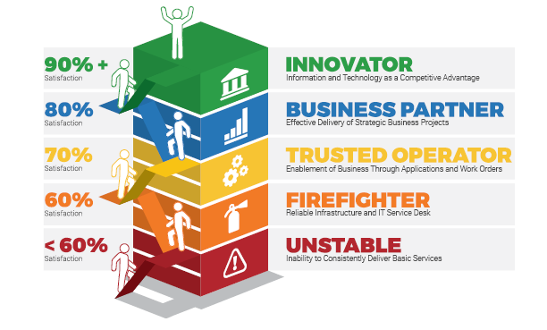
Systematically Improve
IT Performance
Follow our standardized path to drive IT maturity and effectiveness for your department. Each leader on your team will work with a dedicated Info-Tech Executive Advisor to create customized annual roadmaps to address their specific challenges and opportunities. Whether your IT department is an Unstable Operator, an Innovative Champion, or at any stage in-between, Info-Tech has the proven knowledge and skills and years of practical IT management and advisory experience to help stabilize and optimize your IT operations.
Info-Tech Research Group Maturity Model
Each Executive on Your Team Receives:
A dedicated Executive Advisor to help diagnose and drive improvement within your organization.
A customized Key Initiative Plan around your top priorities and a clear roadmap of how to improve their IT function.
On-demand advisory support for all of your key projects.
Complete online access to tools and best-practice resources.

Slide 35
A Step by Step
Program to Systematically Improve IT Performance
Info-Tech provides best-practice research
making your job easier.
01 MANAGE AND IMPROVE
Core IT Processes
02 FASTER AND MORE EFFECTIVELY COMPLETE YOUR
Technology Projects
Tools & Templates
Step-by-Step Methodologies
Benchmarking & Diagnostic Programs Training & Executive Coaching
Insights & Advice From 20,000+ Peers
03 TRAIN AND DEVELOP YOUR
IT Leadership Team
₀₄ BUILD A DATA-DRIVEN
IT Strategy
05 A STEP-BY-STEP PROGRAM TO
Systematically Improve IT

Slide 36
Info-Tech Research Group
Performance Difference
For over 20 years Info-Tech has provided IT teams with practical advice that helps make measurable improvement.
Since launching our systematic program to improve IT performance in 2013, Info-Tech members have dramatically outperformed their peers by delivering superior levels of business satisfaction.

Slide 37
Application Portfolio Snapshot Example
Design
Product
Produce
Product
This shows which applications support which business capabilities and highlights the extent of risk each capability faces due to technical or backend issues.
Sell
Product
High Risk
Market Research & Analysis is at High Risk
Moderate Risk
10
#
#
#
#
#
Market Research &
Analysis
Process Engineering
Material Management
Material Quality
Management
Order
Fulfillment
Product
Delivery
Low Risk
#
Requirements
Gathering
Product Marketing
Production
Management
Production
Optimization
Product
Testing
Invoice
Management
#
#
#
#
#
Minimal Risk
Defining
Instructions
Optional view for business capability map and snapshot outcome.
Product Development
Product
Prototyping
Allocation
Management
#
#
Fulfillment
Planning
Sales
Processing
Customer
Care
#
#
#
#
Unknown Risk
(Risk can not be measured as IT has no oversight over applications)
Conceptual
Modelling
Production Portfolio
Management
Manufacturing Asset Planning
#
#
Operational
Maintenance
Operations
Support
Complain
Management
#
#
#
#
High Functional Redundancy for Manufacturing Asset Planning
Customer Retention is enabled by “Shadow IT” causing uncertain risk
Cost
Estimation
Process
Refinement
#
#
Packaging
Management
Lifetime Revenue Assessment
#
Application Count
#
#
Risk is an aggregate measure of:
Non-compliance with IT policies
Immediacy of software expiration or end of life
Maintainability of application
Misalignment to technology strategy
#
#
#
#
#
Sourcing
Strategy
#
Contract
Management
Channel
Management
Customer Retention
Inventory
Management
Sales
Execution
Customer
Management
Account
Management
#
#
Outsourcing
Strategy
Risk
Management
Regulatory & Compliance
Knowledge
Management
#
#
#
#
Partner
Management
Product
Training
Change
Management
Enterprise Data Management
Storage
Management
Product
Innovation
Shared
#
#
#
#
#
#
#
Procurement
Management
#
Workflow Management
#
Collaboration & Innovation
#
Supply Chain
Management
#
Asset
Management
Contract Negotiation
#
No applications support Change Mgmt.” Potential Gap

Slide 38
Application Portfolio Snapshot Example
Design
Product
Produce
Product
This shows which applications support which business capabilities and highlights the extent of risk each capability faces due to technical or backend issues.
Sell
Product
High Risk
Market Research & Analysis is at High Risk
Moderate Risk
Market Research &
Analysis
Process Engineering
Material Management
Material Quality
Management
Order
Fulfillment
Product
Delivery
Low Risk
#
#
#
#
#
#
#
#
#
#
#
#
#
#
#
#
#
#
#
#
#
#
#
#
#
#
#
#
#
#
#
#
#
Requirements
Gathering
Product Marketing
Production
Management
Production
Optimization
Product
Testing
Invoice
Management
Defining
#
#
#
#
#
#
#
#
#
#
#
#
#
#
#
#
#
#
#
#
#
#
#
#
#
Minimal Risk
Instructions
Optional view for business capability map and snapshot outcome.
Product Development
Product
Prototyping
Allocation
Management
Fulfillment
Planning
Sales
Processing
Customer
Care
Unknown Risk
(Risk can not be measured as IT has no oversight over applications)
#
#
#
#
#
#
#
#
#
#
#
#
#
#
#
#
#
#
#
#
#
#
#
#
#
#
#
#
#
Conceptual
Modelling
Production Portfolio
Management
Manufacturing Asset Planning
Operational
Maintenance
Operations
Support
Complain
Management
#
#
#
#
#
#
#
#
#
#
#
#
#
#
#
#
#
#
#
#
#
#
#
#
#
#
#
#
#
#
#
#
#
#
Risk is an aggregate measure of estimations on
Non-compliance with IT policies
Immediacy of software expiration or end of life
Maintainability of application
Misalignment to technology strategy
Cost
Estimation
High Application Excess
(redundancy or disparity) for Manufacturing Asset Planning
Process
Refinement
Packaging
Management
Customer Retention is enabled by “Shadow IT” causing uncertain risk
Lifetime Revenue Assessment
#
#
#
#
#
#
#
#
#
#
#
#
#
#
#
#
#
#
#
#
#
#
#
#
Sourcing
Strategy
Contract
Management
Channel
Management
Customer Retention
Inventory
Management
Sales
Execution
Application Legend
#
#
#
#
#
#
#
#
#
#
#
#
#
#
#
#
#
#
#
#
#
#
#
#
#
#
#
#
#
#
#
#
#
Customer
Management
Account
Management
Outsourcing
Strategy
Risk
Management
Regulatory & Compliance
Knowledge
Management
#
Enterprise Application
#
#
#
#
#
#
#
#
#
#
#
#
#
#
#
#
#
#
#
Custom Application
Shared
Partner
Management
Product
Training
Change
Management
Enterprise Data Management
Storage
Management
Product
Innovation
#
Productivity Tool
#
#
#
#
#
#
#
#
#
#
#
#
#
#
#
#
#
#
#
#
#
#
#
#
#
Partner Application
Contract Negotiation
Procurement
Management
Workflow Management
Collaboration & Innovation
Supply Chain
Management
Asset
Management
#
Business-Managed Application
#
#
#
#
#
#
#
#
#
#
#
#
#
#
#
#
#
#
#
#
#
#
#
#
#
#
#
#
#
#
#
No applications support Change Mgmt.” Potential Gap
Notes:
Here is an example of the primary output. And we will get to the full deliverable in a moment, but this is really the central product.

