Slide 1
Security Policy Review
Final Report
Prepared for: Jane Doe, CIO, GN IM ORG
Prepared by: John Smith, Analyst

Slide 2
The Security Policy Review
Review policies to identify gaps and provide recommendations to augment the policy suite.
Agenda
Call 1 | Introductions and Engagement Rationale Policy Requirements Gathering
Call 2 | Policy Checklist – Initial Assessment Clarify Findings
Call 3 | Review Final Deliverables Discuss Next Steps
Info-Tech Insight
The most effective security policies are modular, standardized, compliant, and up to date.
Reviewing the security policy suite using a structured approach can improve its effectiveness.
Info-Tech Research Group | 2

Slide 3
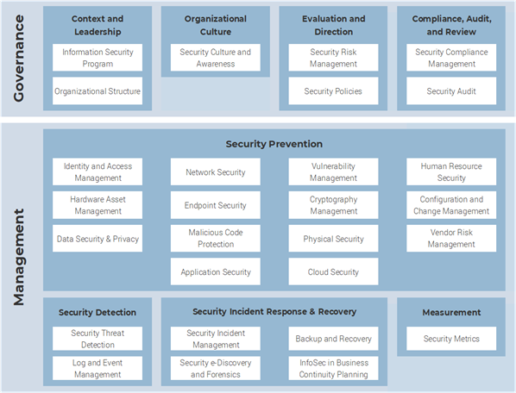
Engagement Background
This slide is meant to capture engagements. Be sure to amend this slide before delivering the report.
A half-day meeting was held with John Smith, Fake Title, from GN IM ORG on June 15, 1937
Engagement Context
Reviewing security policies is a recommendation coming out of an external audit.
Engagement Scope
The focus of this engagement is to review security policies and identify gaps per domain area. This was done by reviewing security policies against a checklist based on the Info-Tech framework and providing recommendations based on domain areas that can be used to close gaps and augment reviewed policies.
Info-Tech Research Group | 3

Slide 4
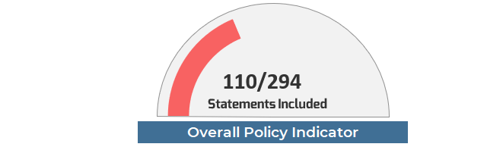
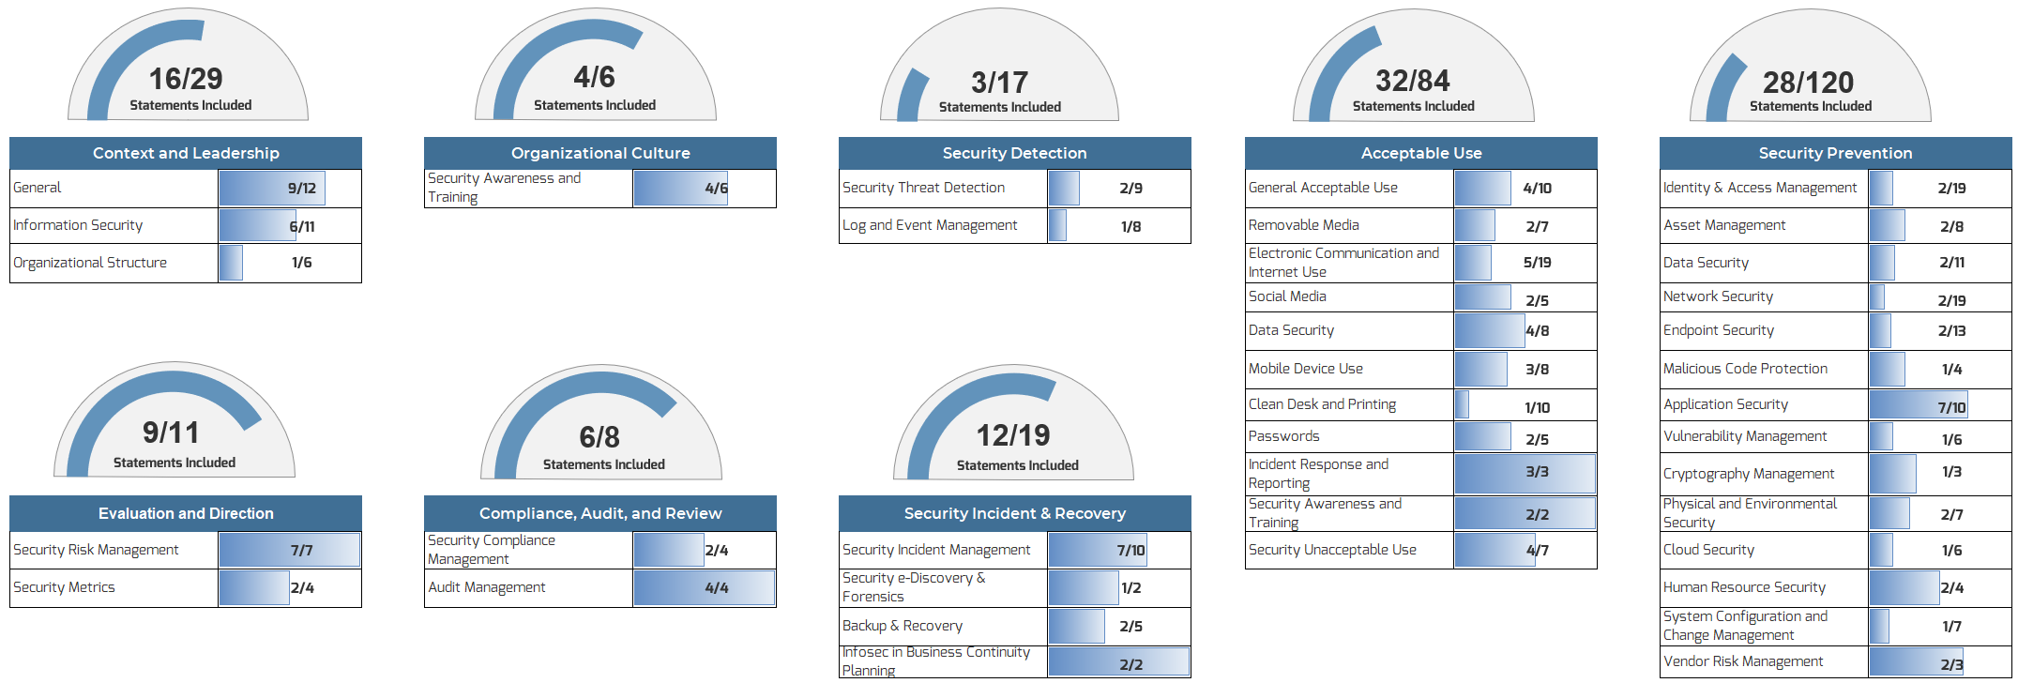
Policy Review Dashboard – GN IM ORG
The focus of this slide is on the Security Policy Review dashboard. Copy and paste this dashboard from the Security Policy Review tool tab 3. Be sure to delete this text box prior to sending the report.
The dashboard shows the identified control gaps per domain area for reviewed policies.

Slide 5
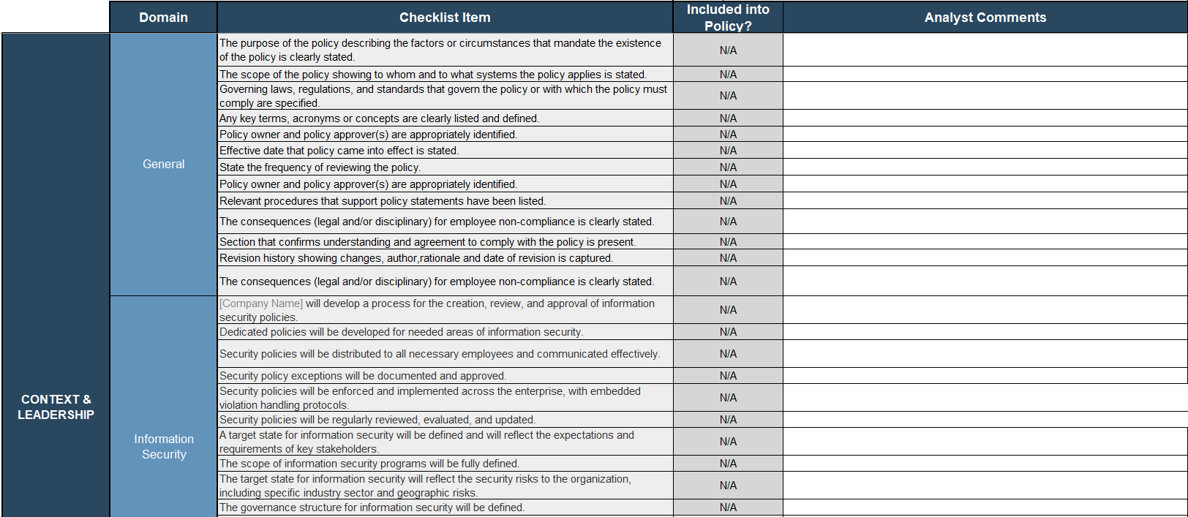
Policy Review Checklist – Sample
The security policy checklist (attached) shows identified gaps per checklist item and analyst recommendations to close gaps and augment policies.
This slide is meant to show a sample of tab 2 for the Security Policy Review tool. The tool must be attached to this report as part of the final deliverables.

Slide 6

Key Next Steps
This slide is meant to show analyst recommendations on policies to update, create, or retire. Be sure to update this list as part of the final deliverables.
It is recommended that GN IM IT update, create, or retire the following policies:
Security Policies to Update:
  Security Awareness and Training Policy
  Compliance Management Policy
  Asset Management
  Incident Management
  Backup & Recovery
Security Policies to Create:
Information Security Policy
Security Policies to Retire:
  Human Resources Security Policy
To create new policies, refer to:
Develop and Deploy Security Policies
Consistency is king. Use Info-Tech’s templates to ensure that all policies are standardized.

