Slide 1
Security Policy Review
Review security requirements to identify gaps in the policy suite.

Slide 2
How to use
Use Info-Tech’s Security Policy Review service to assess the current state of your existing security policies. Identify gaps so that policies can be updated to align with industry best-practice standards.
The analyst will assess the level of completeness using the checklist based on Info-Tech’s framework and research. Additionally, the analyst will add their recommendations based on their personal industry experience where applicable.
This research also includes a visual dashboard that details your progress toward addressing the gaps within the policy checklist.

Slide 3

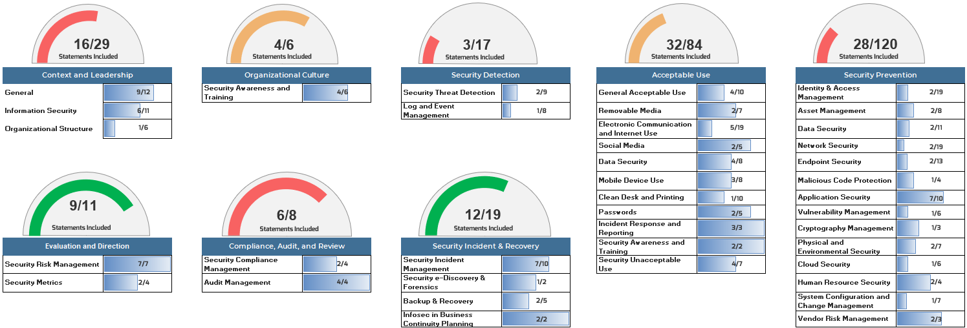
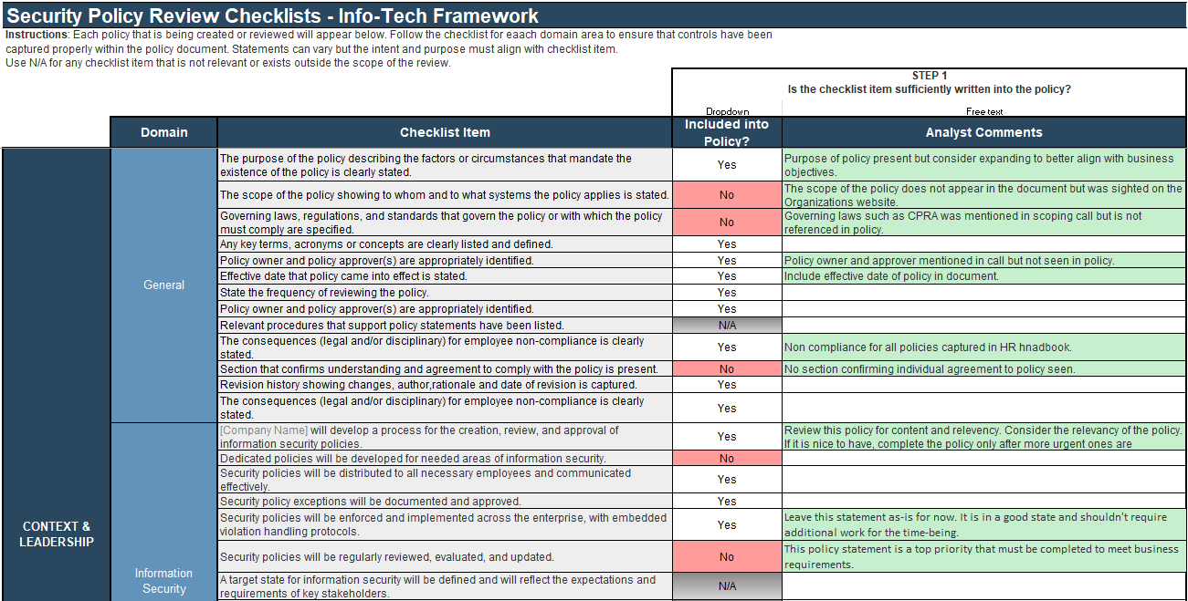

What is the Security Policy Review service?
Definition
Info-Tech’s Security Policy Review service is geared toward organizations with existing security policies. As your organization undergoes changes, it will need to review and incorporate new requirements into the existing policies. This assessment is focused on evaluating your current policies, identifying gaps, and providing recommendations to augment policies.
Key Outcome: A polished and compelling report with recommendations on how to improve your security policies.

Slide 4


Security policy review importance
The goal of a security policy review is to assess what security policies currently exist within the organization, identify gaps, and provide recommendations.
Reviewing a security policy suite using a structured approach can also improve its overall effectiveness and does a better job of achieving policy goals.
  Business Stakeholders
  Compliance Regulations
Convince business stakeholders of how security policies help protect assets. Maintain trust with customers, partners, and key stakeholders.
Convince IT staff to comply with security policies and, in turn, relevant regulations and standards. Identify potential security risks and reduce the likelihood of security incidents.

Slide 5
Service Description
Receive the Security Policy Suite
First-Pass Review
Discuss With Member
Complete Review
Send Deliverable
2-4 hours
1 hour
1 hour
Receive a copy of the security policy document(s).
Email member acknowledging receipt of document(s).
Download a copy of the Security Policy Review tool from SharePoint.
  Conduct initial assessment of the document(s)
  Ensure service deliverable aligns with Security Policy Review service and not Develop and Deploy Security Policies blueprint.
  Check received security policy document(s) against the policy checklist.
Review your initial findings with the member.
Ask any clarifying questions you may have.
Recommend Develop and Deploy Security Policies if there is a need to develop new policies.
  Clarify any other requirements.
Revise the assessment, if necessary, based on the information gathered in the member call.
Complete the final deliverable using the Security Policy Review report template. (Make sure you include any other comments or recommendations you captured during your review.)
  Send the final deliverable to the member.
  Ensure all member documents, the checklist tool, and the final deliverable report are uploaded to the SharePoint site.

Slide 6
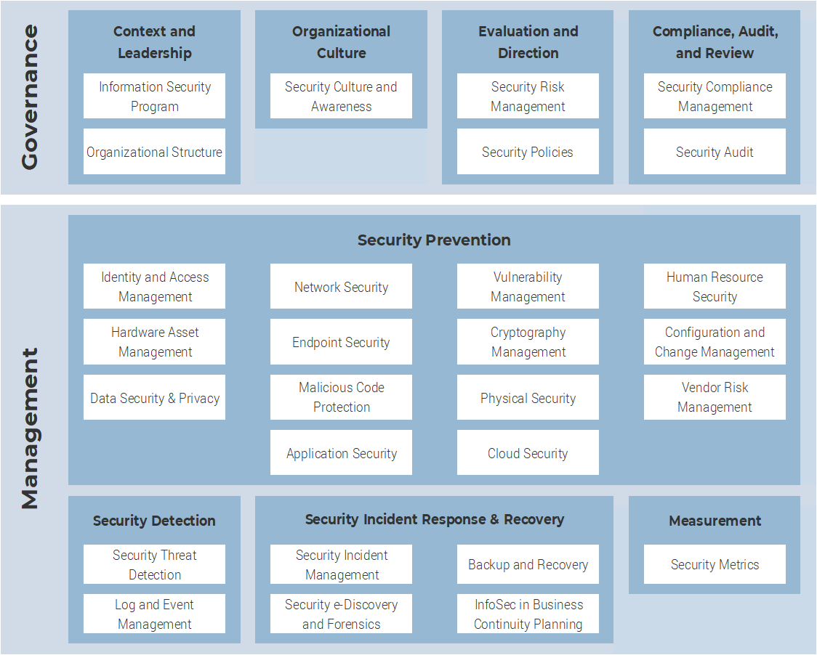
Info-Tech’s framework integrates best practices to create a best-of-breed security framework
Security Policy Framework
Save time spent creating policies from scratch by using Info-Tech’s policy templates mapped to the Info-Tech framework, which incorporates multiple industry best-practice frameworks (NIST, ISO, SOC 2, CIS, PCI, HIPAA).
Customize the templates to reflect your digital environment and the language used in your organization.

Slide 7
Review Tool
Your goal is to fill out as many Yes/No questions as possible. For each section, the controls statements that evaluate to “Yes” will be tallied, enabling you to see gaps in the security program within that domain.
Tab 2. Security Policy Checklist
For security policies that are being reviewed, use the checklist to identify gaps and align with the Info-Tech framework. It is recommended that you add a note to entries, especially those that receive a “No,” to help the member correct any issues.
Provide analyst comments for key recommendations to plug identified gaps to cover the scope of the security domain.

Slide 8
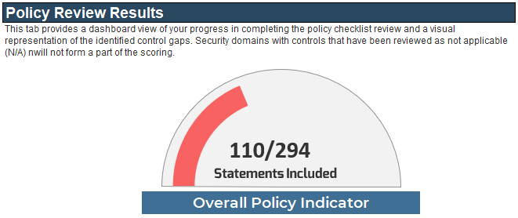
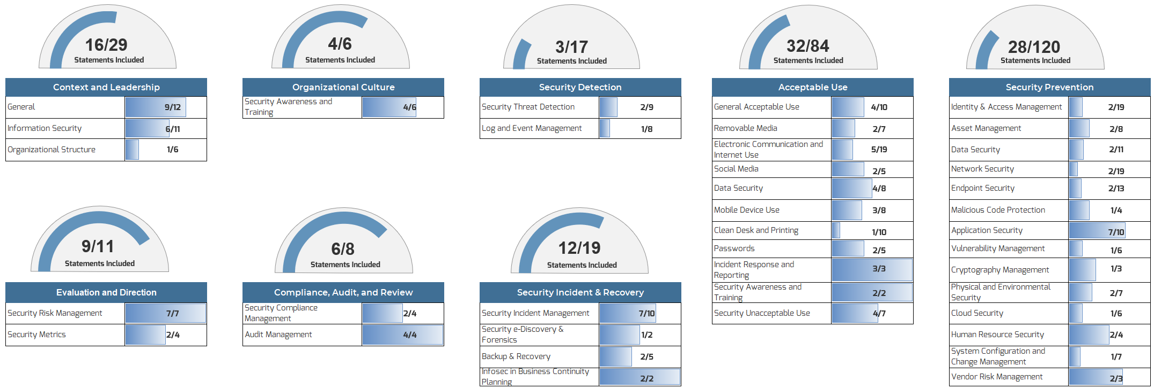
Review Tool
Tab 3. Dashboard
The Results tab shows a visualization for the Security Policy Review for each domain. Copy the diagram and incorporate into the Security Policy Review report.

