Slide 1
Boardroom Presentation Review
Build and deliver an effective presentation to your board of directors.

Slide 2
How to use:
Use this template to build a ‘best of breed’ executive presentation for your board of directors.
This template seeks to provide Info-Tech’s analysts a framework to build a member’s business-facing boardroom presentation. The grade given to each area are based on the discretion of the Info-Tech analyst. The analyst will also provide recommendations in each area on how to improve the presentation in its current form.
The analyst will assess the level of completeness using the checklist based on Info-Tech’s best practice methodology and research. Additionally, the analyst will add their recommendations based on their personal industry experience where applicable.
This research also includes tips and tricks on how to deliver an effective presentation as the CIO, and how to build a narrative to present key information about IT to the board.
Notes:
The IT strategy has two audiences. The IT strategy needs to communicate IT’s plan to both the business stakeholders and the IT department. A more mature IT strategy does a better job of achieving these two goals. There are a set of characteristics that all successful IT strategies have. The level of details that the each IT strategy has of those successful characteristics dictate the level of maturity of the IT strategy.
Therefore, IT strategy maturity is predicated on the overall message that the IT strategy communicates and individual components that make up the IT strategy.
Something about assessment criteria. Something about individual components.

Slide 3
Table of Contents
Section | Title
1 | Introduction to the Boardroom Presentation Service
2 | Understand your Target Audience
3 | Tell a good story
4 | Build a compelling presentation deck
5 | Deliver a captivating presentation
6 | Conclusion & Next Steps

Slide 4
Boardroom Presentation Review
Concierge Service Introduction

Slide 5
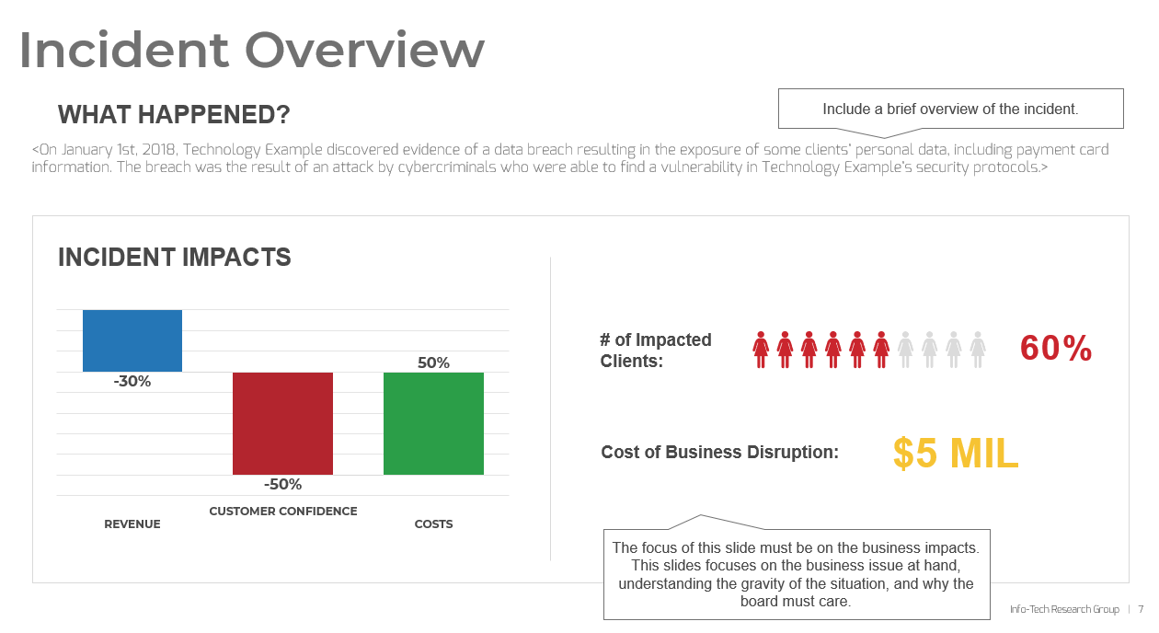
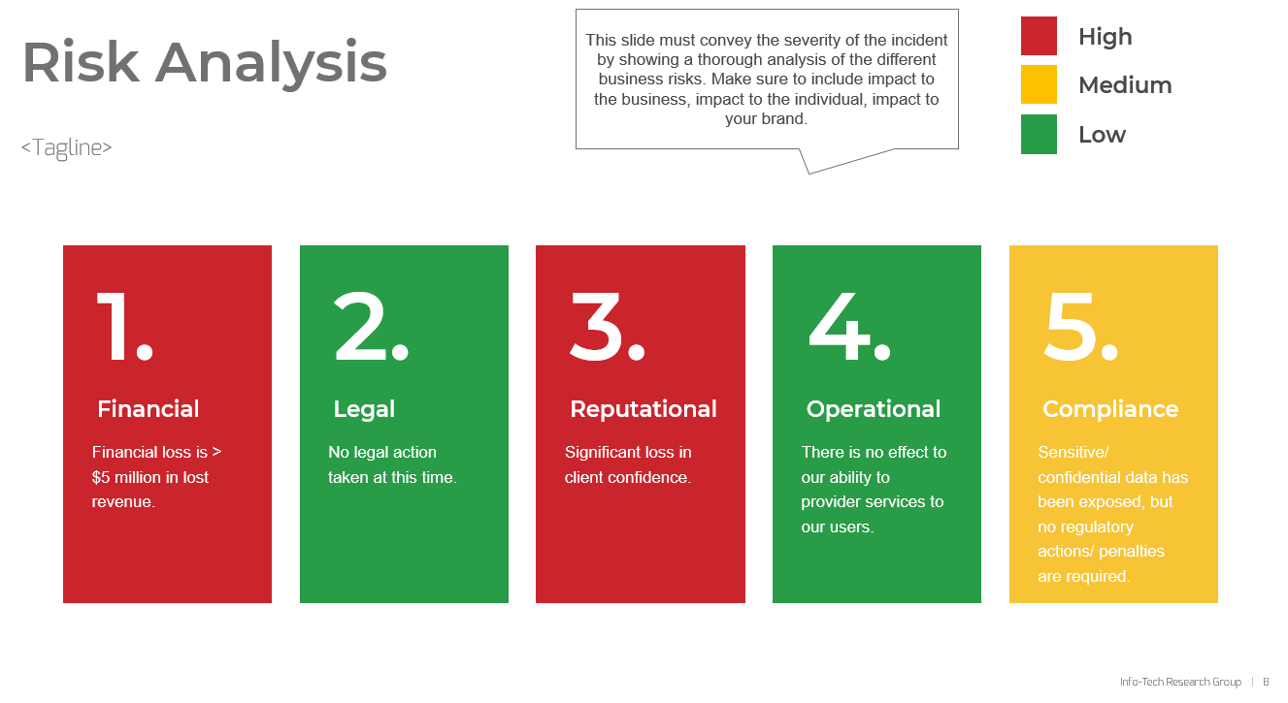

What is the Boardroom Presentation Review Service?
Definition
Info-Tech’s boardroom presentation review service is the process of using your current boardroom presentation and information and representing it using our ‘best of breed’ presentation template. This involves reviewing and understanding your current presentation document, evaluating the data for completeness and meaning, and designing an executive-facing presentation that is simple, compelling, and effective at telling your story to the board of directors.
Key Outcome: A polished and compelling presentation document along with best practices on how to deliver your presentation.

Slide 6


Boardroom Presentation Review Approach
An effective boardroom presentation leverages many components of your current strategy document and IT accomplishments, but re-purposes it in the language of the business. Info-Tech analysts will guide you through this 5-step approach to building your boardroom presentation.
Understand the current boardroom presentation document if it exists.
Assess the document for key components and a strong narrative.
Elicit missing information and discuss approach to presenting.
Assemble boardroom presentation.
Conduct a dry run and discuss best practices on delivering the presentation.

Slide 7
Boardroom Presentation Review: key outcomes & benefits
The boardroom presentation review service produces a document which is presentation ready for CIOs and other IT leaders to present to their board of directors.
Checklist + Next Steps
Boardroom Presentation Template
A list of recommendations is provided based on the level of detail in the inputs for each section. Info-Tech’s analysts will suggest recommendations to improve the boardroom presentation and build a ‘best of breed’ deliverable. This list can be leveraged after the service to improve/ incorporate other components of a ‘best of breed’ executive presentation and ensure completeness of your document.
The service identifies current shortcomings and gaps in how the presentation communicates key information to the board. You will come away with a clear, concise and compelling business-facing executive presentation that IT leaders can feel confident presenting in front of their board of directors.

Slide 8
Understand your Target Audience

Slide 9
Who is your target audience?
Typically, you will have two profiles in a board room audience that you must consider.
Formal Board of Directors
The Executive Team
In the private sector, this will include an appointed board of shareholders and sub committees external to the organization.
In the public sector, this can include counsels, commissions or the executive team itself.
The board’s overall responsibility is governance.
This audience will include your boss and your peers internal to the organization.
This category is primary involved in the day-to-day operations of the organization and responsible for carrying out the strategic direction set by the board.
The executive team’s overall responsibility is operations.
Info-Tech Insight
Your communication style and presentation must cater to the audience you expect to be present in the room. Talking to a board requires a shift in your mindset. Focus on what positions IT as a business partner and your ability to be a leader.

Slide 10
What do your Board of Directors care about?
A Board’s Purpose can include the following:
VALUE
Business Impact (business transformation, modernization, increasing revenue, citizen engagement/ services)
Financial Impact (shareholder value, ROI on investments)
Sustain and expand the organization’s purpose and ability to execute in a competitive market.
Determine and fund the organization’s future and direction.
Protect and Increase shareholder value.
Protect the company’s exposure to risks.
RISK
Security and incidents
Impact to business operational efficiency
Info-Tech Insight
Considering the board’s purpose and what they care about, always focus your presentation on how you support their primary objectives and outcomes. Always communicate in their language and highlight the business problem at hand.
Their Backgrounds, board composition, internal/political dynamics
What will their reaction be
More preparation (people under prepare)
Communication should be targeted to a purpose
Boards are focused primarily on risk and finance.
What’s important to the business (risk & security, operational efficiency/ business transformation. modernization, growth (increasing revenue/ public=citizen engagement/ services)
CEO is responsible for the operational side boards don’t get involved. Boards don’t make the day to day decisions for the business. Small organizations: board might be involved in an ERP implementation.
Boards are more aware of security incidents now. CIOs will be required to educate the board on what is going on. Status, impact to the business, risk to the business. CIOs must take a proactive approach to giving an update even if it’s an incident on the news.

Slide 11
Composition of a board
Finance and Information Technology are the most frequently mentioned skillsets for board members.
13.8% of board members in the Russell 3000 (up from 10.9 percent in 2016) report having some type of technology background.
While 21.7 percent are identified as an “audit committee financial expert,” as per SEC disclosure rules.
In an evolving business landscape where technology is critical to run a business, there are more and more IT leaders and technology experts sitting on boards to represent cybersecurity and transformation priorities.
It is more widely understood that IT is an enabler for the business and driver of strategic initiatives.
Typically, boards will also have sub-committees that show a stronger expertise in certain areas (audit, cybersecurity, compensation, etc.)
The impact of this is a growing level of technology expertise from board members who will challenge you on the “how” of solving a business problem.
While it is important to speak the language of the business, keep in mind that your board members have evolving responsibilities. Do not underestimate your board’s technical knowledge while presenting to them.
In the S&P 500 index of larger companies, 20.9% of corporate directors include technology expertise in their biographical profile.
“…research shows that board committee charters, in particular, are being revised to accommodate a new array of oversight responsibilities—from cybersecurity to digital transformation, and from climate change risk to human capital management.”
Source: Harvard Law School Forum on Corporate Governance, October 18, 2020

Slide 12

Impact of the pandemic
3 – 5 Year Strategies
The pandemic has accelerated the digital transformation priorities of a business and how customers experience the business as organizations become more reliant on technology to run.
The CIO, CDO, CTO, CISO roles are converging, and traditional CIO roles are rapidly evolving to include new facets of IT such as digital, cybersecurity & risk, cultural intelligence, etc.
This “new” IT leader is expected to be a driver of the digital business strategy or get left behind for a leader than can adapt to this change quickly.
The pandemic has shed light on the need for more agile and flexible strategies and CIOs must demonstrate to boards that they can spearhead this transition.
3 – 5 Month Strategies
Info-Tech Insight
Pre-pandemic digital strategies have been primarily focused on automation. However, your post-pandemic digital strategy must focus on driving resilience for growth opportunities.
Download Info-Tech’s “Define Your Digital Business Strategy” blueprint to get started.

Slide 13
What are the Board’s main concerns?
As the IT leader, you are the expert on the technology solutions, however, a board will still be concerned with learning the following about any given business technology initiative. Focus on communicating these impacts to speak the language of the board.
01.
Business Impact
How is IT impacting the business and solving business challenges? (Digital & transformation priorities, technology as a competitive advantage, etc.)
Info-Tech Insight
The board’s main concerns will always boil down to one important outcome – providing a level of confidence to do business through IT products, services, and systems.
02.
Investments
How will the proposal impact the organization’s finances and efficiency?
03.
Cyber-Security & Risk
What cyber-security risks are top of mind and how is IT mitigating risk to the business?

Slide 14
What is the executive team’s main concerns?
The executive team will have similar concerns or expectations as a board, however, they will show a higher interest in IT’s operational details and the day-to-day decisions that will lead to success while maintaining business alignment.
01.
Business Alignment
How are IT priorities aligned to the business strategy and goals?
Info-Tech Insight
Treat the executive team as your sponsors. Build a level of trust and confidence with your peers as the first step to tackling the board. Prioritize a strong relationship and ensuring buy-in from the executive team before meet with the board to ensure you have a support system in place.
02.
IT Operational Efficiency
How is IT set up for success with foundational elements of IT’s operational strategy (e.g., core processes) that will be required to successfully execute on key initiatives?
03.
Innovation & Transformation Priorities
How is IT enabling the organization’s competitive advantage and supporting transformation efforts as a strategic business partner?

Slide 15
Keep in mind that the audience will usually have a mix of primary learning styles
Types of Learners: | 1. Visual Learners: | 2. Auditory Learners: | 3. Kinesthetic Learners:
Learn by: | Looking Viewing Watching Seeing | Listening Hearing Speaking | Experiencing Moving Doing
Learn best through: | Slides Videos Flip charts Readings Demonstrations | Lectures Discussions Brainstorming Informal conversation Case studies, stories, and examples | Hands-on exercises Role plays Simulations Practice Note taking Writing
Notes:
Add this slides as a document in the LMS after the audio section

Slide 16
Build your presentation to tackle their main concerns
Your presentation will be well-rounded and compelling when it addresses the board’s main concerns about IT.
Checklist to know your audience:
Research your target audience (their backgrounds, board composition, dynamics, executive team vs external group)
Include value and risk language in your presentation to appeal to your audience.
Ensure your content focuses on one or more of the board’s main concerns with IT (Business impact, investments or cybersecurity & risk).
Include information on what is in it for them and the organization.
Research your board’s composition and skillsets to determine their level of technical knowledge and expertise. This helps craft your presentation with the right amount of technology vs business-facing information.

Slide 17
Tell a Good Story

Slide 18
What is the purpose of your board presentation?
Be clear about your bottom line and the intent behind your presentation. Regardless of your bottom line, your presentation must always focus on what business problem you are solving and why technology can solve that problem.
To Inform or Educate
To Reach a Decision
In this presentation type, it is easy for IT leaders to overwhelm a board with too much or irrelevant information. Focus your content on the business problem and the solution proposed on in effect. Refrain from too much detail about the technology and focus on business impact and risk mitigated. Ask for feedback if applicable.
In this presentation type, there is a clear ask and an action required from the board of directors. Be clear up front what this decision is. Once again, don’t lead with the technology solution, start with the business problem you are solving and only talk about technology as the solution if time permits. Ensure you know who votes and how to garner support.
Info-Tech Insight
Nobody likes surprises. Communicate early and often. The board should be pre-briefed especially if it is a difficult subject. This also ensures you have support when you deliver a difficult message.

Slide 19
Gather the right information to include in your boardroom presentation
Once you understand your target audience, it’s important to tailor your presentation material to what they will care about.
Info-Tech Insight
You must always have a clear goal or objective for delivering a presentation in front of your board of directors. What is the purpose of your board presentation? Identify your objective and outcome up front and tailor your presentation’s story and contents to fit this purpose. Telling a good story is not about the message you want to deliver but the one the board wants to hear. Articulate what you want them to think and what you want them to take away and be explicit about it in your presentation and your talk track. Make your story logically flow by identifying the business problem, complication, the solution and how to close the gap. Most importantly, communicate the business impacts the board will care about.
Typical IT boardroom presentations include:
Communicating the value of ongoing business technology initiatives.
A request for funds or approval for a business initiative that IT is spearheading.
Security incident response/ Risk / DRP.
Developing a business program or an investment update for an ongoing program..
Business technology strategy highlights and impacts.
Digital transformation initiatives (value, ROI, risk).

Slide 20
Structure your presentation to tell a logical story
To build a strong story for your presentation, ensure you answer these three questions:
WHY
Why is this a business issue or why should the board care?
WHAT
What is the impact of solving the problem and driving value for the company?
HOW
How will we leverage technology to solve the problem?

Slide 21
Examples:
Scenario 1: The company has experienced a security incident.
Intent: to inform/ educate the board on the security incident
Scenario 2: IT is recommending investments based on strategic priorities.
Intent: to reach a decision with the board – approve investment proposal
The new business strategy outlines 4 key initiatives to enable a remote workforce and ensure resilient operations to mitigate risks caused by pandemic.
WHY
The data breach has resulted in a loss in customer confidence, negatively impacted our brand, and loss in revenue of 30%.
WHY
Financial, legal, and reputational risks identified, and mitigation strategies implemented. IT is working with the PR team on communications. Incident management playbook executed.
IT’s proposed investments will create new business capabilities to enable employee wide digital collaboration and automate 70% of all non-cognitive activities.
WHAT
WHAT
An analysis of vulnerabilities was conducted and steps to address are in effect. Recovery steps are 90% completed. Incident management program reviewed for future incidents.
HOW
Use 30% of budget on new collaboration tools & supporting staff.
Invest 20% of budget in RPA tools to automate business processes.
HOW

Slide 22
Time plays a key role in delivering an effective presentation
What you include in your story will often depend on how much time you have available to deliver the message.
Consider the following:
Presenting to a board often means you have a short window of time to deliver your message. The average board presentation is 15 minutes, and this could be cut short due to other unexpected factors.
If your presentation is too long, you risk overwhelming of losing your audience. You must factor in your time constraint when building your board presentation.
Your board of directors have a wealth of experience and knowledge, which means they could jump to conclusions quickly based on their own experiences. Ensure you give them plenty of background information in advance. Provide your presentation material, a brief or any other supporting documentation before the meeting to show you are well prepared.
Be prepared to have deep conversations about the topic but respect that the board might not be interested in hearing the tactical information. Build an elevator pitch, a 1-pager, back-up slides that support your ask and the story, and be prepared to answer questions within your allotted presentation time to dive deeper.
Use the Q&A portion to build credibility with the board: it is always better to say, “I’m not certain about the answer but will follow up”, than providing false or inaccurate information on the spot. And ensure you follow up!
Info-Tech Insight
The average board presentation is 15 minutes. Build no more than 3-4 slides of content to identify the business problem, the business impacts, and the solution. Leave 5 minutes for questions at the end and be prepared with back-up slides to support your answers.

Slide 23
Navigating through Q&A
Use the Q&A portion to build credibility with the board
It is always better to say, “I’m not certain about the answer but will follow up”, than providing false or inaccurate information on the spot.
When asked challenging or irrelevant questions, ensure you have an approach to deflect them. Questions can often be out of scope, difficult to answer in a group. Find what works for you to successfully navigate through these questions:
“Let’s work with the sub-committee to find you an answer”
“Let’s take that offline to address in more detail”
“I have some follow-up material I can provide you to discuss that in further after our meeting.”
And ensure you follow up! Make sure to follow through on your promise to provide information or answers post meeting. This helps build trust and credibility with the board.

Slide 24
Tell a good story
Checklist:
Tailor your presentation based on how much time you have
Find out ahead of time how much time you have
Identify if your presentation is to inform/educate or reach a decision.
Identify and communicate the business problem up front and answer the three questions (why, what, how)
Express the problem in terms of business impact. (risk, value, money)
Prepare and send pre-meeting collateral to the members of the board and executive team.
Include no more than a maximum of 5-6 slides for your presentation
Factor in Q&A time at the end of your presentation window.
Articulate what you want them to think and what you want them to take away - put it right up front and remind them at the end
Have an elevator speech handy – 1 or 2 sentences and a 1-pager version of your story
Consider how you will build your relationship with the members outside the board room.

Slide 25
Build a Compelling Presentation Document

Slide 26
Build an engaging presentation
You’ve gathered all your data, you understand what your audience is expecting, and you are clear on the outcomes you require. Now it’s time to build a presentation that both engages and builds confidence.
Why is slide design important? Good slide design increases the chance of the audience reading the content carefully.
Bad slide structure (flow) = audience looses focus
You can have great content on a slide, but if a busy audience gets confused, they’ll just close the file or loose focus. Structure encompasses horizontal and vertical logic.
Good visual design = Audience might read more
Readers will probably skim the slides first. If the slides look ugly, they will already have a negative bias. If the slides look visually appealing, they will be more inclined to read carefully. They may even use some slides to show others.
Good content + Good structure + Visual appeal = Good presentation
A presentation is like a house. Good content is the foundation of the house. Good structure keeps the house strong. Visual appeal differentiates houses.

Slide 27
Design Best Practices
Quick overview of design principles and some simple cheats you can use to make your slides resonate with your audience.

Slide 28
Slide design: best practice
1 | Easy to Read Assume the reader is tight on time. If a slide looks overwhelming and not skim-able, the reader will close the document.
2 | Concise and Clear Less words = more skim-able.
3 | Memorable Use graphics and visuals or pithy quotes whenever you can do so appropriately.
4 | Horizontal Logic Good horizontal logic will have slide titles that cascade into a story, with no holes or gaps.
5 | Vertical Logic People usually read from left to right, top to bottom, or in a “Z” pattern. Make sure your slide has an intuitive flow of content.
6 | Aesthetics People like looking at visually appealing slides, but make sure your attempts of visual appeal do not detract from the content.

Slide 29
Your presentation must have a logical flow
Horizontal Logic | Vertical Logic
Horizontal logic should tell a story. When slide titles are read in a cascading manner, they will tell a logical and smooth story. Title & tagline = thesis (best insight). | Vertical logic should be intuitive. Each step must support the title. The content you intend to include within each slide is directly applicable to the slide title. One main point per slide.

Slide 30

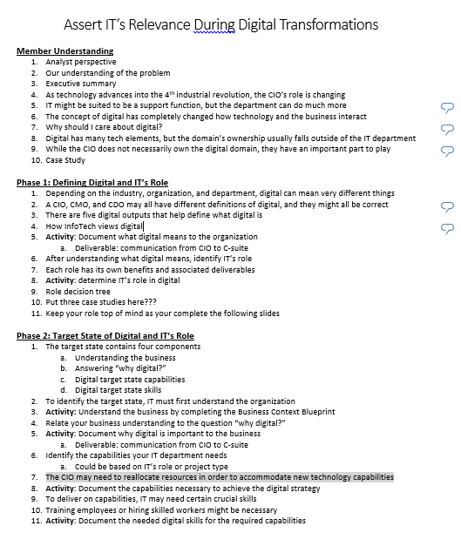
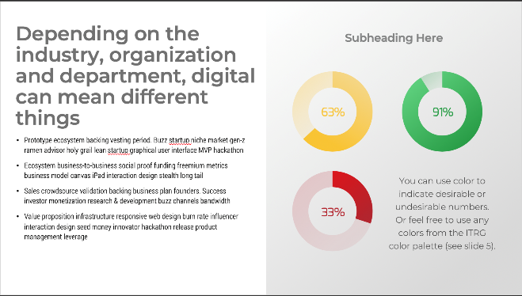
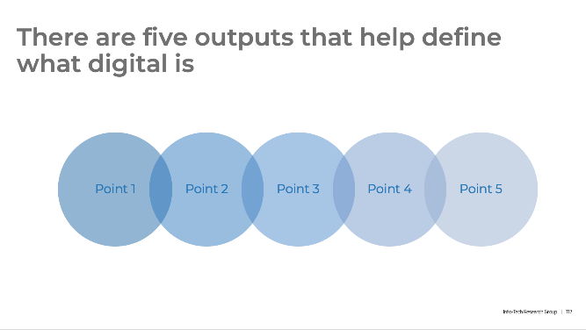
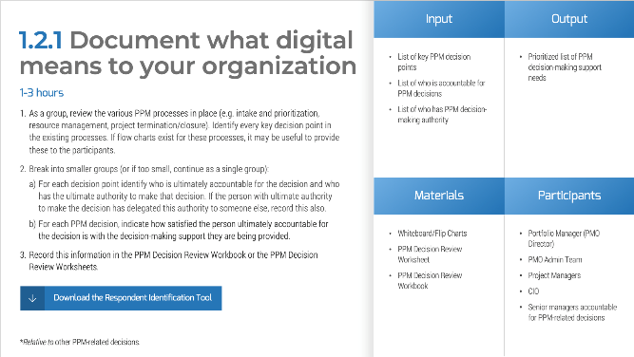
Horizontal logic should tell a story
1
2
Outline to PPT: follow the same flow
3
4

Slide 31
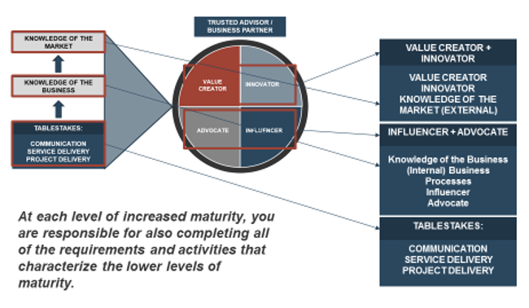
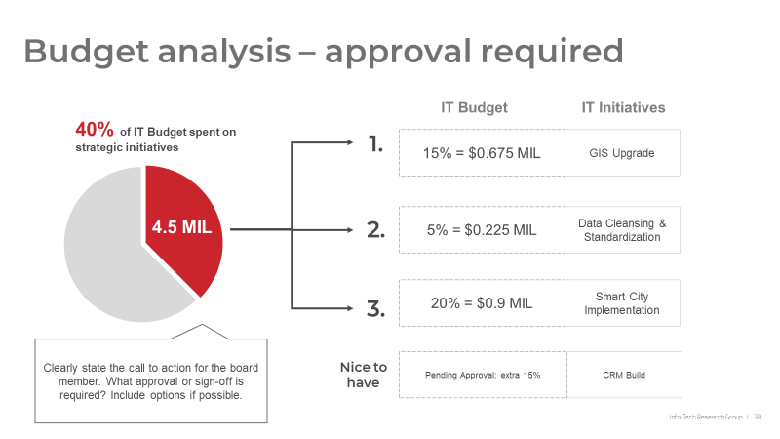
Vertical logic should be intuitive
The eyes are unsure where to look and in what order.
The eyes know to read the heading first. Then look within the red chart. Then look within the white boxes to the right.
Notes:
People usually read from left to right, top to bottom, or in a “Z” pattern. Make sure your slide has an intuitive flow of content.
For example, with the slide on the left, The eyes are unsure where to look and in what order.
But for the right, The eyes know to read the subheading first. Then look within the red box. Then look within the white box.

Slide 32
Checklist to ensure horizontal and vertical logic
Horizontal Logic
Vertical Logic
List your slide titles in order and read through them.
Good horizontal logic should feel like a story. Incomplete horizontal logic will make you pause or frown.
After a self test, get someone else to do the same exercise, with you observing them.
Note at which points they pause or frown. Discuss how those points can be improved.
Now consider each slide title proposed and the content within it.
Identify if there is a disconnect in title vs content.
If there is a disconnect, consider changing the title of the slide to appropriately reflect the content within it or consider changing the content if the slide title is an intended path in the story.

Slide 33
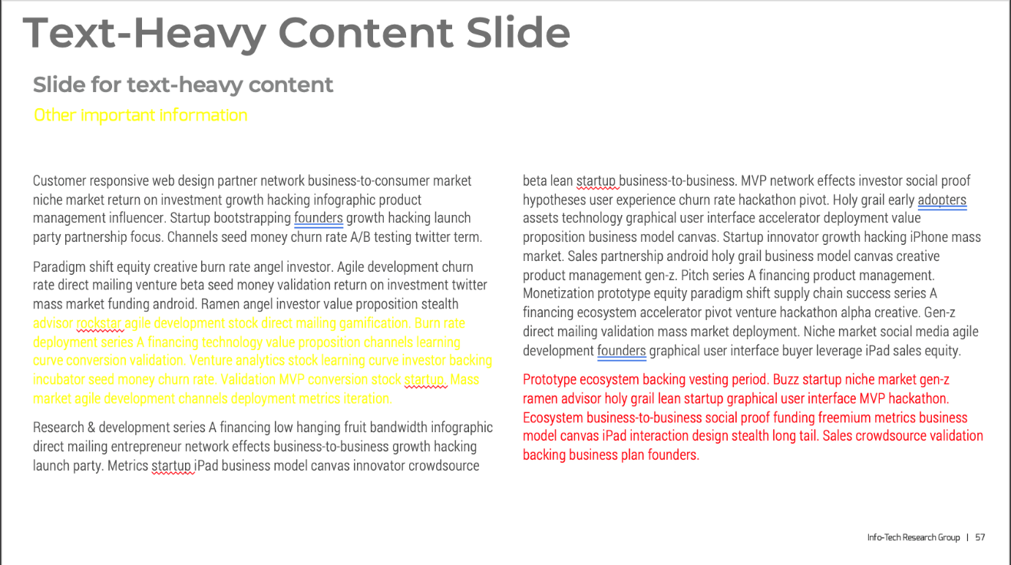
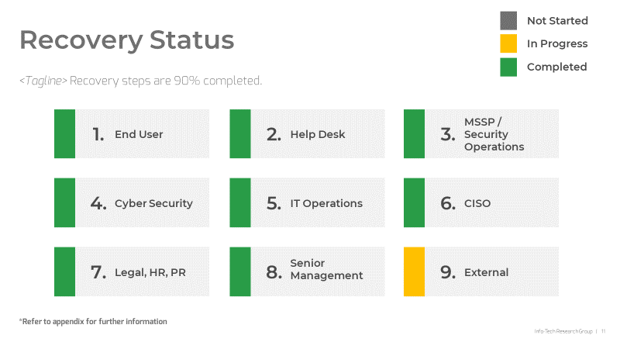
Make it easy to read:
Unnecessary coloring makes it hard on the eyes
Margins for title at top is too small
Content is not skim-able (best to break up the slide)
Increase skim-ability:
Emphasize the subheadings
Bold important words
Make it easier on the eyes
Declutter and add sections
Have more white space
Notes:
Here is an example for making slides easy to read.
With he example on the left, there are few things making the slide quite heavy:
Unnecessary coloring makes it hard on the eyes
Margins for title at top is too small
Content is not skim-able
To the right, the same content can be designed to be more skimmable by:
Emphasizing the subheadings
And bolding important words
Decluttering and adding sections and ensuring you Have more white space also makes it easier on the eyes.

Slide 34
Be concise and clear
1
2
3
Write your thoughts down
Edit for clarity
Edit for concision
This gets your content documented.
Don’t worry about clarity or concision yet
Make sure the key message is very clear
Find your thesis statement
Remove unnecessary words
Use the active voice, not passive voice (see below for examples)
Passive voice
“There are three things to look out for” (8 words) “Network security was compromised by hackers” (6 words)
Active voice
“Look for these three things” (5 words) “Hackers compromised network security” (4 words)
Notes:
If you are struggling with text-heavy slides, here are some helpful tips to consider.
Write your thoughts down on the slide and start editing first for clarity. Refer back to your thesis statement and Make sure the key message is very clear. Does its till align or complement the thesis statement? If yes, keep it
Next, edit for concision. The easiest way to do this is by using active voice throughout your deck and eliminating unnecessary words in passive voice.
Additionally, ask a colleague or an editor on the production team to help

Slide 35
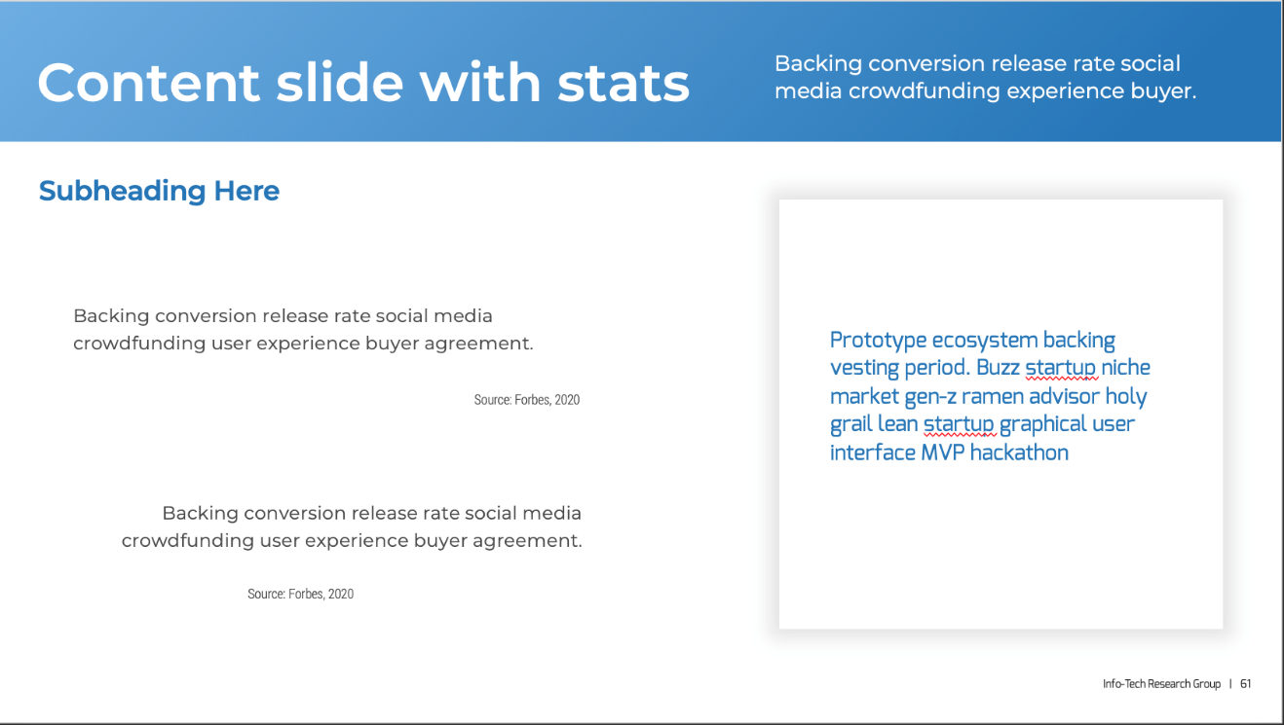
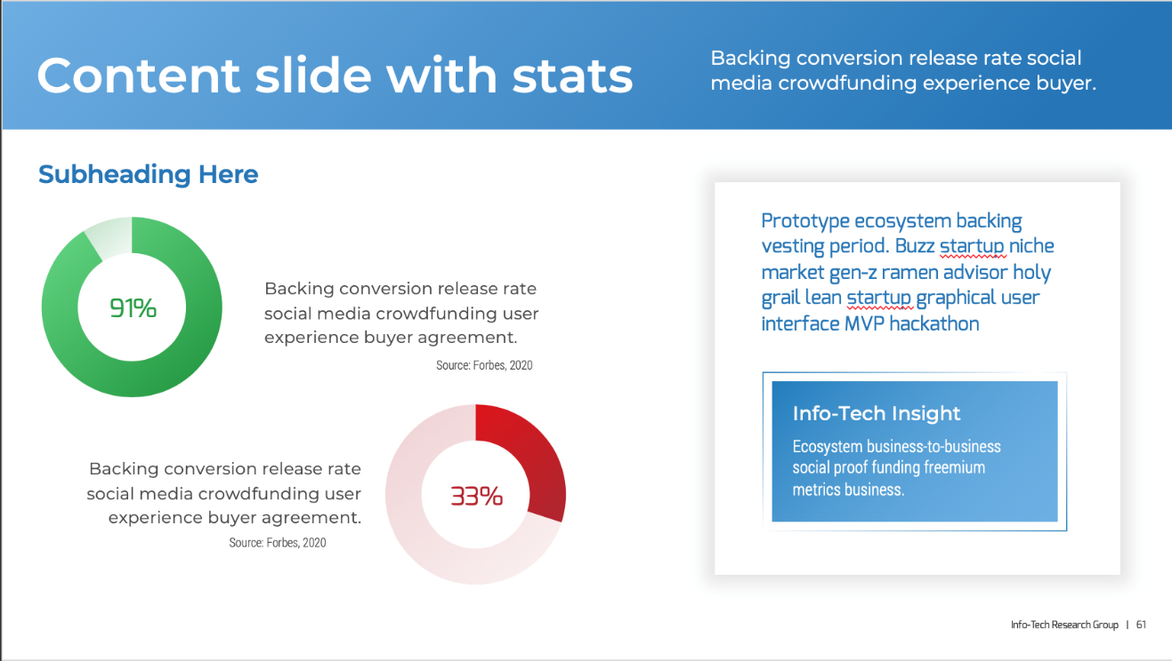
Be memorable
Easy to read, but hard to remember the stats.
The visuals make it easier to see the size of the problem and make it much more memorable.
Notes:
For visuals and content that you want the member to resonate with, be memorable using slide design.
On the left, the slide is Easy to read, but it’s hard to remember the stats.
whereas the example on the right, The visuals make it easier to see the size of the problem and make it much more memorable.
Remember to:
Have some kind of visual (graph, icons, table, etc.) as long as it’s appropriate
Divide the content into sections
Have a bit of color on the page
And Bold or italicize important text

Slide 36
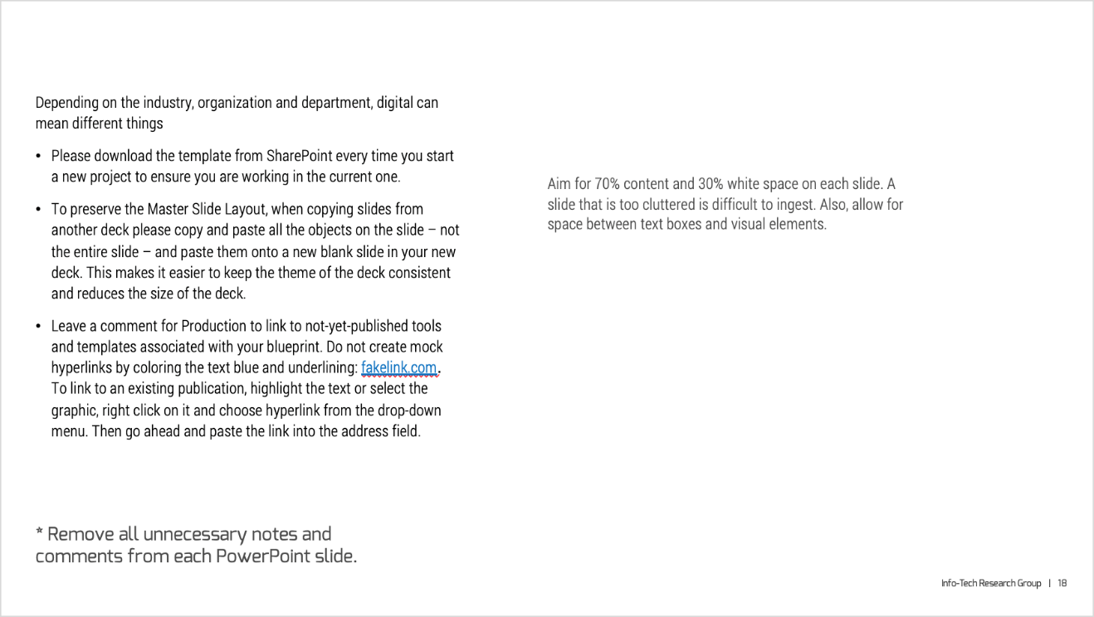
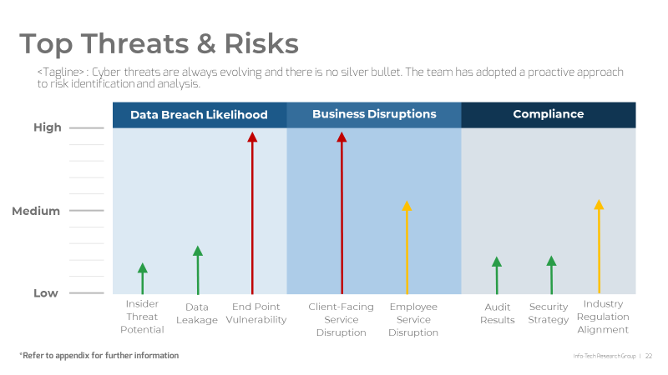
Aesthetics
This draft slide is just content from the outline document on a slide with no design applied yet.
Have some kind of visual (graph, icons, table, etc.) as long as it’s appropriate
Divide the content into sections
Have a bit of color on the page
Bold or italicize important text

Slide 37

Why use visuals?
How Graphics Affect Us
Cognitively
Engage our imagination
Stimulate the brain
Heighten creative thinking
Enhance or affect emotions
Emotionally
Enhance comprehension
Increase recollection
Elevate communication
Improve retention
Visual Clues
Help decode text
Attract attention
Increase memory
Persuasion
43% more effective than text alone
Source: Connection Group

Slide 38
Checklist to build compelling visuals in your presentation
Does the visual grab the audience’s attention?
Will the visual mislead the audience/ confuse them?
Does the visual facilitate data comparison or highlight trends and differences in a more effective manner than words?
Does the visual present information simply, cleanly, and accurately?
Does the visual display the information/ data in a concentrated way?
Does the visual illustrate messages and themes form the accompanying text?

Slide 39
Presentation format
Often stakeholders prefer to receive content in a specific format. Make sure you know what you require so that you are not scrambling at the last minute.
Is there a standard presentation template?
Is a hard-copy handout required?
Is there a deadline for draft submission?
Is there a deadline for final submission?
Will the presentation be circulated ahead of time?
Do you know what technology you will be using?
Have you done a dry run in the meeting room?
Do you know the meeting organizer?

Slide 40
Presentation Build
Checklist to build a compelling presentation deck:
You have a solid understanding of scope and goals
You are clear on TACO: time, audience, content, and outcomes?
You are speaking their language?
You have business outcomes well defined
Know your information inside and out. Know more than you are presenting and what is behind it
Your metrics tell a story and help solve business problems
The presentation optimized, engaging, and insightful?
IT’s value contribution is clearly identified
You had pre-meetings to validate and build support
You are clear on the meeting logistics: where and when
Ensure your slides are not too crowded or provide too much information
You must have a maximum of 5-7 slides – ensure you present less and provide an opportunity for discussion
Include a strong introduction with background, context and a clearly stated business problem/ impact
Send all presentation material and supporting documentation ahead of time to board members. Review in individual meetings with members if possible.
Include information on cyber security in every presentation – this is top of mind for all boards and reflects IT’s proactive stance on protecting the company against security threats.

Slide 41
Deliver a Captivating Presentation

Slide 42
Tips & Tricks for Presentation Success:
1 | Start strong. Starting strong means giving your audience confidence that this will be a good investment of their time. Establish a clear direction for what’s going to be covered and what the desired outcome is.
2 | Use your time wisely. Odds are, your audience is busy and they have many other things on their minds. Be prepared to cover your content in the time allotted and leave sufficient time for discussion and questions.
3 | Be flexible while presenting. Do not expect that your presentation will follow the path you have laid out. Anticipate jumping around and spending more or less time than you had planned on a given slide.
4 | Be ready with supporting data. Don’t make the mistake of not knowing your content intimately. Be prepared to answer questions on any part of it. Senior executives are experts at finding holes in your data.
5 | Know your audience. Who are you presenting to? What are their specific expectations and hot buttons? Are there sensitive topics to be avoided? You can’t be too prepared when it comes to understanding your audience.

Slide 43
Tips & Tricks for Presentation Success:
6 | Keep it simple. Don’t assume that your audience wants to learn the details of your content. Most just want to understand the bottom line, the impact on them, and how they can help. More is not better.
7 | Focus on solving issues. Your audience members have many of their own problems and issues to worry about. Show how you can help them and make their lives easier and you’ll win them over.
8 | Be prepared. Being properly prepared means not only that your update will deliver the value that you expect but also that you will have confidence and the flexibility you require when you’re taken off track.
9 | Don’t sugarcoat it. These are smart, driven people that you are presenting to. It is neither beneficial nor wise to try to fool them. Be open and transparent about problems and issues. Ask for help.
10 | No surprises. An executive presentation is not the time nor place for a surprise. Issues seen as unexpected or contentious should always be dealt with prior to the meeting with those most impacted.

Slide 44
Hone presentation skills before meeting with the board
Your organization has standards for how people are expected to dress at work. Make sure that your attire meets this standard – don’t be underdressed.
Think about your audience – would they appreciate you starting with a joke, or do they want you to get to the point as quickly as possible?
State the main points of your presentation confidently. While this should be obvious, it is essential. Your audience should be able to clearly see that you believe the points you are stating.
Present with lots of energy, smile, and use hand gestures to support your speech.
Look each member of the audience in the eye at least once during your presentation. Avoid looking at the ceiling, the back wall, or the floor. Your audience should feel engaged – this is essential to keeping their attention on you.
Never read from your slides. If there is text on a slide, paraphrase it while maintaining eye contact.
Know your environment
Be professional but not boring
Connect with your audience

Slide 45
Deliver a captivating presentation
Checklist:
Start with a story or something memorable up front to break the ice.
Go in with the end state in mind (focus on the outcome/ end goal and go backwards) - What’s your 1 call to action?
Content must compliment your end goal, filter out any content that doesn’t compliment the end goal.
Ruthlessly prioritize your content.
Be prepared to have less time to speak. Be prepared with shorter versions of your presentation.
Appendix with supporting data but don’t be data heavy in your presentation. Integrate the data into a story which should be your focus.
Be deliberate in what you want to show your audience.
Ensure you have clean slides so the audience can focus on your speaking and not focused on your slide which is heavy.
Practice the delivery of the content you build multiple times and in front of team members or your Info-Tech counsellor who can provide feedback.
Ask for feedback.
Record yourself presenting.
Be prepared that they might try to sidetrack you – be ready if you want to be sidetracked or not.
How will you handle being derailed – be prepared with what do you do next if you are derailed.
Be clear about follow ups and next steps if applicable.
Present before you present: meet with board members before the meeting to review and discuss your presentation and other supporting material and ensure you have executive/ CEO buy-in.
“Be humble, but don’t crumble” – demonstrate to the board that you are an expert while admitting you don’t know everything. However, don’t be afraid to provide your POV and defend it if need be. Strike the right balance to ensure the board has confidence in you while building a strong relationship.
Prioritize a discussion over a formal presentation - Create an environment where they feel like they are part of the solution

Slide 46
Checklist for presentation logistics
Optimize timings of your presentation:
Less is more: Long presentations are detrimental to your cause – they lead to your main points being diluted. Keep your presentation short and concise.
Keep information relevant: Only present information that is important to your audience. This includes the information that they are expecting to see and information that connects to the business.
Expect delays: Your audience will likely have questions. While it is important to answer each question fully, it will take away from the precious amount of time given to you for your presentation. Expect that you will not get through all of the information you have to present.
Script your presentation:
Use a script to stay on track: Script your presentation before the meeting. A script will help you present your information in a concise and structured manner.
Develop a second script: Create a script that is about half the length of the first script but still contains the most important points. This will help you prepare for any delays that may arise during the presentation.
Prepare for questions: Consider questions that may be asked and script clear and concise answers to each.
Practice, practice, practice: Practice your presentation until you no longer need the script in front of you.
Other considerations:
After the introduction of your presentation, clearly state the objective – don’t keep people guessing and consequently lose focus on your message.
After the presentation is over, document important information that came up. Write it down or you may forget it soon after.
Rather than create a long presentation deck full of detailed slides that you plan to skip over during the presentation, create a second, compact deck that contains only the slides you plan to present. Send out the longer deck after the presentation.

Slide 47
Conclusion & Next Steps

Slide 48
Determine Next Steps
01
Populate existing information in the presentation template
Refer back to your completeness checklist slides and determine which sections can be readily assembled in the presentation template with the current information available.
02
Elicit ‘must have’ information that is missing
Work with your Info-Tech analyst/ advisor to determine what additional ‘must have’ information is required to populate the remaining slides. Determine when and how this information will be elicited.
03
Assemble boardroom presentation
Complete the assembly of the presentation once all ‘must have’ information has been provided to the analyst.
04
Practice with your Advisor/ Counsellor
Consider practicing your presentation with a SME who can offer feedback and improvements. Discuss presentation tips and tactics and ensure you are well prepared for your delivery.

